Slide 1
RDF and Linked Data
Jenn Riley
Head, Carolina Digital Library and Archives
The University of North Carolina at Chapel Hill

Slide 2
21st century information landscape
Everything interconnected
Build on others’ data
Semantic Web
  Think of it as authority files on steroids
  It’s all very meta

Slide 3
Linked Data
Use URIs as names for things
Use HTTP URIs so that people can look up these names
When someone looks up a URI, provide useful information, using standards
Include links to other URIs, so that they can discover more things
Tim Berners-Lee, Linked Data – Design Issues
http://www.w3.org/DesignIssues/LinkedData.html

Slide 4
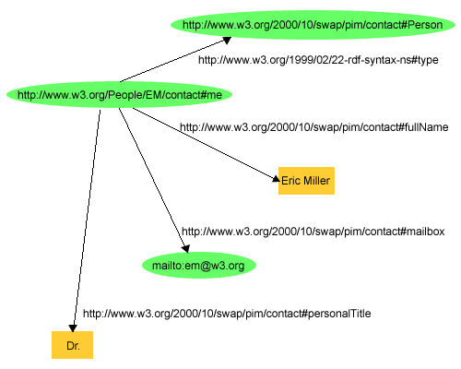
The RDF data model is a graph
From RDF Primer http://www.w3.org/TR/rdf-primer/

Slide 5
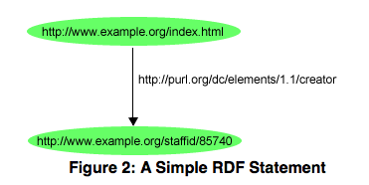
Graphs are made up of triples
This is a “statement,” aka a “triple”. A statement is made in a particular direction.
subject
predicate
object
From RDF Primer http://www.w3.org/TR/rdf-primer/

Slide 6
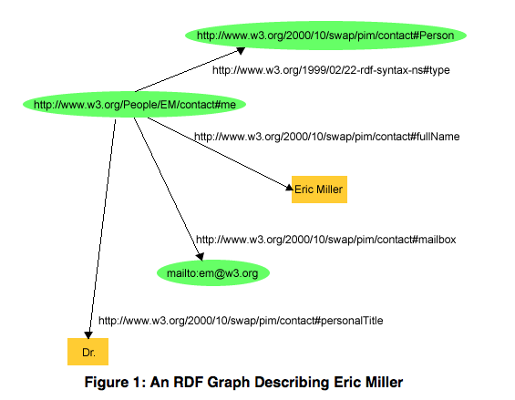
The centrality of URIs in RDF
RDF uses URIs to identify:
individuals, e.g., Eric Miller, identified by http://www.w3.org/People/EM/contact#me
kinds of things, e.g., Person, identified by http://www.w3.org/2000/10/swap/pim/contact#Person
properties of those things, e.g., mailbox, identified by http://www.w3.org/2000/10/swap/pim/contact#mailbox
values of those properties, e.g. mailto:em@w3.org as the value of the mailbox property (RDF also uses character strings such as "Eric Miller", and values from other datatypes such as integers and dates, as the values of properties)
Figure and text from RDF Primer
<http://www.w3.org/TR/rdf-primer/>

Slide 7
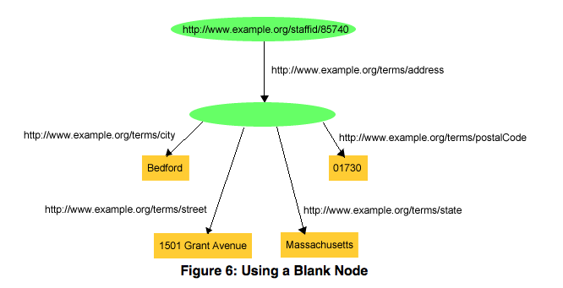
Blank nodes
This blank node stands in for “John Smith’s address”
Figure from RDF Primer
<http://www.w3.org/TR/rdf-primer/>
Notes:
Subjects and objects can be blank nodes; but predicates cannot be.
Another example: a book is by Jane Smith. Book hasAuthor Jane Smith OK, but better would be Book hasAuthor (blank node for person); (blank node for person) hasName Jane Smith

Slide 8
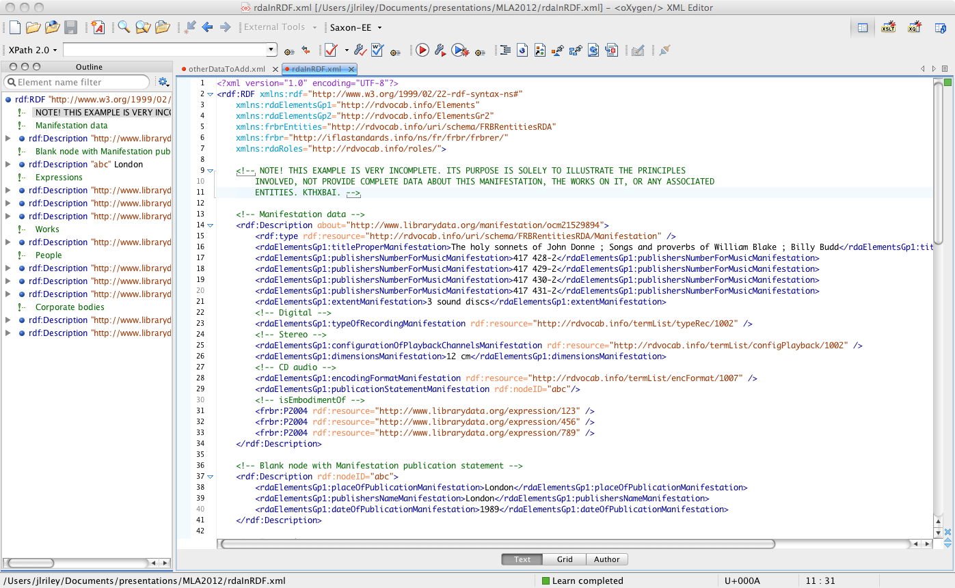
Encoding a graph into data

Slide 9
Woah. Really?!?
Nobody is meant to create this data in this form directly. Really.
Libraries encoding data in this form opens up enormous possibilities for us to participate in the wider information community.
Let’s explore that idea.

Slide 10
This is the last of the XML, I promise.

Slide 11
Some realities of RDF that scare us
No predetermined set of properties to care about
No guarantee that the same person/item/place/whatever are always referred to with the same URI
No inherent mechanism/requirement for vetting properties, URIs, etc
But let’s be frank here. Are our library/archive/museum records really:
  Complete?
  Authoritative?
  Consistent?
  Accurate?
  All that functional for what we want to do?

Slide 12
Other important features of the Semantic Web/Linked Data environment
The RDF graph model is the most important thing; encoding triples in a specific syntax is secondary
The concept of a “record” isn’t really meaningful when looking at the information world as a graph
Open world assumption
Many vocabularies, with connections between them
Expectation that implementations will deal with data from multiple sources
Reasoners

Slide 13
How do you…
find all the triples you need?
know what predicates and URIs to use when creating new triples?
know what predicates and URIs to use when processing data?

Slide 14
Infrastructure that we’ll need
Ways to identify trusted data sources
Ways to identify and understand properties and classes defined by others
Best practices for data caching
Actual shared cataloging
  We’ll need to stop downloading records. I mean that.
Better data creation, management, sharing, and exposure systems
  Ones that actually work
Library community best practices on where to scope our data creation efforts

Slide 15
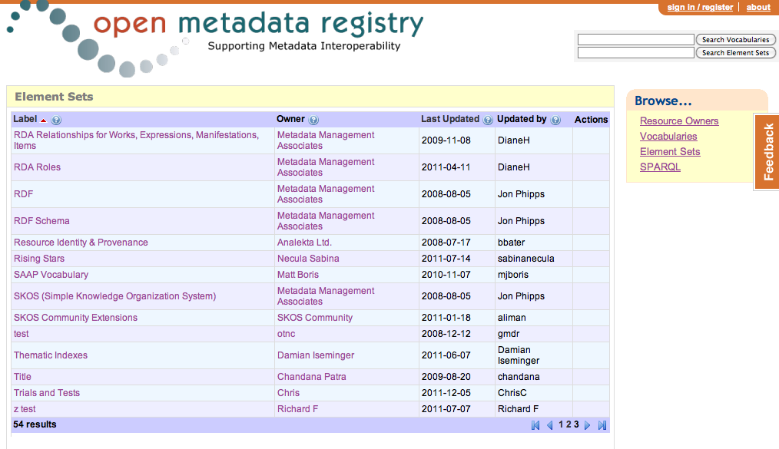
Here’s one part of that emerging infrastructure

Slide 16
Large Linked Data initiatives to watch
Named graphs, RDF spaces
  “standard model with formal semantics for systems which manage multiple collections of RDF data”
Provenance WG
Also watch DC-Architecture

Slide 17
What the library community is doing
Exposing authority (and more recently bibliographic) data, and vocabularies as Linked Data
W3C Linked Library Data Incubator Group
Stanford Linked Data Technology Plan
RDA as data elements in Open Metadata Registry
  Still dancing around official endorsement
LC Bibliographic Framework Transition Initiative
  “The new bibliographic framework project will be focused on the Web environment, Linked Data principles and mechanisms, and the Resource Description Framework (RDF) as a basic data model.” (From http://www.loc.gov/marc/transition/news/framework-103111.html)
  http://www.bibframe.org

Slide 18
My burning question
What would it mean for libraries to be LD consumers, and not just publishers?

Slide 19
Thanks!
jennriley@unc.edu
These slides: http://www.lib.unc.edu/users/jlriley/presentations/nccu/13spring/rdfNCCU.pptx
W3C LLD Incubator Group final report: http://www.w3.org/2005/Incubator/lld/XGR-lld-20111025/
Stanford Linked Data Technology Plan: http://www.clir.org/pubs/reports/pub152/LDWTechDraft_ver1.0final_111230.pdf
Open Metadata Registry: http://metadataregistry.org
Hillmann, Diane, Karen Coyle, Jon Phipps, and Gordon Dunsire. (January/February 2010) “RDA Vocabularies: Process, Outcome, Use.” D-Lib Magazine 16, no. 1/2. http://dlib.org/dlib/january10/hillmann/01hillmann.html

