Slide 1
What every librarian needs to know about digital collections
Jenn Riley, Head, Carolina Digital Library and Archives

Slide 2
Words to the Wise
Digitization is the easy part
Effective digital programs involve staff from many places within the library
Transfer policies and approaches from the analog whenever possible
Effective participants in DL teams:
Come from diverse backgrounds
Learn as they go
Think analytically
Have technical aptitude, but aren’t necessarily programmers
Make good decisions about when to reuse and when to build anew

Slide 3
Some types of digital projects
Digitized collections
Online reference sources
Scholarly texts
Online publishing

Slide 4
Digitized collections

Slide 5
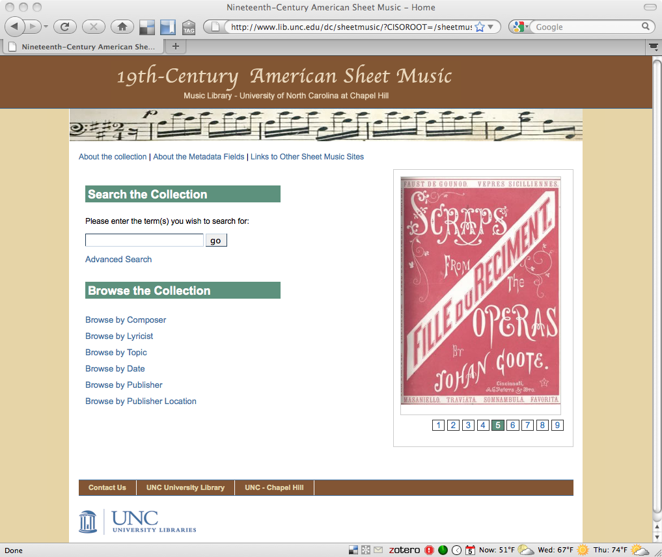

Slide 6
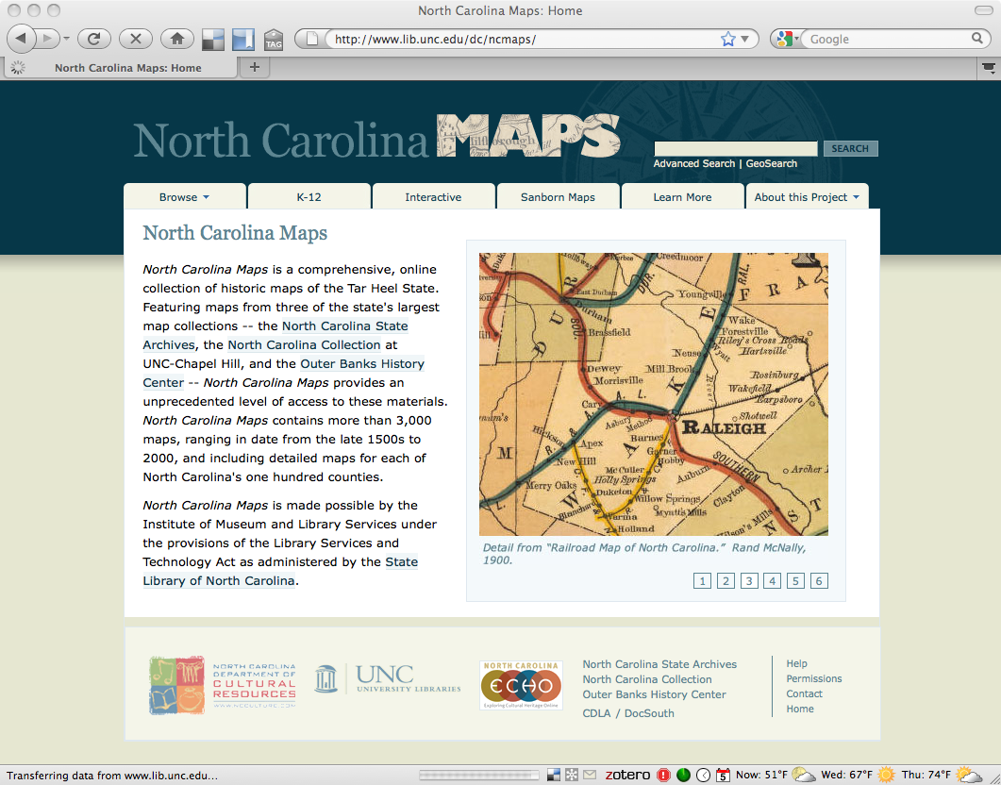

Slide 7
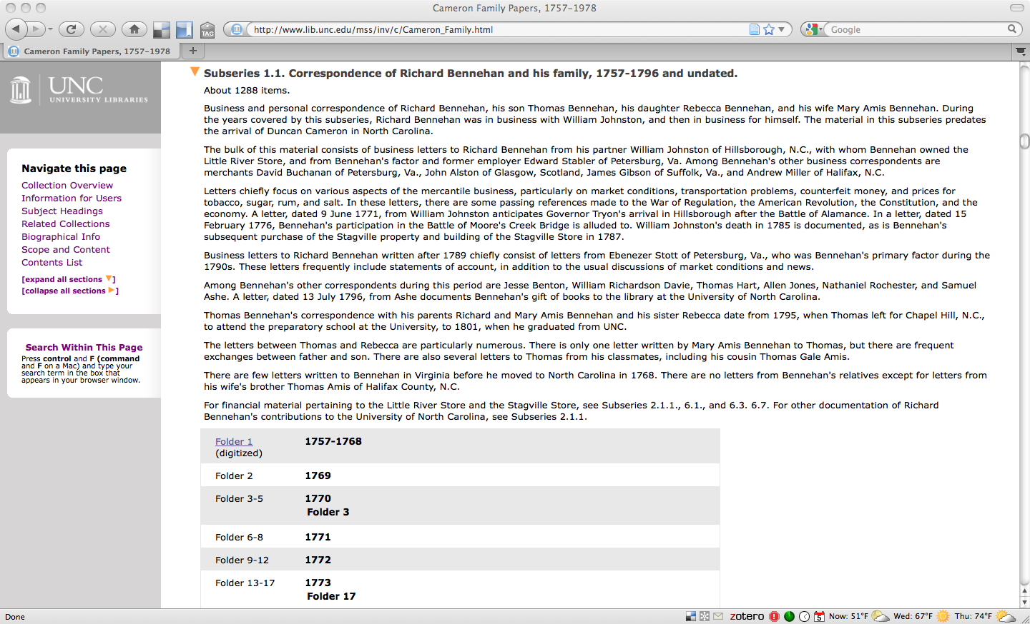

Slide 8
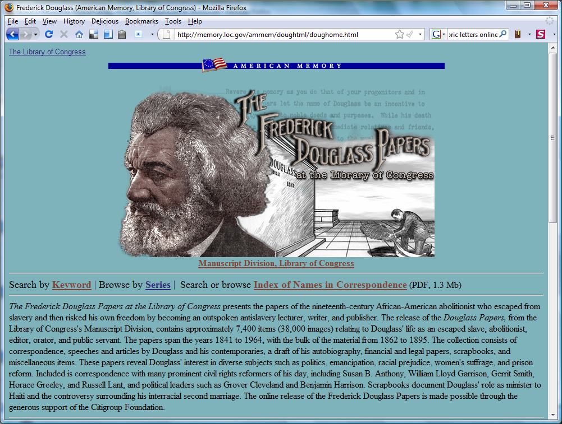

Slide 9
Subject specialist contributions to digitized collections
Selection between and within collections
Input into:
Definition of primary and secondary user communities
User discovery needs
Metadata model
Delivery mechanisms
Identify related collections
Facilitate collaboration with other institutions

Slide 10
Online reference sources

Slide 12
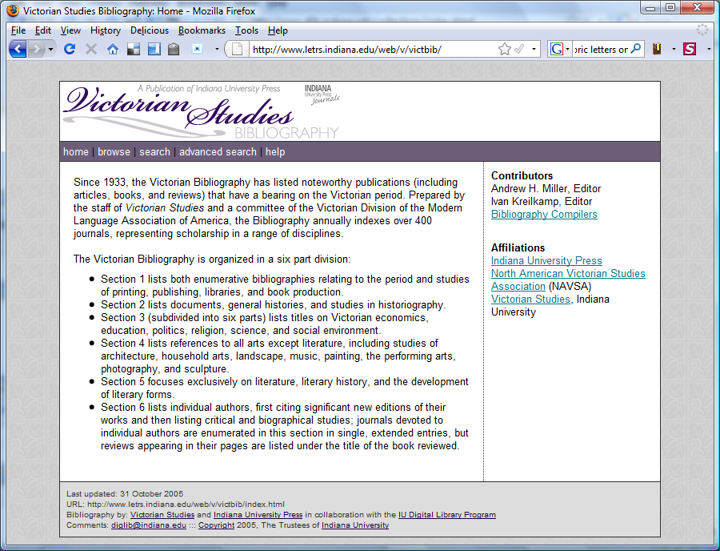

Slide 14
Subject specialist contributions to online reference sources
Identify existing print resources to convert
Identify need for new reference sources
Make connections with appropriate scholars and publishers in the subject area
Input into:
Definition of primary and secondary user communities
User discovery needs
Metadata model
Delivery mechanisms
Facilitate collaboration with other institutions

Slide 15
Scholarly texts

Slide 16
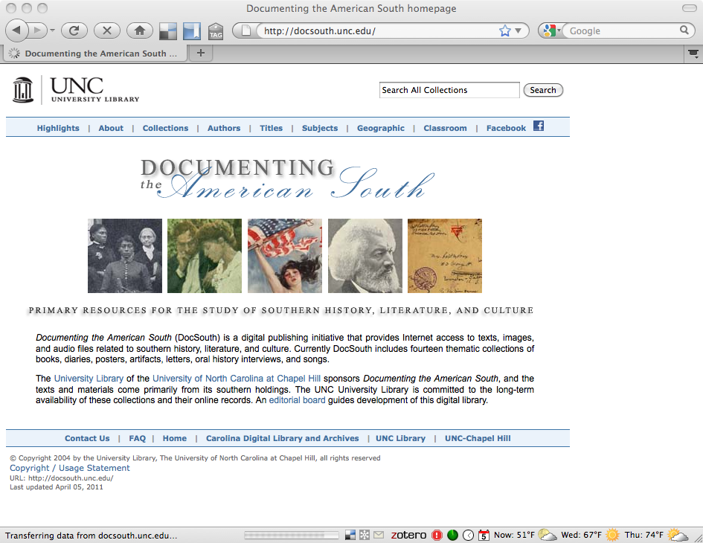

Slide 17
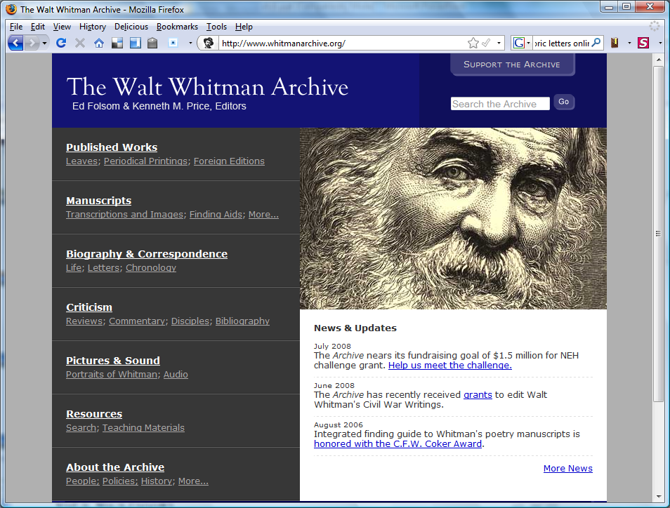

Slide 18
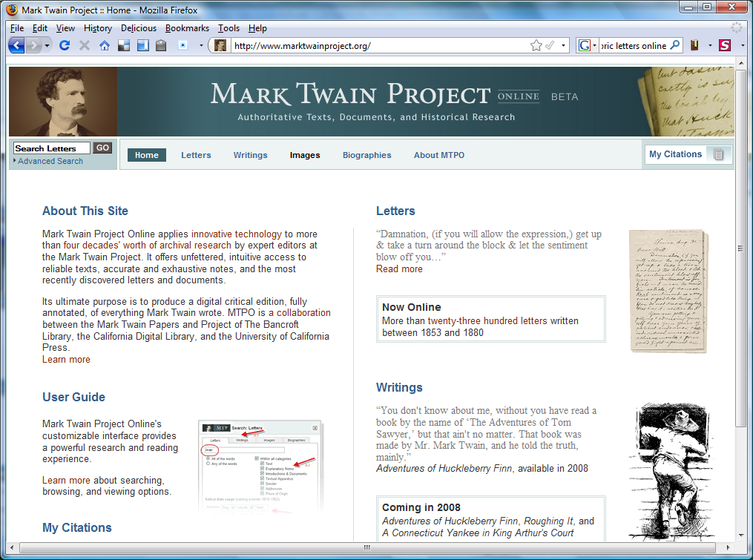

Slide 19
Subject specialist contributions to scholarly texts
Selection
Interpretation of texts as part of the encoding process
Make connections with appropriate scholars and publishers in the subject area
Input into:
Definition of primary and secondary user communities
User discovery needs
Metadata model
Delivery mechanisms
Facilitate collaboration with other institutions

Slide 20
Online publishing

Slide 21
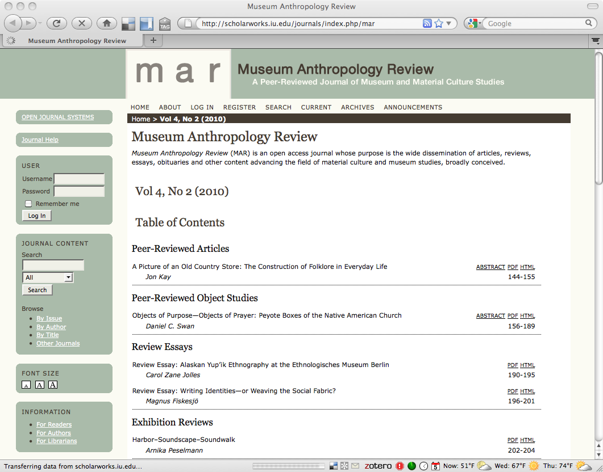

Slide 22
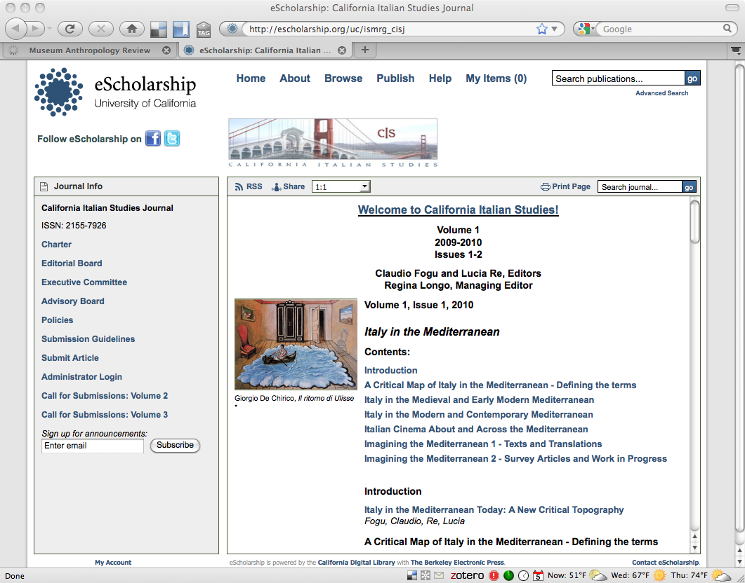

Slide 23
Subject specialist contributions to online publishing
Make connections with appropriate scholars and publishers in the subject area
Shape and lead the ongoing transformation in scholarly communication
Input into:
Definition of primary and secondary user communities
User discovery needs
Metadata model
Delivery mechanisms
Facilitate collaboration with other institutions

Slide 24
Moving from Project to Program
No longer enough to just put a few resources online
No longer enough to have all DL work done in one department
Collaborative efforts are becoming the norm
Efficiencies of scale
Involving new types of partners / expanding opportunities
Less duplication of effort

Slide 25
Are you ready?
Libraries and librarianship are changing.
We increasingly produce information rather than simply providing access to it.
Our work is more collaborative than ever.
How will you contribute?

Slide 26
Thank you!
jennriley@unc.edu
These presentation slides: <http://www.lib.unc.edu/users/jlriley/presentations/uncsils/11spring/inls513.pptx>
Questions?

