Slide 1
Institutional Repositories: Policy, Scope, and direction
Jenn Riley
Head, Carolina Digital Library and Archives

Slide 2
The promise of institutional repositories
The Sound of Music. Image from IMDB.com.
Notes:
IR content
Repository manager jobs

Slide 3
And what we’ve learned is… reality is more like this.
Platoon. Image from IMDB.com.
Notes:
Lack of self-deposit
Repo lib jobs given little authority, guidance. “coordinators”
Researchers’ allegiance is with discipline, not institution
Grey lit focus sometimes more effective

Slide 4
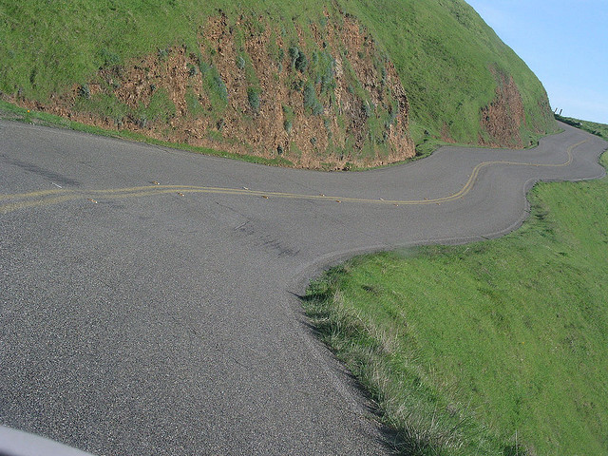
What’s next?
Image by Luiza Leite. http://www.flickr.com/photos/lleite/6608081/
Notes:
Shift to focus on services

Slide 5
Big shift to a focus on services
authors’ rights consulting
metadata preparation
journal hosting
researcher profiles
open access advocacy
bulk ingest
research data
digital humanities
digitization
did I mention data?
ETDs

Slide 6
UNC’s approach is a bit different
Began as digital preservation research effort
Added in access/IR focus along the way
3 collecting streams
Faculty research/creative work
Born-digital special collections (including university records)
Locally digitized physical library collections
Might be ready for some reshuffling
Notes:
3 streams
Never had a repo librarian
What we’re facing now

Slide 7
Subject specialists’ roles
faculty partnerships
authors’ rights consulting
needs analysis
new forms of publishing
open access advocacy
SERVICES
digital humanities
research data
referrals
did I mention data?
content recruitment

Slide 8
My opinion
IR and digital library efforts will be increasingly integrated
Repositories are going to be an important part of the evolving scholarly communication landscape
But not as central as we originally imagined
IR and related services will be increasingly distributed throughout the staff in academic libraries.
Including subject specialists.

Slide 9
Thanks!
jennriley@unc.edu
http://cdla.unc.edu
http://cdr.lib.unc.edu

