Slide 1
What every librarian needs to know about digital collections
Jenn Riley, Head, Carolina Digital Library and Archives

Slide 2
Big Lessons (1)
Digitization is the easy part
Effective digital programs involve staff from many places within the library
Transfer policies and approaches from the analog whenever possible
We haven’t solved the sustainability problem yet
  What’s the role of business planning?
  How do we effectively balance sustainability with innovation?

Slide 3
Big lessons (2)
Effective participants in DL teams
  Come from diverse backgrounds
  Learn as they go
  Think analytically
  Have technical aptitude, but aren’t necessarily programmers
  Make good decisions about when to reuse and when to build anew

Slide 4
Some types of digital initiatives
Digitized collections
Online reference sources
Scholarly texts
Online publishing
Institutional repositories

Slide 5
Digitized collections

Slide 6
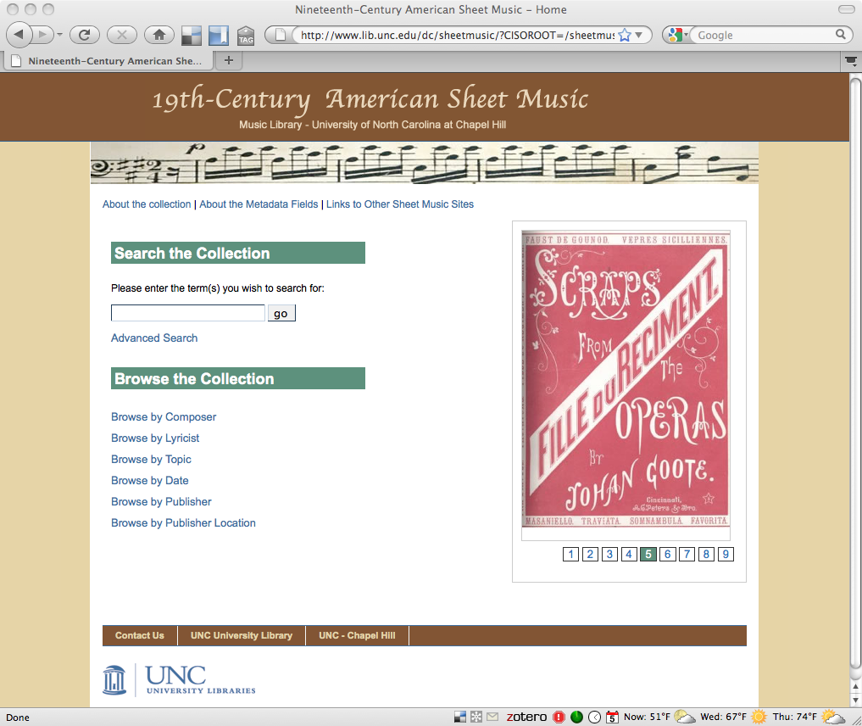

Slide 7
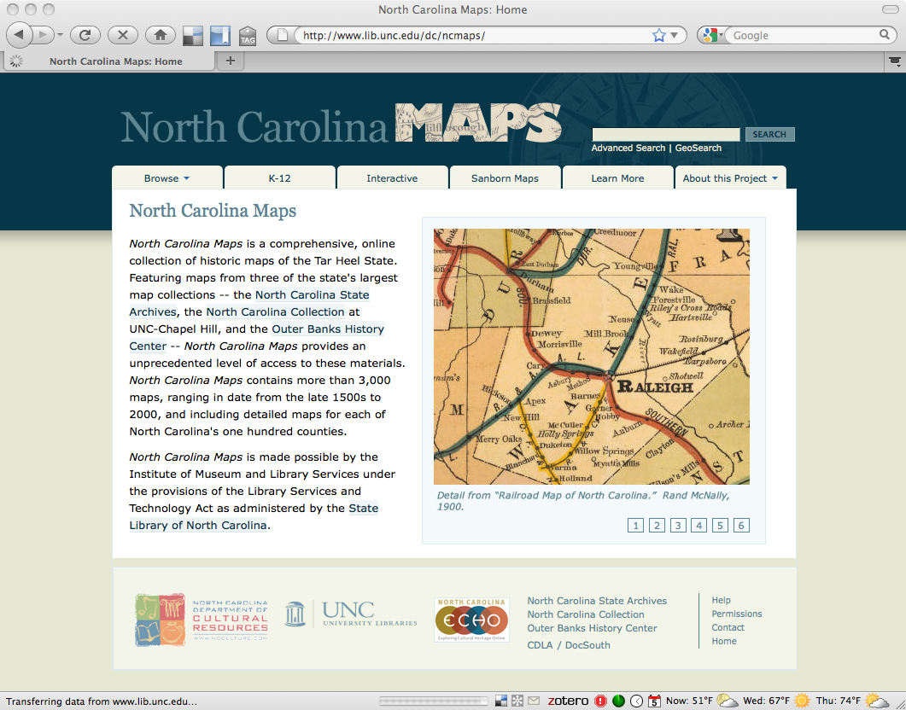

Slide 8
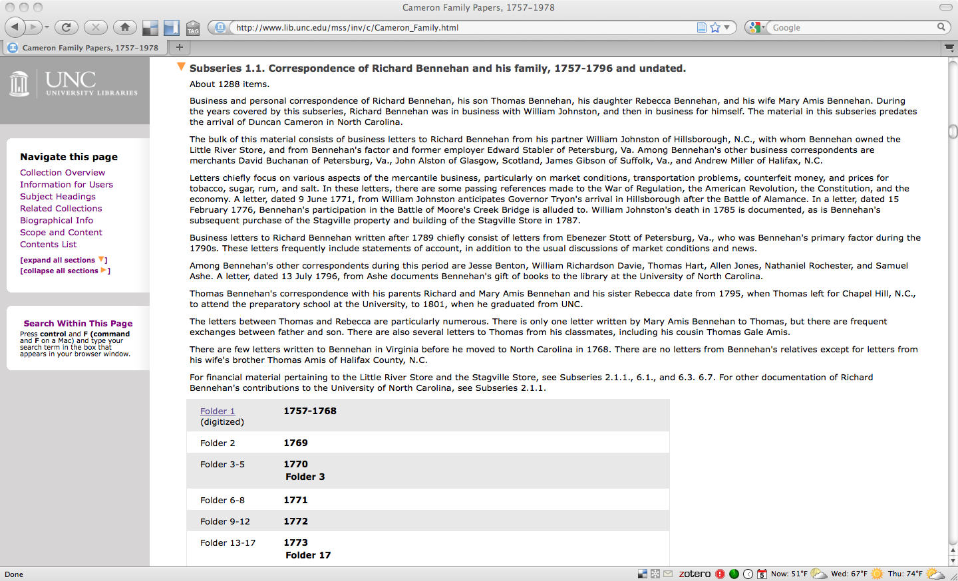

Slide 9
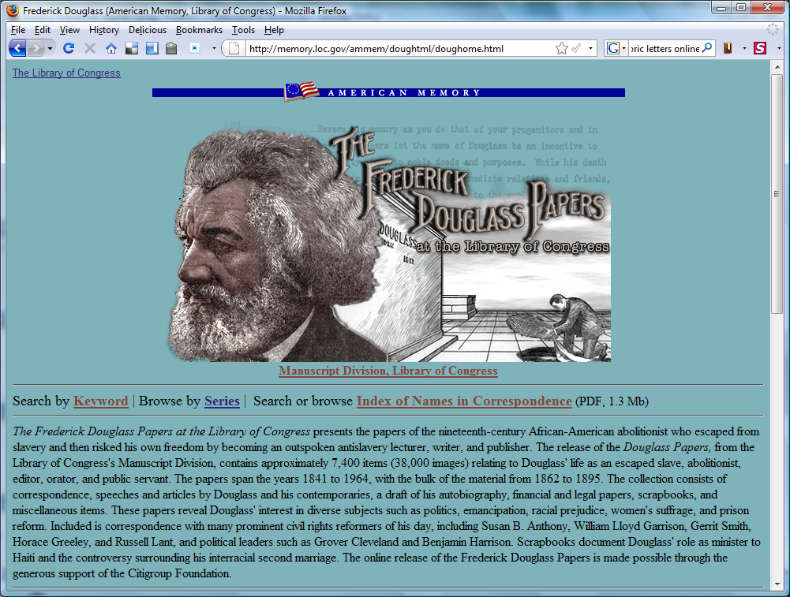

Slide 10
Online reference sources

Slide 11
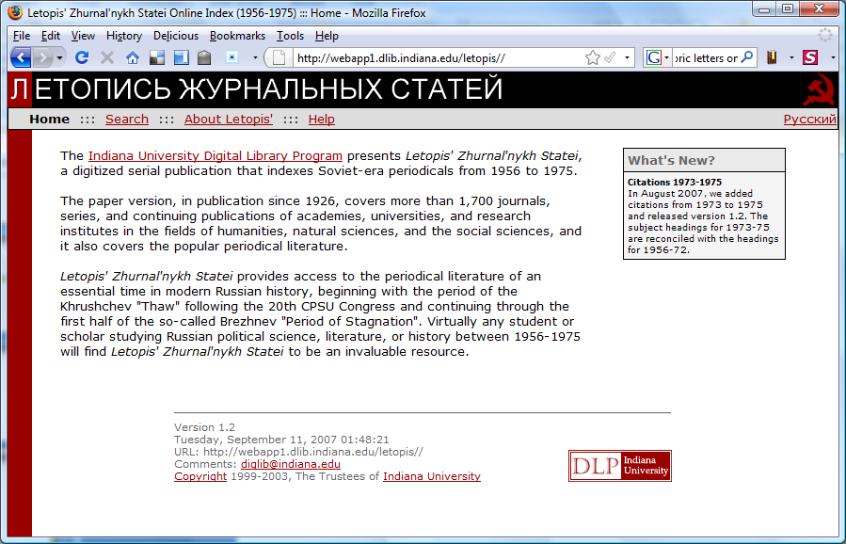

Slide 12
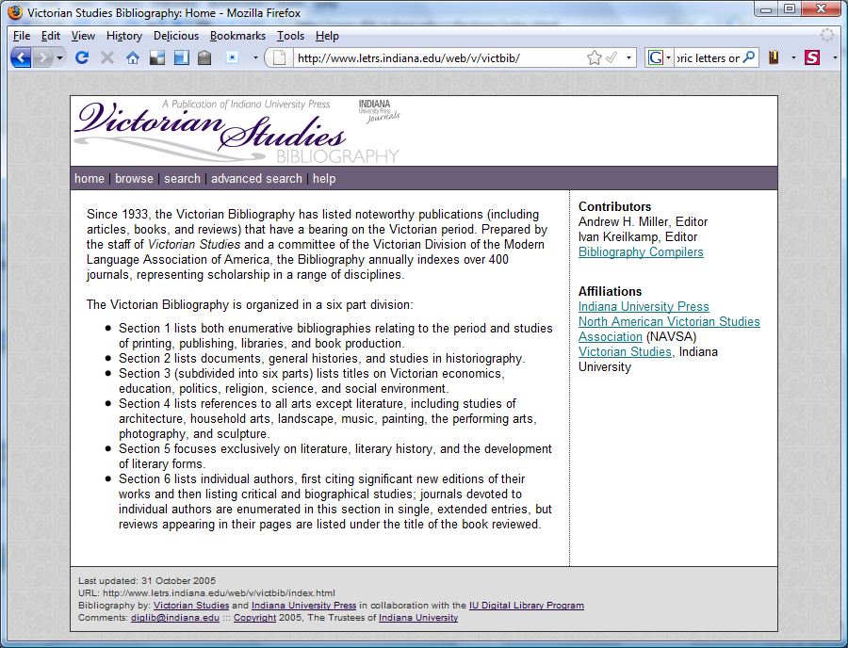

Slide 13
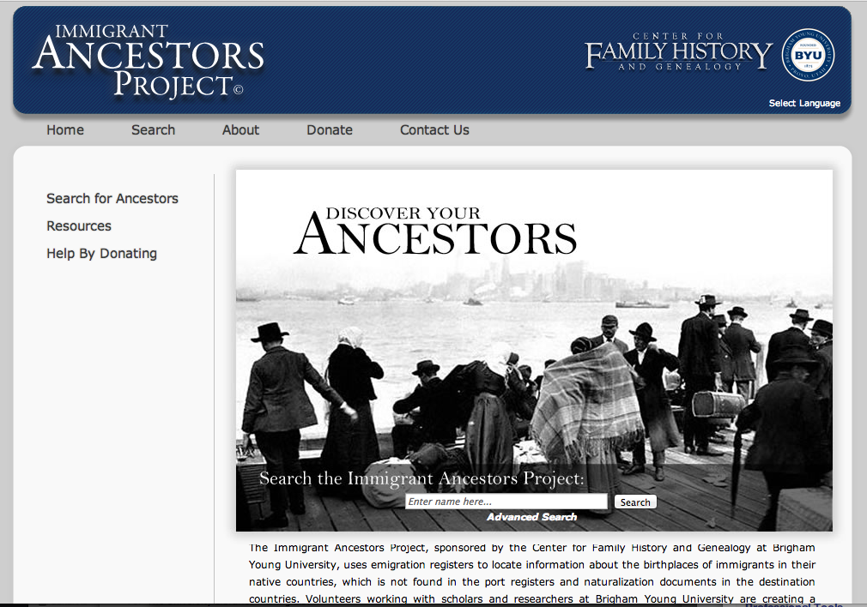

Slide 14
Scholarly texts

Slide 15
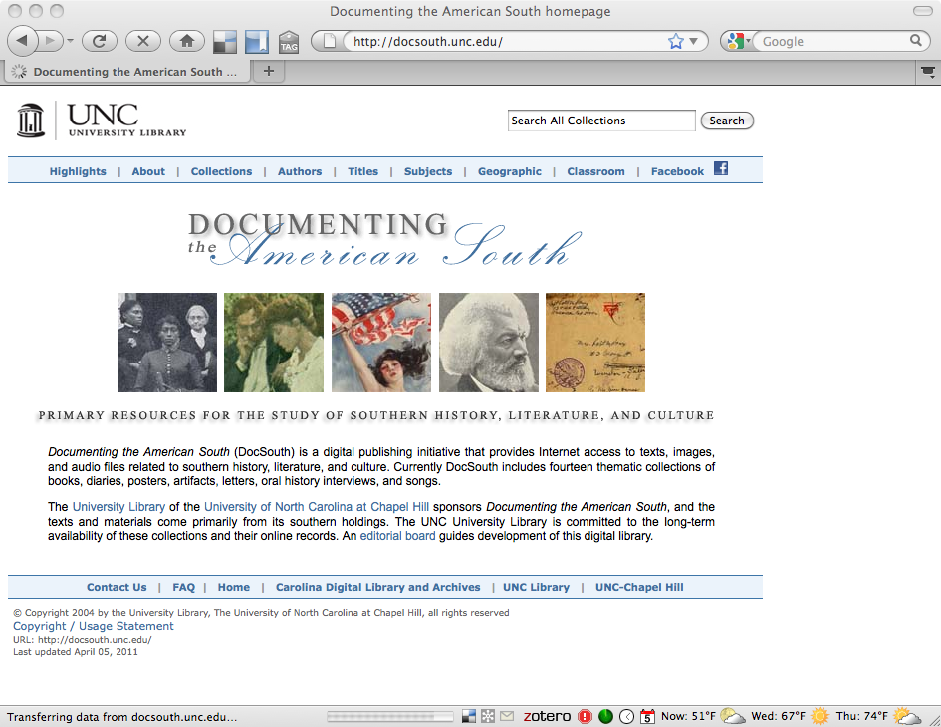

Slide 16
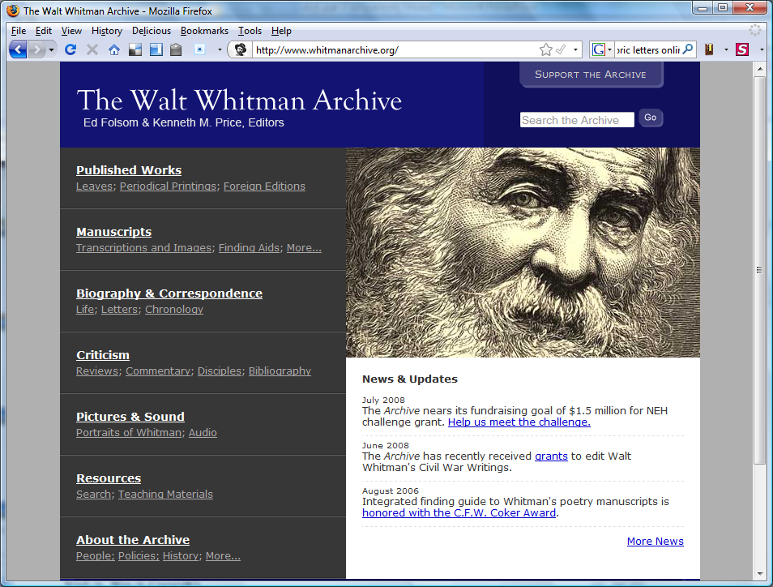

Slide 17
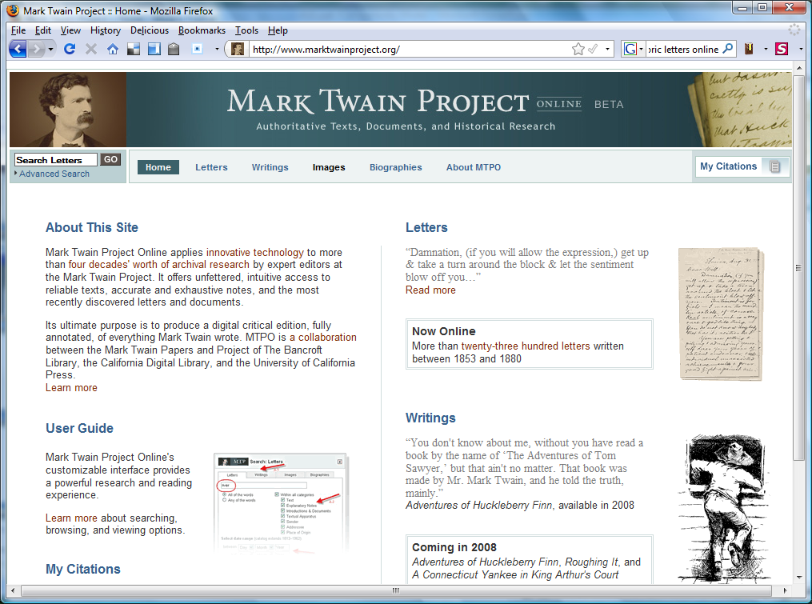

Slide 18
Online publishing

Slide 19
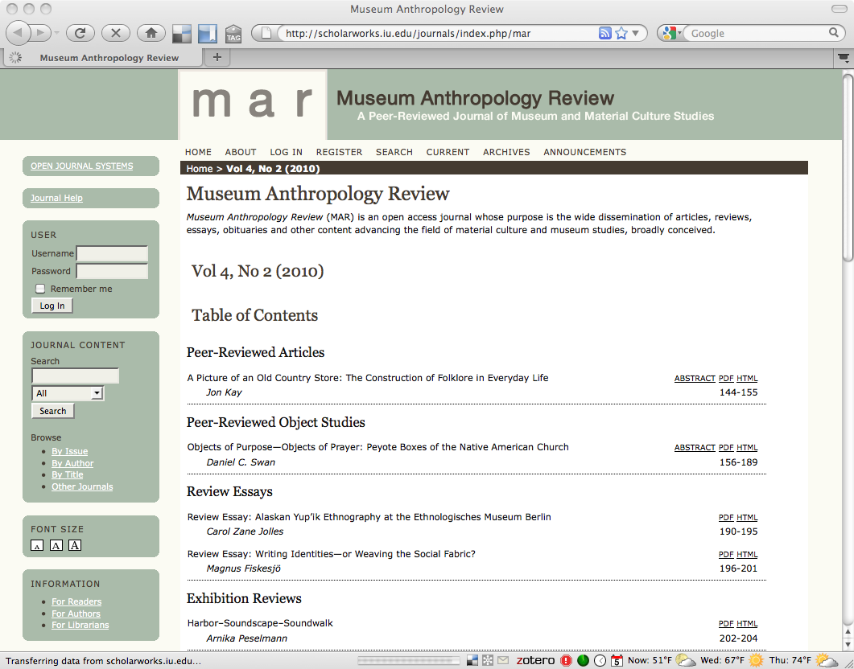

Slide 20
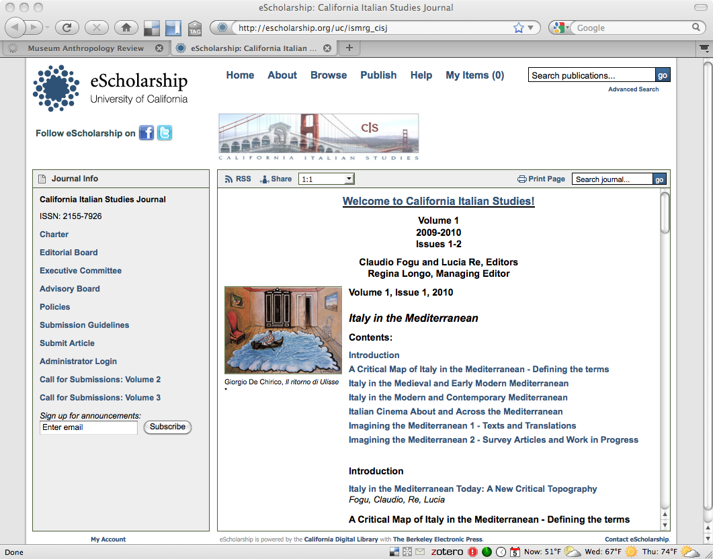

Slide 21
Institutional repositories

Slide 22
In the beginning…
Hey, libraries are really catching the raw end of this scholarly publishing deal!
I know! Let’s build a repository for pre-prints, and faculty will deposit their works there to make them more easily accessible!

Slide 23

OK, so that didn’t go so well.
Platoon.
Image from IMDB.com.
Notes:
Lack of self-deposit
Repo lib jobs given little authority, guidance. “coordinators”
Researchers’ allegiance is with discipline, not institution
Grey lit focus sometimes more effective

Slide 24
Big shift to a focus on services
authors’ rights consulting
journal hosting
metadata preparation
researcher profiles
open access advocacy
bulk ingest
research data
digital humanities
did I mention data?
digitization
ETDs

Slide 25
My opinion
Repositories are going to be an important part of the evolving scholarly communication landscape
IR and digital library efforts will be increasingly integrated
IR and related services will be increasingly distributed throughout the staff in academic libraries.
Including subject specialists.
But not as central as we originally imagined

Slide 26
Moving from Project to Program
No longer enough to just put a few resources online
No longer enough to have all DL work done in one department
Collaborative efforts are becoming the norm
  Efficiencies of scale
  Involving new types of partners / expanding opportunities
  Less duplication of effort

Slide 27
So how do we keep doing all of this?
Even the strongest connection to library and academic mission are not enough
Build business planning into the skill set of librarians
Use shared technical architectures
Be thinking about sustainability issues from the very beginning
Partner
Focus on something shorter than “forever”

Slide 28
Are you ready?
Libraries and librarianship are changing.
We increasingly produce information rather than simply providing access to it.
Our work is more collaborative than ever.
How will you contribute?

Slide 29
Thank you!
jennriley@unc.edu
These presentation slides:
<http://www.lib.unc.edu/users/jlriley/presentations/uncsils/13spring/inls513.pptx>
Questions?

