Slide 1

The Next Evolution of Library Cataloging: Finding Our Place in the 21st Century Information Ecology
Jenn Riley
Head, Carolina Digital Library and Archives
The University of North Carolina at Chapel Hill

Slide 2
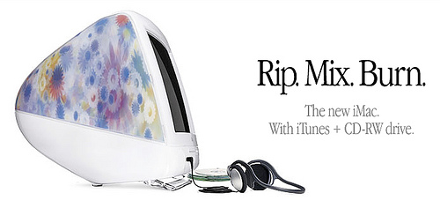
Remix culture

Slide 3
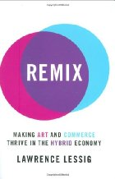
Read/Only culture
Read/Write culture

Slide 4
Libraries must acknowledge support for both RO and RW.

Slide 5
A redefined role for libraries, and our metadata

Slide 6
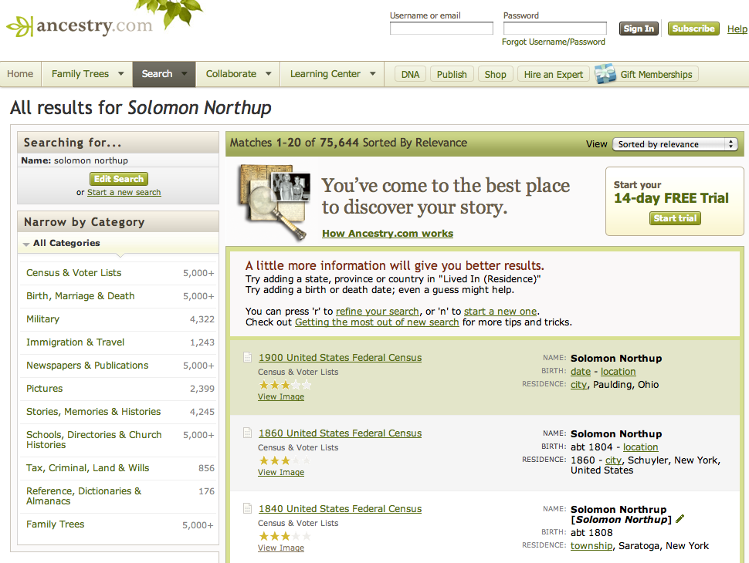
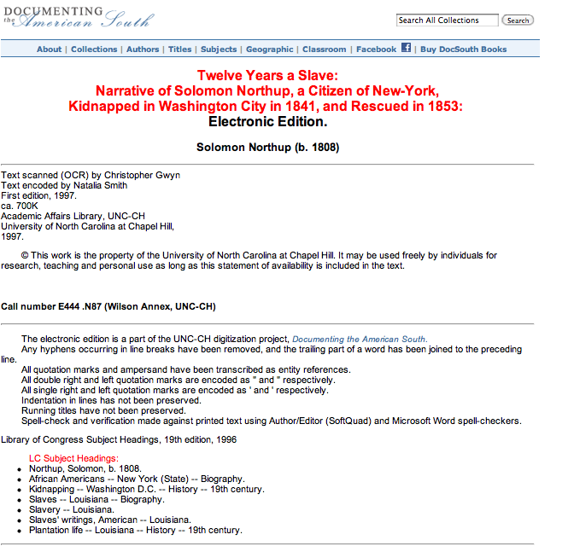
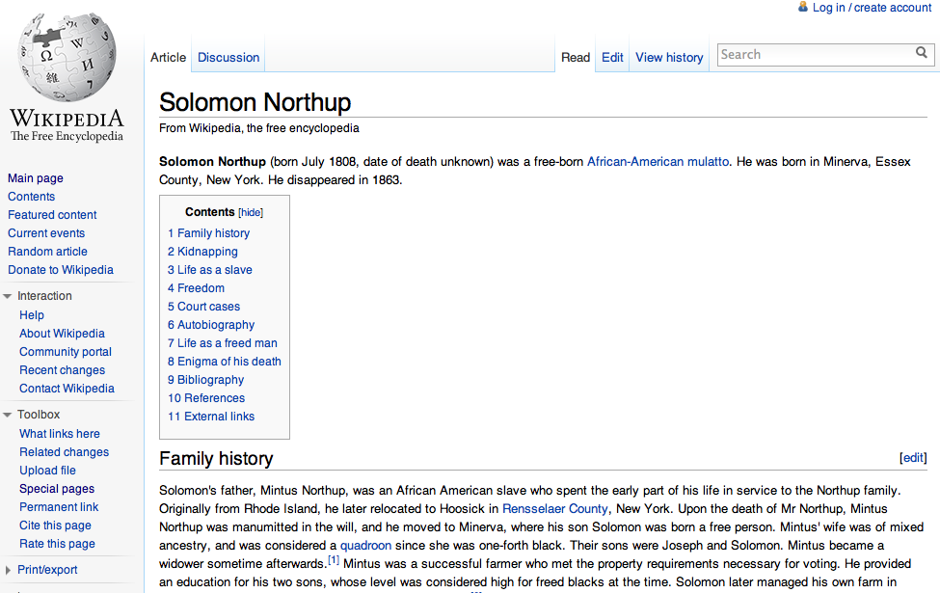

Slide 7
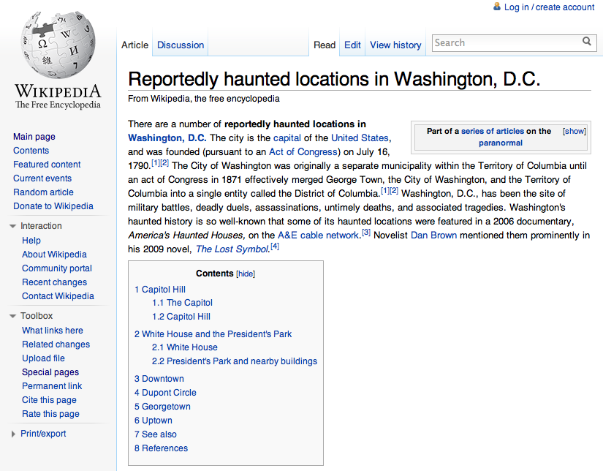
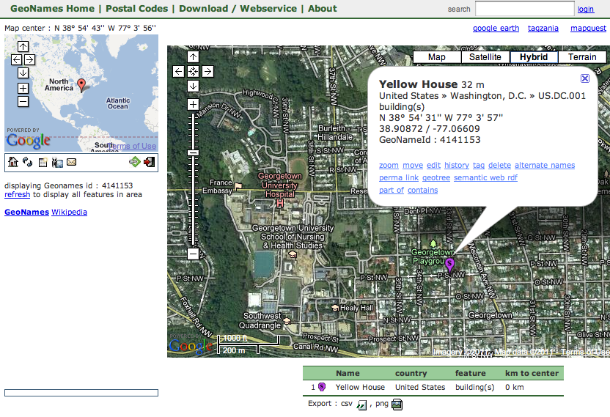


Slide 8
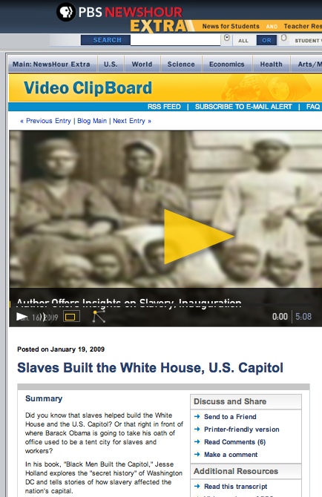
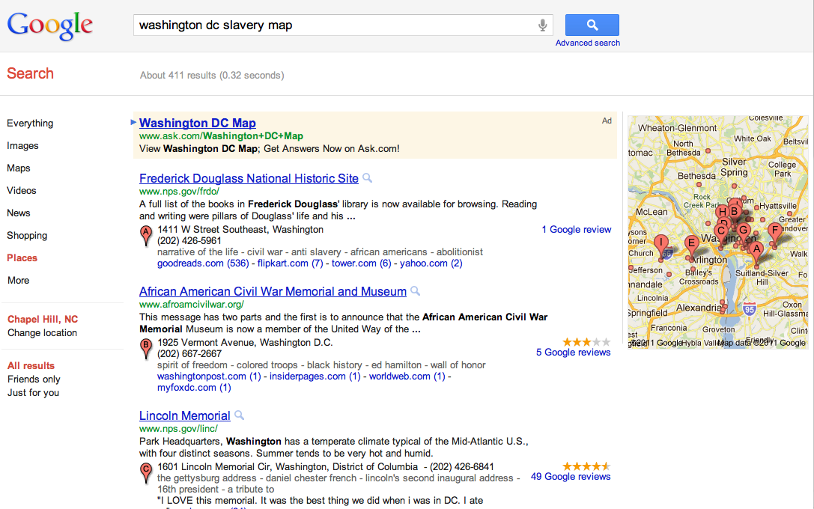
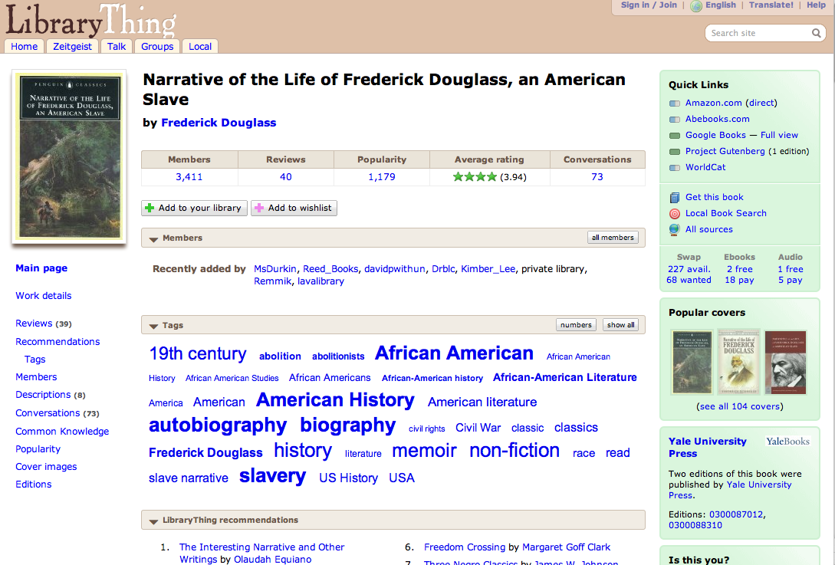

Slide 9
Really? That’s scary.

Slide 10
Cutter: Objects of the Catalog
To enable a person to find a book of which either
  the author
  the title
  the subject
To show what the library has
  by a given author
  on a given subject
  in a given kind of literature
To assist in the choice of a book
  as to its edition (bibliographically)
  as to its character (literary or topical)
}
is known

Slide 11
Library missions are broad
ALA Strategic Plan 2010-2015
ALA provides leadership in the transformation of libraries and library services in a dynamic and increasingly global digital information environment.
Big Audacious Goal:
ALA builds a world where libraries, both physical and virtual, are central to life-long discovery and learning and where everyone is a library user.
Libraries collaborate effectively with each other, with museums, archives and other information providers to increase public access to information.

Slide 12
Interpreting that mission

Slide 13
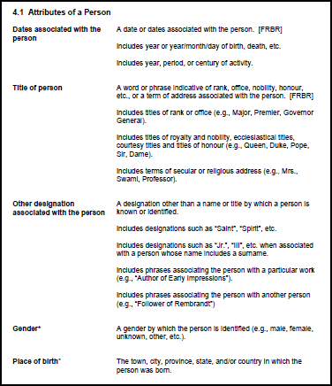
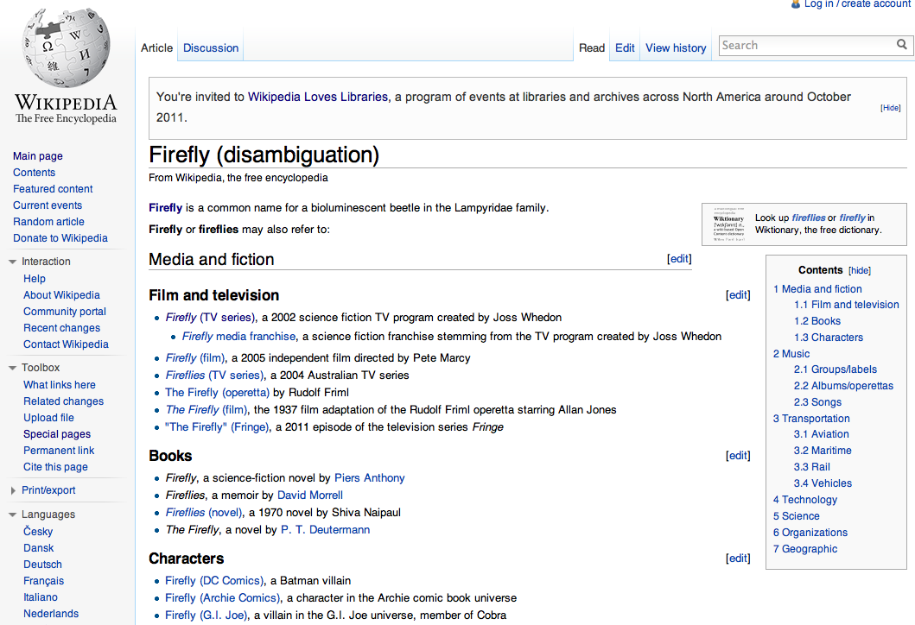
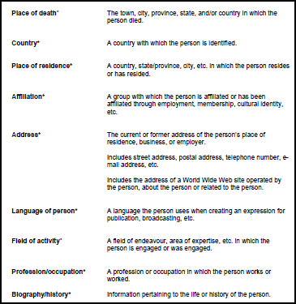
A broad view of library metadata

Slide 14
So how do we pay for all of this?

Slide 15
No more copy cataloging

Slide 16
Give up control of some of the details

Slide 17
Use technology more effectively

Slide 18
This is going to take a while

Slide 19
Thank you!
jennriley@unc.edu
CC BY-SA 3.0
Fractal image by Jon Zander (Digon3)
http://commons.wikimedia.org/wiki/File:Lines_Apophysis_Fractal_Flame.jpg

