Slide 1
Implementing (parts of) FRAD in a FRBR-based discovery system
Jenn Riley
Metadata Librarian
Indiana University Digital Library Program

Slide 2
V/FRBR project
Funded by an Institute of Museum and Library Services National Leadership Grant
October 1, 2008 - September 30, 2011
In “Demonstration” category
Provide a public and concrete testbed for FRBR
with real data (80,000 musical sound recordings, 105,000 scores)
in a production environment
as a response to the call in the LC WG on the Future of Bibliographic Control report

Slide 3
Other project goals
To provide an openly-accessible web search interface to the FRBRized data in Variations, for community analysis;
To make supporting data, including data model documentation and FRBRized data, available to the community for analysis; and
To apply innovative, evidence-based interface design techniques to Variations cataloging and search interfaces to make the most of the FRBR-compliant data model.

Slide 4
Central question
How do you create a full, production data model from a human-readable conceptual model?
Or, what does it mean to “implement” FRBR, anyways?

Slide 5
Our approach
Interpret FRBR literally whenever possible
Represent FRBRized data in XML
For sharing data between tools and with other systems
Don’t be limited by what we can automatically produce from MARC
Version 1.0 of XML Schemas released March 2010
Other more formal (UML?) data model documentation not (yet) created

Slide 6
(Some) goals for V/FRBR XML Schemas
Allow reusability in whole or in part
Use terminology directly from FRBR suite of reports
Packaging format in addition to specific entities/relationships
Make as human readable as possible
Allow for strict FRBR data, more useful FRBR data, and domain implementations

Slide 7
If that’s implementing FRBR, what does it mean to implement FRAD?

Slide 8
FRAD adds new attributes to FRBR entities
Work entity
FRAD, p. 44-45

Slide 9
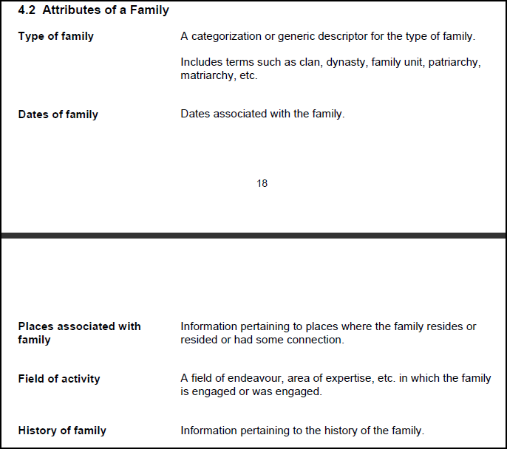
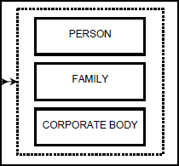
New Family entity
FRAD, p. 23; 41

Slide 10
Many new relationships
FRAD, p. 62-63

Slide 11
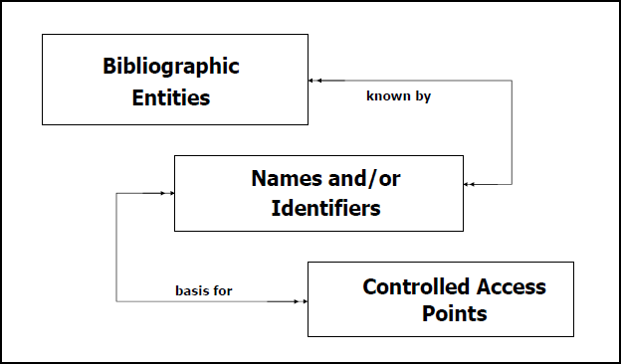
FRAD extension of the model
FRAD, p. 19

Slide 12
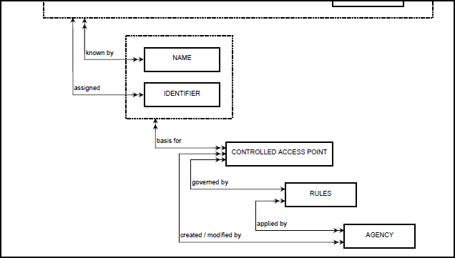
More new entities added by FRAD
(Group 1, 2, and 3 entities)
FRAD, p. 23

Slide 13
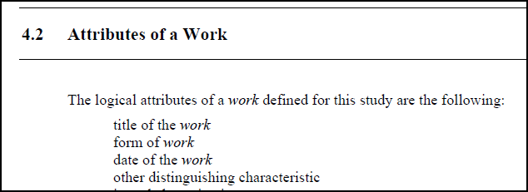
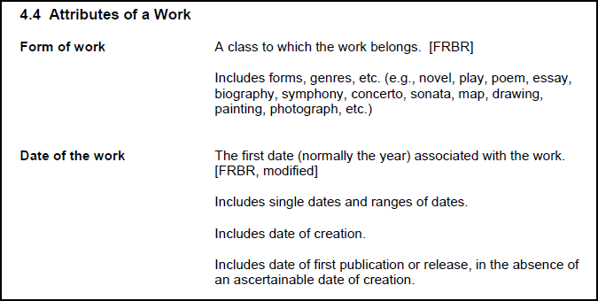
Which means…
FRBR
Notice, no title attribute in FRAD
FRAD

Slide 14
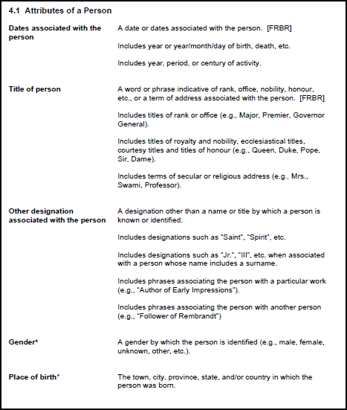
FRAD could be a game-changer
This isn’t your father’s catalog.
FRAD, p. 38-40

Slide 15
What if catalogs could…
be fully internationalized, showing different forms of headings to users in different locations and with different preferred languages?
provide users with supplementary information helping them to better understand the resources they seek and their context?
dynamically pull information from records when needed for disambiguation or context?
lead users (effectively) to previously unknown resources?
be research systems, and not just finding systems?
This is the catalog FRAD suggests to us.

Slide 16
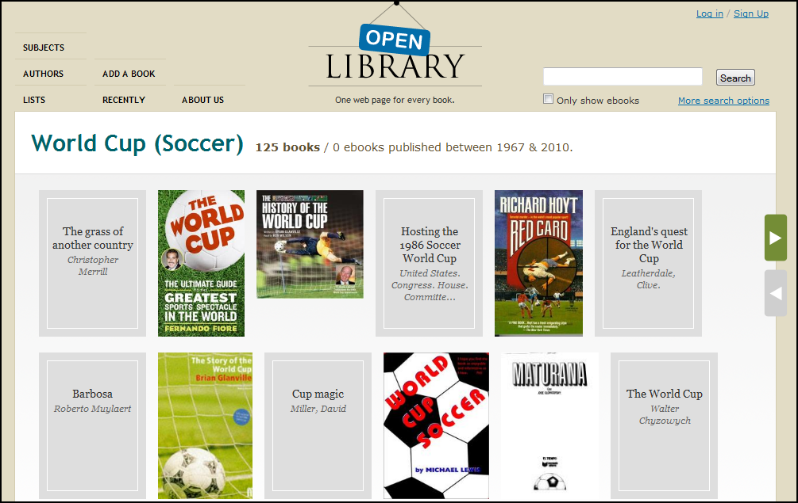
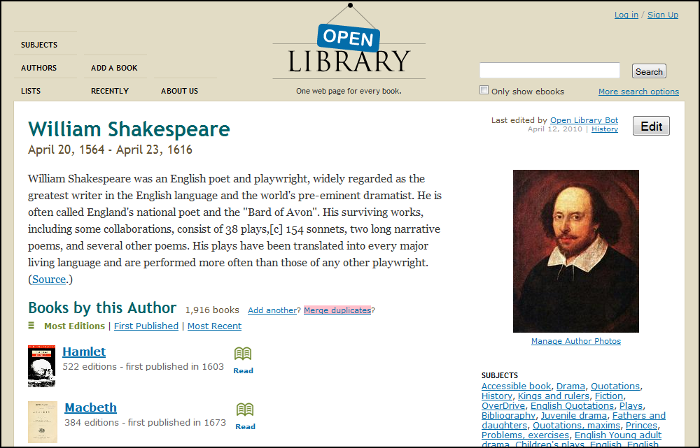
Person, Concept, or Work as destination?
http://www.openlibrary.org

Slide 17
V/FRBR implementation decisions
Add new FRAD attributes to FRBR entities?
Add Family entity?
Add new relationships?
Add Name, Identifier, Controlled Access Point, Rules, and Agency entities?

Slide 18
Fallout from those decisions
We kept “title of” and “name of” attributes on FRBR entities
And had to make one up for Family
Well, actually, we realized after the fact we still need to go back and add one for Family
Needed a way to distinguish between primary and variant titles
To do this, we took advantage of an enhancement structure we’d already built

Slide 19
3 levels
frbr:
entities/attributes/relationships from FRBR report, plus @identifier and wrapping structure
36 XML Schemas
efrbr:
adds <note>; adds XML attributes to refine meaning of XML elements; groups publication elements
48 XML Schemas
vfrbr:
restricts and extends efrbr for the description of musical materials
48 XML Schemas
hopefully provides a model for other domain-specific FRBR implementations

Slide 20
efrbr Schema structure

Slide 21
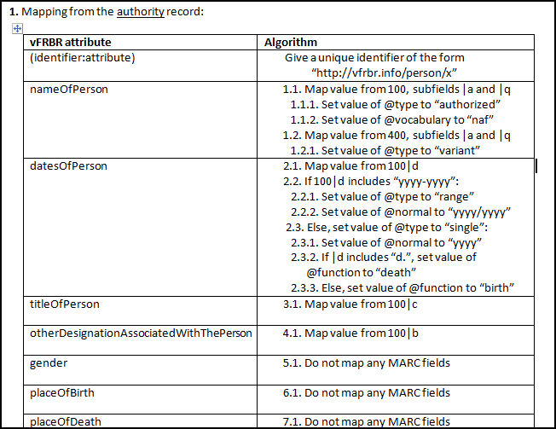
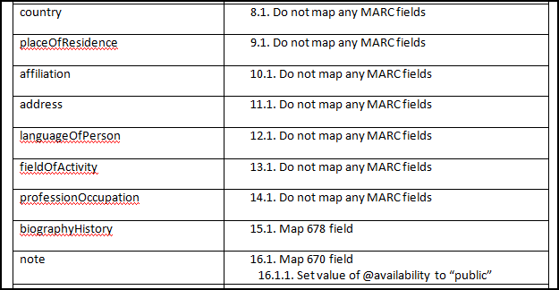
Batch loading data from MARC

Slide 22
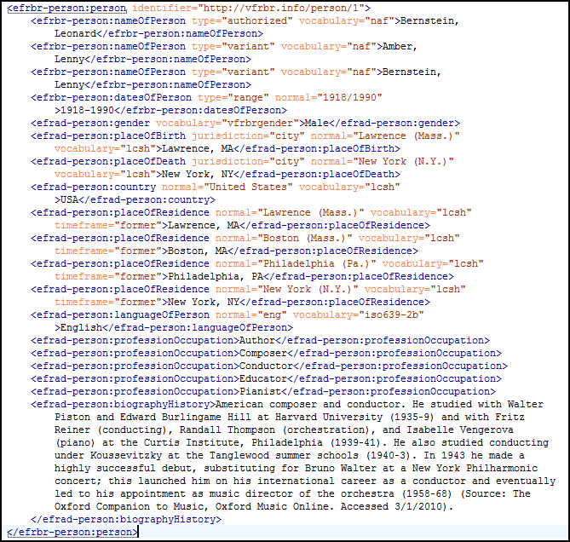
What if?

Slide 23
What next for V/FRBR?
Public release of early beta search soon (next week?)
Data batch loaded from MARC so many limitations
Not yet full FRAD display
Availability of FRBRized data
Full export for download available soon
Remote search via Web Services or some kind of API after that
FRBRized cataloging tool in development

Slide 24
What next for the community?
IFLA needs to officially resolve differences between FRBR and FRAD
And figure out what to do with FRSAD
Need some real FRAD implementations
Need to show (concretely) benefits of additional data in FRAD
Will RDA do this?
I’m not so sure
Need to demonstrate ability to pull this extra data in from other sources
Get over “not invented here” syndrome
Embrace Linked Data

Slide 25
Thank you! For more information:
jenlrile@indiana.edu
Project site: http://vfrbr.info
FRBR XML schemas: http://www.dlib.indiana.edu/projects/vfrbr/schemas/
These presentation slides: http://www.dlib.indiana.edu/~jenlrile/presentations/ ala2010acig/rileyFRAD.pptx

