Slide 1
Creating a FRBRized Data Structure in XML
Jenn Riley
Metadata Librarian
Indiana University Digital Library Program

Slide 2

V/FRBR project
Funded by an Institute of Museum and Library Services National Leadership Grant
  October 1, 2008 - September 30, 2011
  In “Demonstration” category
Provide a public and concrete testbed for FRBR
  with real data (80,000 musical sound recordings, 105,000 scores)
  in a production environment
  as a response to the call in the LC WG on the Future of Bibliographic Control report

Slide 3
Other project goals
To provide an openly-accessible web search interface to the FRBRized data in Variations, for community analysis;
To make supporting data, including data model documentation and FRBRized data, available to the community for analysis; and
To apply innovative, evidence-based interface design techniques to Variations cataloging and search interfaces to make the most of the FRBR-compliant data model.

Slide 4
Central question
How do you create a full, production data model from a human-readable conceptual model?
Or, what does it mean to “implement” FRBR, anyways?

Slide 5
Our approach
Interpret FRBR literally whenever possible
Represent FRBRized data in XML
  For sharing data between tools and with other systems
  Don’t be limited by what we can automatically produce from MARC
  Version 1.0 of XML Schemas released March 2010
Other more formal (UML?) data model documentation not (yet) created

Slide 6
(Some) goals for V/FRBR XML Schemas
Allow reusability in whole or in part
Use terminology directly from FRBR suite of reports
Represent all of FRBR and as much of FRAD as is “reasonable”
Packaging format in addition to specific entities/relationships
Make as human readable as possible
Allow for strict FRBR data, more useful FRBR data, and domain implementations

Slide 7
3 levels
frbr:
  entities/attributes/relationships from FRBR report, plus @identifier and wrapping structure
  36 XML Schemas
efrbr:
  adds <note>; adds XML attributes to refine meaning of XML elements; groups publication elements
  48 XML Schemas
vfrbr:
  restricts and extends efrbr for the description of musical materials
  48 XML Schemas
  hopefully provides a model for other domain-specific FRBR implementations

Slide 8
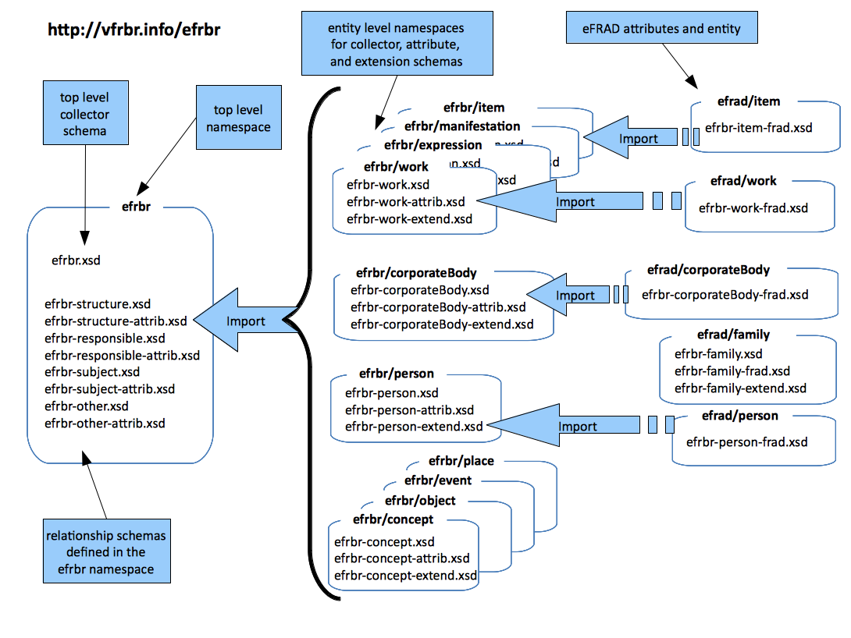
efrbr Schema structure

Slide 9
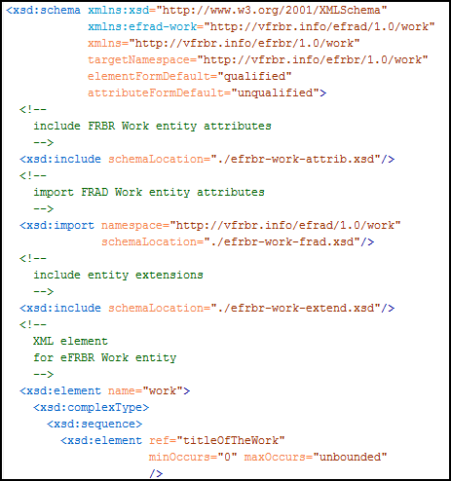
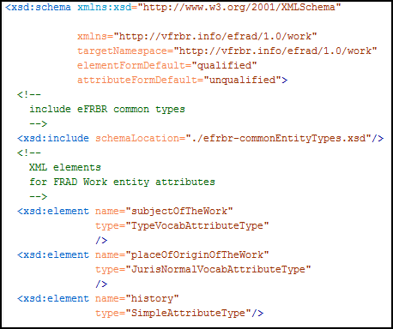
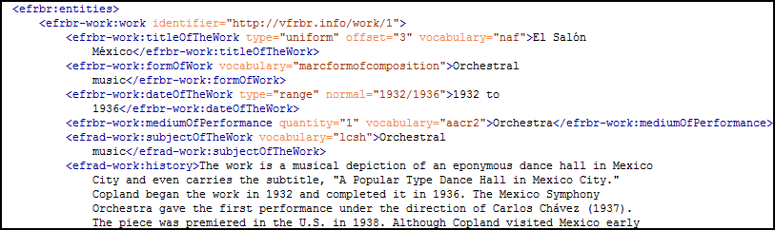
efrbr example
XML Schemas
XML instance

Slide 10
For more information
jenlrile@indiana.edu
Project site:
http://vfrbr.info
FRBR XML schemas:
http://www.dlib.indiana.edu/projects/vfrbr/schemas/
These presentation slides:
http://www.dlib.indiana.edu/~jenlrile/presentations/
ala2010frbr/rileyFRBRxml.pptx

