Slide 1
Speculating on the future of the metadata standards landscape
Jenn Riley
Head, Carolina Digital Library and Archives
The University of North Carolina at Chapel Hill

Slide 2
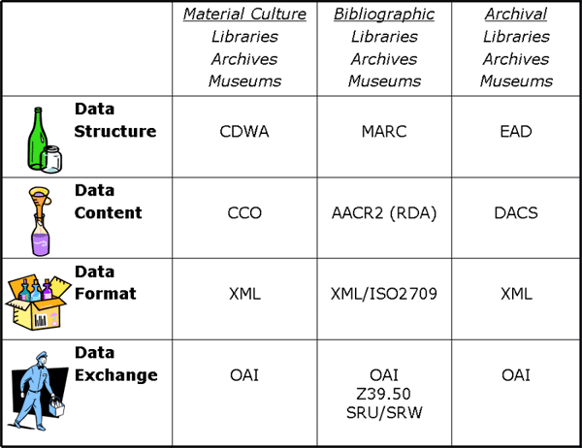
RDA?
RDA
RDA?
Elings & Waibel, “Metadata for All” http://firstmonday.org/htbin/cgiwrap/bin/ojs/index.php/fm/article/view/1628/1543
Notes:
Rules don’t *necessarily* have to imply a certain element set. Their instructions can be generic – “classes of metadata elements”
This is also scoped to within the cultural heritage community. No fundamental interoperability beyond that, even with this model.

Slide 3
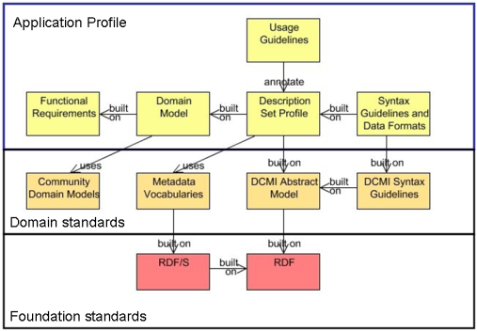
RDA
FRBR
RDA
This is important too.
DCMI Singapore Framework http://dublincore.org/documents/singapore-framework/
Notes:
The goal here is to promote interoperability with other communities. Push machine interoperability into all levels of the diagram. Which means you can be interoperable with those who use the same foundation standards, and sometime domain standards.
BUT this is a different definition of interoperability than we saw in the last diagram. That’s a big problem here – agreeing upon what we mean by interoperability and having it not be too extreme.

Slide 4
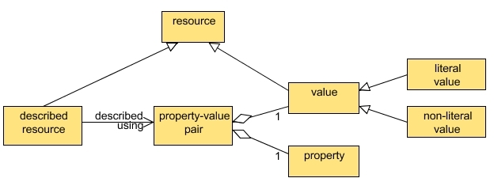
DCMI Resource Model
(from the DCMI Abstract Model) http://dublincore.org/documents/abstract-model/

Slide 5
Do we need a new one of these?
What if the atomistic, formal expression of data becomes widespread?
Notes:
I think we do need a new one. It needs to be in between the library one and the DCMI one.

Slide 6
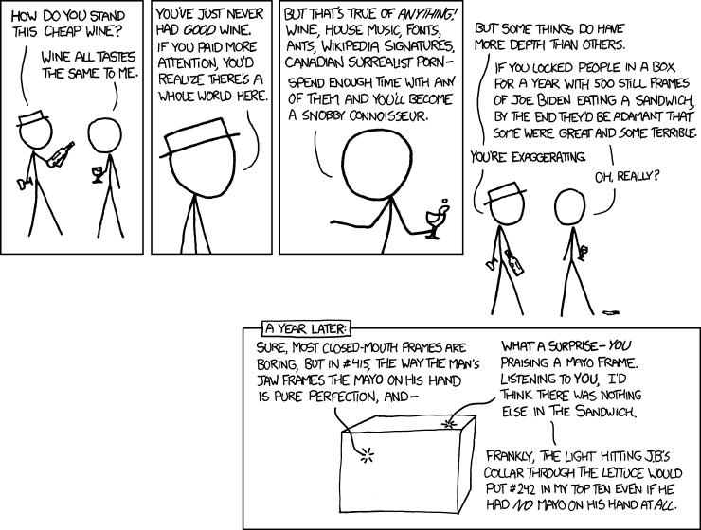
And let’s be sure to avoid this….
http://xkcd.com/915/ xkcd comic by Randall Munroe

Slide 7
Formality of expression
Conceptual model
basis for
Data model
Proximity to actual implementation
basis for
Data dictionaries
Element/property vocabularies
basis for
Cataloging rules
Data validity rules
data expressed in
Controlled vocabularies
data expressed in
data expressed in
data expressed in
Binding
Notes:
CVs can be expressed using the same methodologies as bibliographic records. One person’s metadata is another person’s data. That’s nice and tidy, and fun, and elegant, and enables some cool new things. But be wary of descending into Joe Biden photo territory.
But the binding is an implementation of the data model, and information model. Can’t be completely separated.

Slide 8
But, wait. That doesn’t explain how different communities use these, or how they build upon one another.
And the boxes still aren’t mutually exclusive.

Slide 9
Element/property vocabularies
World
Information specialists
Element/property vocabularies
Libraries/archives/ museums
World
Element/property vocabularies
Information specialists
OR
Element/property vocabularies
Libraries/archives/museums

Slide 10
A new framework will emerge.
But we need to help articulate it.

Slide 11
Thank you!
jennriley@unc.edu
CC BY-SA 3.0
Fractal image by Jonathan Zander http://commons.wikimedia.org/wiki/File:Center_Apophysis_Fractal_Flame.jpg

