Slide 1
Next-generation controlled vocabularies
Jenn Riley
Head, Carolina Digital Library and Archives The University of North Carolina at Chapel Hill

Slide 2
Moving from literary warrant to user warrant
Notes:
LCSH etc’s model is wait to add a term until a book (a scholarly work, a secondary source) is about a topic. A user warrant approach would consider common usage in the wild as a reason for incorporating it into a vocabulary.
Language changes. Embrace that fact, don’t fight it.

Slide 3
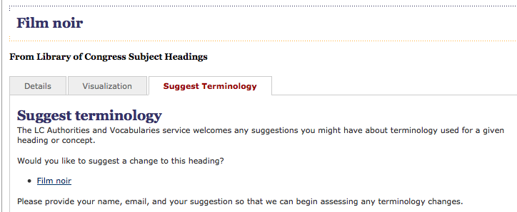
Notes:
This is the old model. You can petition us for an addition or a change. Please rest assured we’ll give it all due consideration. Vocabularies need strong gatekeepers. This model leads to terms like “cookery” and “electric lamp, incandescent” and “Afro American” sticking around for way too long.

Slide 4
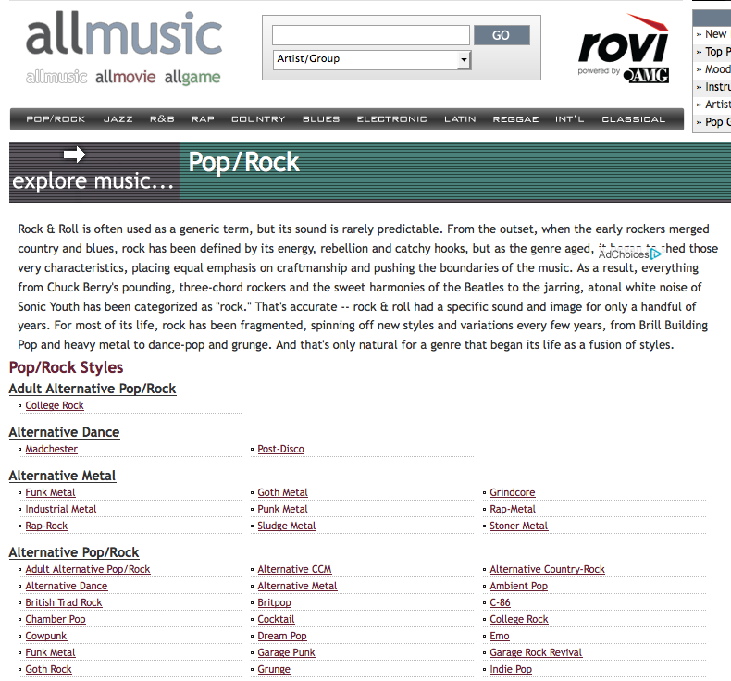
Notes:
This is an industry approach. It’s still curated, but it’s more responsive to the quick evolution of this particular domain. The specialist nature of this site facilitates this approach – people who really know music are making the decisions. This is a glimmer of a trend in the community – assign metadata creation responsibilities to subject experts rather than description experts.
Performing arts are living arts – new genres coming and going. They’re both the subject of scholarly study and a vital part of popular culture.
These terms come and go, but the styles do as well. It’s reality, and we need to deal with it.

Slide 5
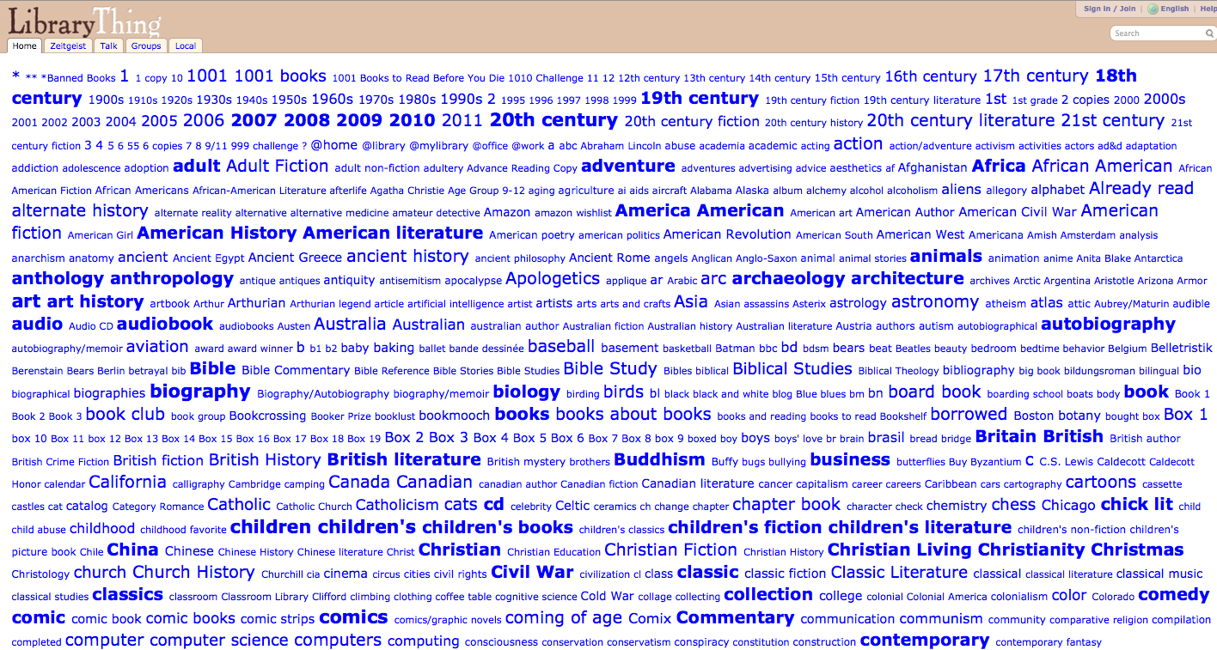
Notes:
Look at these useful terms! There’s some junk in here too. Wait, your catalog doesn’t have junk in it?
Some of these terms are more useful that others. That’s the case for LCSH too.
One thing this approach is missing is hierarchy of the vocab. We’ll get back to this later, because it is an important topic.

Slide 6
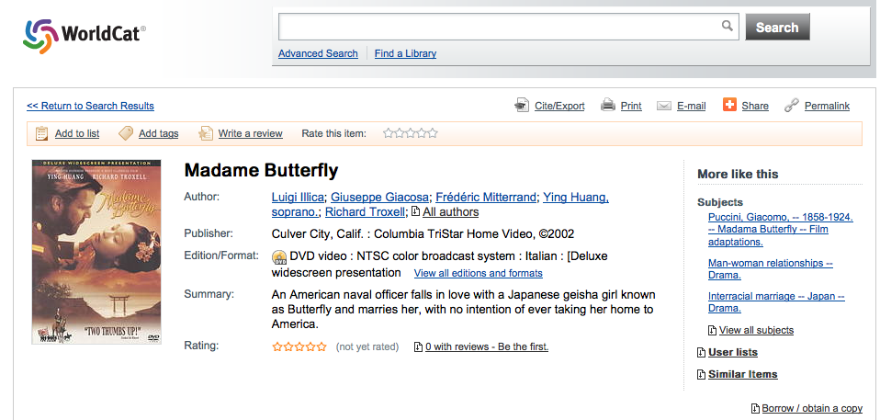
Notes:
This isn’t users creating a vocabulary, but it’s a step.

Slide 7
Linked Data
Notes:
(Explain what it is briefly.) Goal is to make this valuable data of the web.

Slide 8
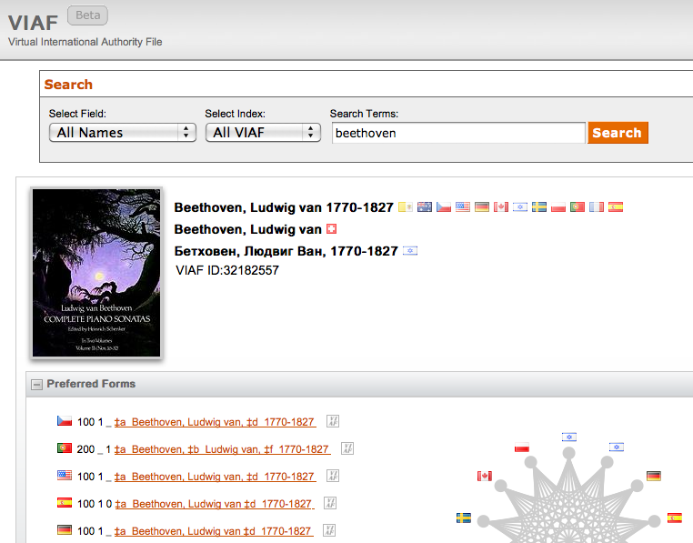
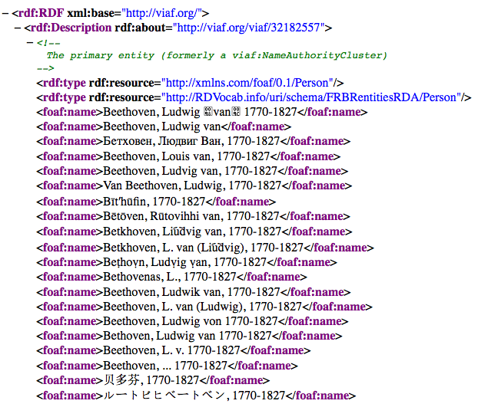
Notes:
Lots of activity in this area for libraries. Vocabularies are some of the first to go LD, before bibliographic info.
This is a pretty simple example. Mechanisms to make the URI dereferencable for software applications but pretty for humans.
These triples could be combined with others from many different sources to do really interesting stuff. This is the next generation – share our data so others (and us) can do really interesting stuff with it. We’ve got good data in our controlled vocabularies. Especially name files, but subject files could be useful too. (More so if they’d be more user-friendly. What if the AllMusic genre list was encoded in RDF?

Slide 9
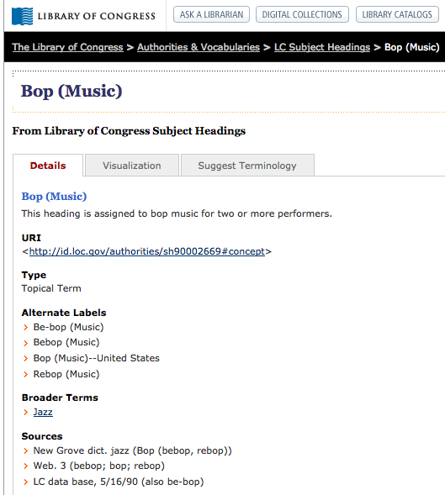
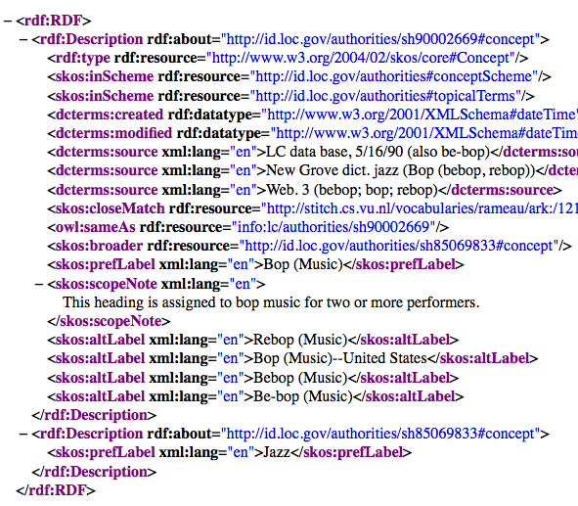
Notes:
And here’s another example of a ridiculous subject heading. But more to the point: this is Linked Data too.
Causing a renewed interest in automatic term expansion. Use/Use for. BT/NT. RT?
This was certainly possible before, but a big advantage of this approach is the publicity given to relationships. The statement rather than the record as the unit of description mandates that links and trails be followed in a way that wasn’t as obvious before. Somehow leveraging the syndetic structure now seems more doable.

Slide 10
Getting serious (for real this time) about isness and aboutness
Notes:
Long standing confusion on this issue. But there’s real movement recently.
MARC 655 has been around a while, but LCSH just now catching up.

Slide 11
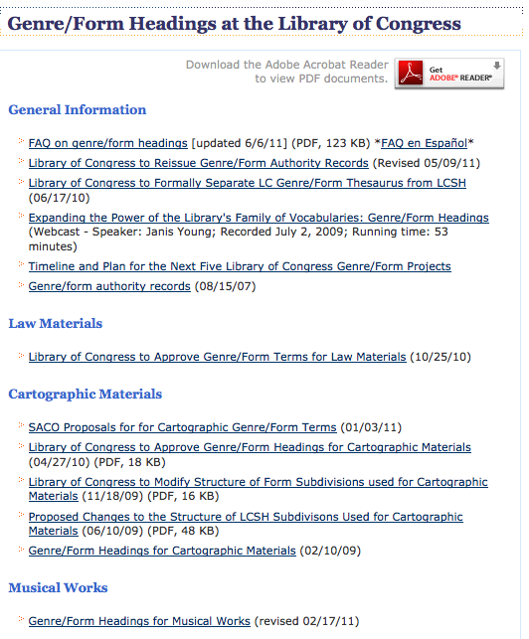
Law
Cartographic
Music
Moving image/ radio
Notes:
Used to have symphony/symphonies problem. This was bad.
Moving to Library of Congress Genre/Form Terms for Library and Archival Materials (LCGFT)
Performing arts, time based media particularly susceptible to this issue. More on that in a moment.
This is making us more comfortable with multiple vocabularies.

Slide 12
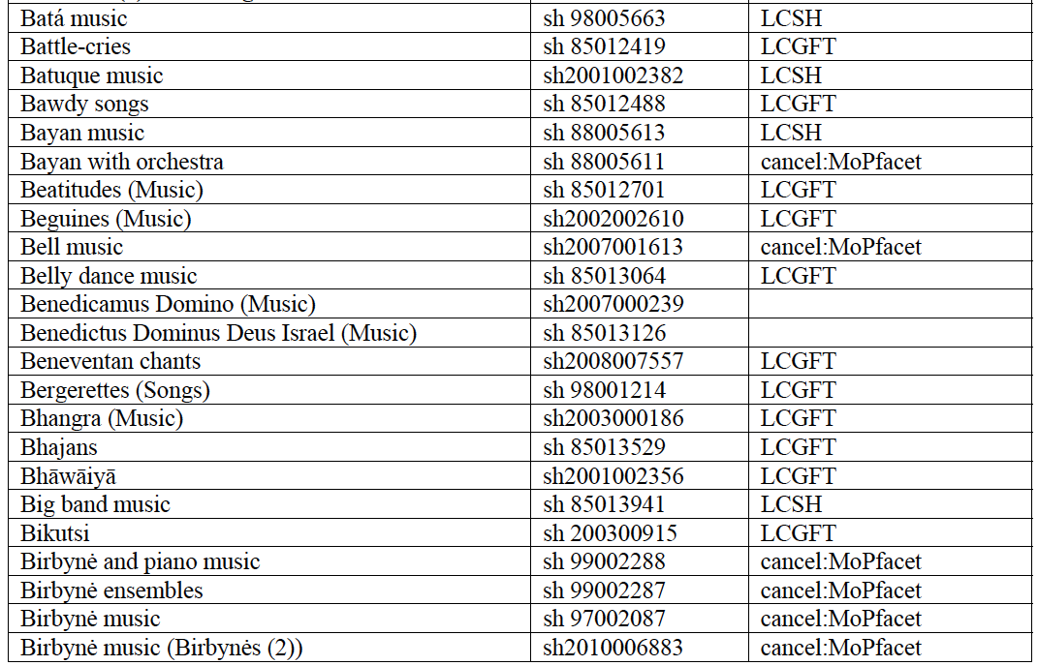
Proposed disposition of some LCSH music terms
Notes:
1990s Music Thesaurus project, never really took off.
Separating genre from medium of performance REALLY difficult. Similar problem in other performing arts – characteristics of the work itself vs peforming style, etc. Really need to figure out what it is you’re trying to capture.
Analog in painting – style vs. medium. Parallels in other performing arts as well.
But have to balance this w/ ease of implementation. How to have conceptual rigor w/ user input?

Slide 13
What does this mean for me?
Notes:
Defining vocabs – use these principles, be cognizant of new uses.
We’re at a time when we’re trying to simultaneously streamline and create more conceptual rigor. This isn’t impossible, but we’ll have to be creative.

Slide 14
Thank you!
jennriley@unc.edu
CC BY-SA 3.0
Fractal image by Jonathan Zander http://commons.wikimedia.org/wiki/File:Wires_Apophysis_Fractal_Flame.jpg

