Slide 1
RDF for Librarians Jenn Riley Metadata Librarian Digital Library Program
DLP Brown Bag Series, September 22, 2010

Slide 2
From Wikipedia…
“A collection of RDF statements intrinsically represents a labeled, directed multi-graph.” <http://en.wikipedia.org/wiki/Resource_Description_Framework>
☒
☒
☒
Learning the lingo is important; however for us it’s probably better to start with understanding how some of the basic concepts are different than what we’re used to.
That’s what we’re going to do today.

Slide 3
Structural differences

Slide 4
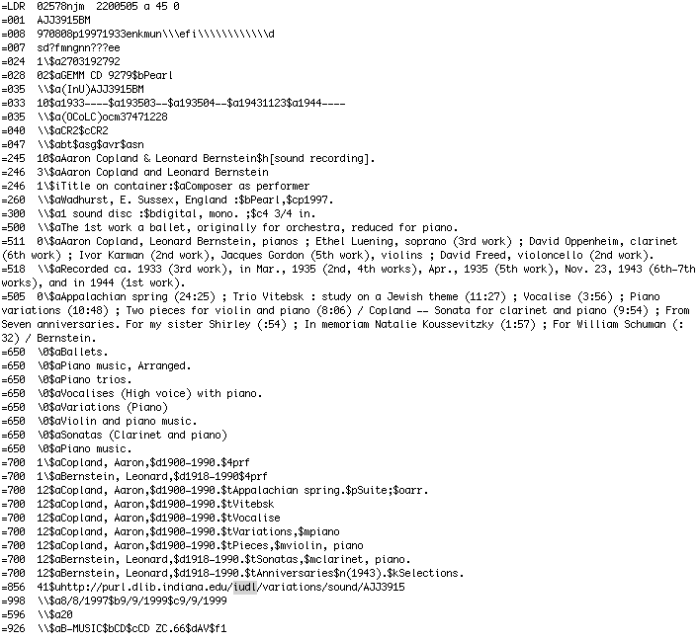
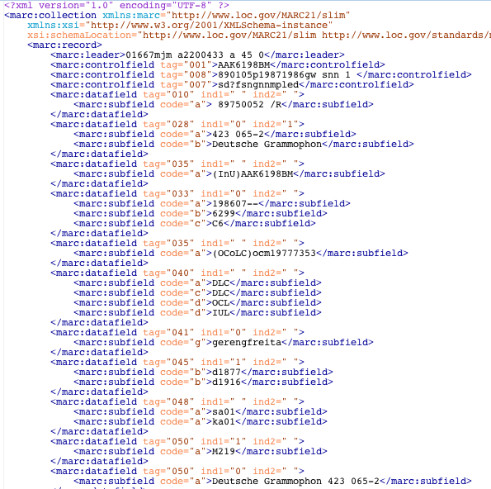
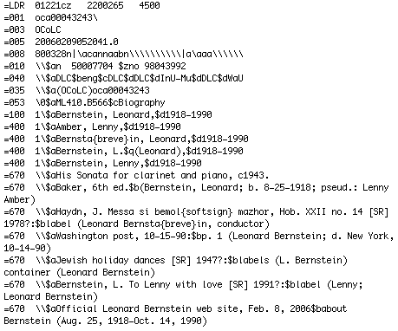
Libraries have “records”

Slide 5
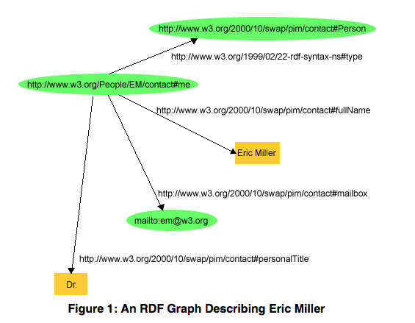
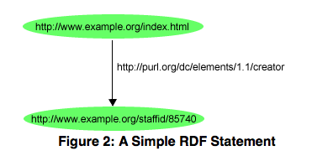
RDF has “statements” and “graphs”
This is a “statement,” aka a “triple”. A statement is made in a particular direction.
predicate
subject
object
Statements combine to form graphs. A graph is of no fixed size and contains no predetermined types of statements. (The graph is the real RDF model; a triple is a secondary representation.)
Figures from RDF Primer <http://www.w3.org/TR/rdf-primer/>

Slide 6
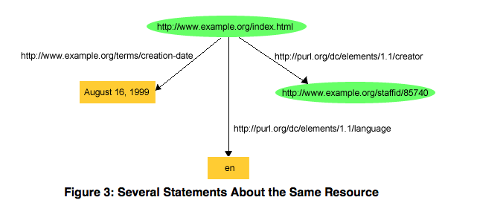
More about statements
subject: must be a URI
predicate: must be a URI
object: can be a URI, or a “literal”
Figure from RDF Primer <http://www.w3.org/TR/rdf-primer/>
Notes:
Literal = “constant value”

Slide 7
The centrality of URIs in RDF
RDF uses URIs to identify:
individuals, e.g., Eric Miller, identified by http://www.w3.org/People/EM/contact#me
kinds of things, e.g., Person, identified by http://www.w3.org/2000/10/swap/pim/contact#Person
properties of those things, e.g., mailbox, identified by http://www.w3.org/2000/10/swap/pim/contact#mailbox
values of those properties, e.g. mailto:em@w3.org as the value of the mailbox property (RDF also uses character strings such as "Eric Miller", and values from other datatypes such as integers and dates, as the values of properties)
Figure and text from RDF Primer <http://www.w3.org/TR/rdf-primer/>

Slide 8
Implications of statement structure (1)
Subjects are always formalized; know exactly what is being talked about
They’re only implicit in library metadata
Makes moot the 1:1 problem
Might still have content vs. carrier problem
Predicates are always formalized
Maybe not all that different than library/archive/museum metadata models
More obviously reusable

Slide 9
Implications of statement structure (2)
Representation of objects is flexible
Using a URI facilitates connecting this value into a larger graph
Literals allow more limited functionality; used when the value isn’t likely to be useful as part of a vocabulary
URI vs. literal a design choice; note the previous example used a literal where a URI might be better!
Making a statement that two different URIs refer to the same thing can join two graphs
Note, URIs aren’t necessarily dereferencable

Slide 10
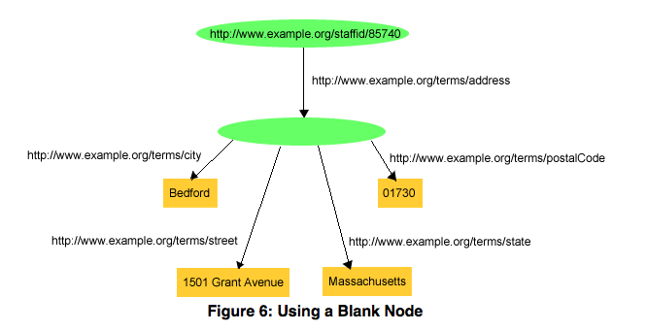
Blank nodes
This blank node stands in for “John Smith’s address”
Figure from RDF Primer <http://www.w3.org/TR/rdf-primer/>
Notes:
Subjects and objects can be blank nodes; but predicates cannot be.
Another example: a book is by Jane Smith. Book hasAuthor Jane Smith OK, but better would be Book hasAuthor (blank node for person); (blank node for person) hasName Jane Smith

Slide 11
Properties vs. elements
Remember, a statement’s predicate represents a property of the resource (subject) being described
Resource=subject; Property=predicate. I don’t know why there are different terms for the model than for individual statements. Let’s move on.
On the surface, an RDF property looks like the same thing as an XML element or a database field
But the underlying formal model is different
Explicit subjects and directionality of statements
Formality of RDF model places additional restrictions but allows more explicit meaning
Therefore inferences you can draw for elements and fields are not as strong as you can for properties

Slide 12
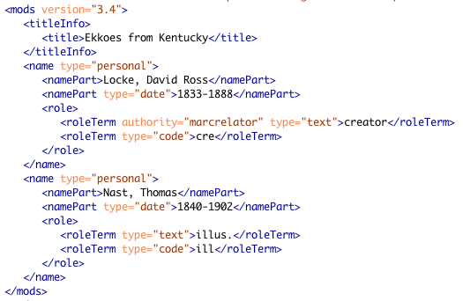
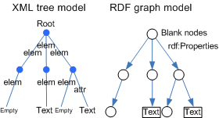
Graph vs. tree
XML documents are trees
This is as good as you can do inferring a graph from a tree:
Tree vs. graph figure from XML2RDF documentation <http://rhizomik.net/html/redefer/xml2rdf/>

Slide 13
Model vs. its syntax(es)
There’s a difference between:
Model of information representation
Property or element definitions
Binding of the information into a specific syntax
MARC is both the record structure (syntax) and content designations (element definitions)
RDF model has many encoding syntaxes
RDF and MARC operate at different levels in this landscape; but that doesn’t mean MARC’s structure is capable of representing the RDF model

Slide 14
Some realities of RDF that scare us
No predetermined set of properties to care about
No guarantee that the same person/item/place/whatever are always referred to with the same URI
No inherent mechanism/requirement for vetting properties, URIs, etc
But let’s be frank here. Are our library/archive/museum records really:
Complete?
Authoritative?
Consistent?
Accurate?
All that functional for what we want to do?

Slide 15
More RDF concepts
Class
A statement can say a subject is of a certain type or category known as a “class”.
Classes can be formally defined in RDF Schema documents
Domain and Range
Specify what classes subjects and objects of statements (respectively) using a given property can be
More than one domain or range statement can be made for any given property
These features allow “inferencing” to deduce statements that aren’t actually made

Slide 16
But both have…
Raging debate over how precise you have to be in indicating what it is you’re describing
An interest in mechanisms to allow consumers of data to evaluate the authority of statements
A tendency to over-model (see “The Modeller” blog post on handout)
Other similarities
“Application profile” notion applicable to both XML and RDF models, though would be implemented differently
XML elements repeatable; RDF makes no restriction on how many statements about the same resource use the same predicate.

Slide 17
Terminology differences

Slide 18
“Subject”
In libraries, what an information resource is about
In RDF, what a statement is about

Slide 19
“Vocabulary”
In libraries, implies a controlled vocabulary of a certain sort
Authorized terms
Lead-in terms (see references, etc.)
Sometimes, hierarchical structure
Sometimes, related terms
In RDF, much looser definition
Includes formal definitions of classes and properties

Slide 20
“Class”
In libraries, a classification scheme indicating the general topic or area of knowledge covered by an information resource
In RDF, a type or category that any type of object or resource belongs to

Slide 21
“Schema”
XML Schema defines a set of elements intended to be used together
RDF Schema defines classes and properties intended to be used anywhere, alone or in combination

Slide 22
So, wait, why should I learn this?

Slide 23
Libraries are moving in this direction
At least a little bit
Increasing viability and acceptance of interoperating with data from outside of libraries
RDA gives us an opportunity to fundamentally rethink some features of our data
Semantic Web activities have been given new life with the grassroots Linked Data movement

Slide 24
Linked Data design issues
Use URIs as names for things
Use HTTP URIs so that people can look up those names.
When someone looks up a URI, provide useful information, using the standards (RDF, SPARQL)
Include links to other URIs. so that they can discover more things.
Tim Berners-Lee <http://www.w3.org/DesignIssues/LinkedData.html>

Slide 25
How much planning do we need to do?
“There are other cases where the easiest thing for somebody to do is to just put data up in whatever form it's available.”
Tim Berners-Lee <http://www.readwriteweb.com/archives/interview_with_tim_berners-lee_part_1.php>
Let’s review some of what libraries have done so far.

Slide 26
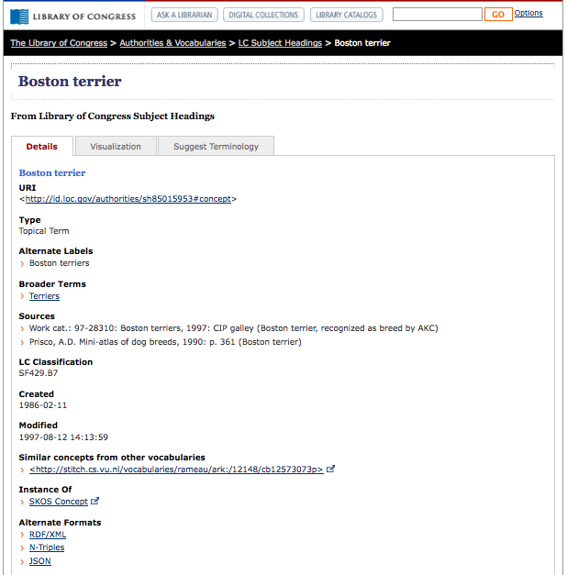
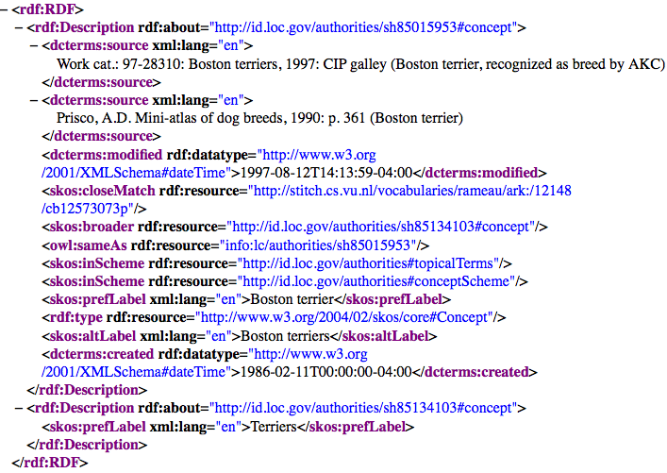
id.loc.gov

Slide 27
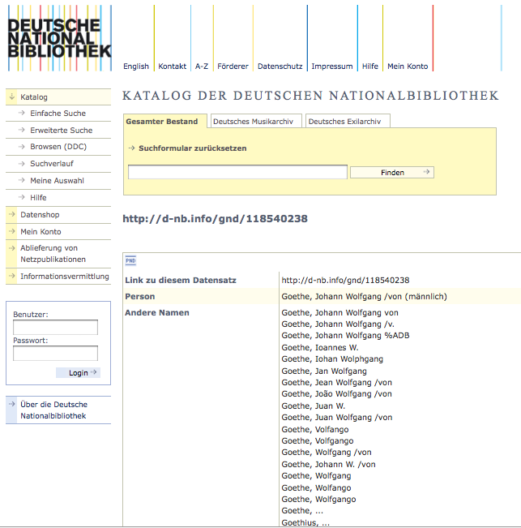
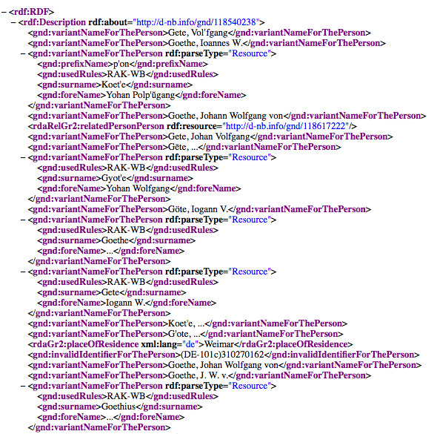
German National Library

Slide 28
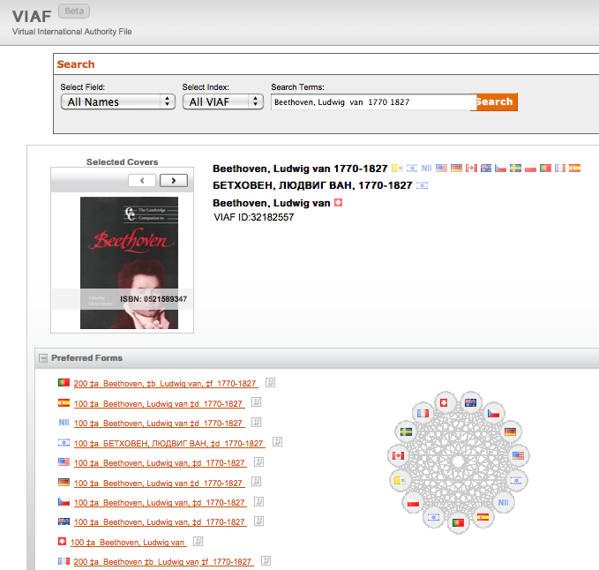
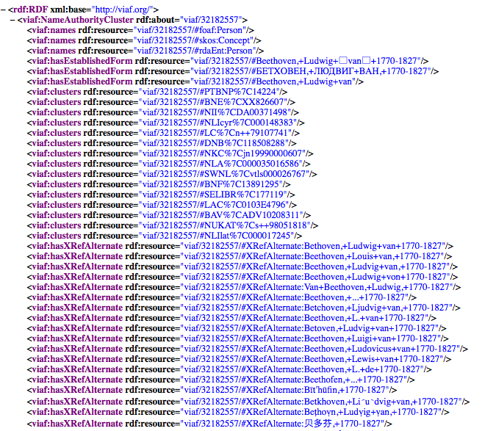
Virtual International Authority File

Slide 29
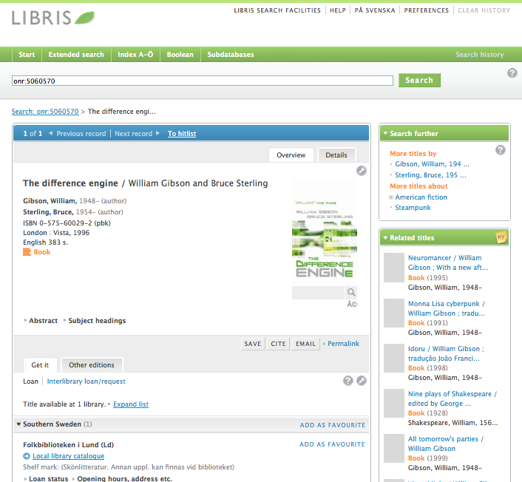
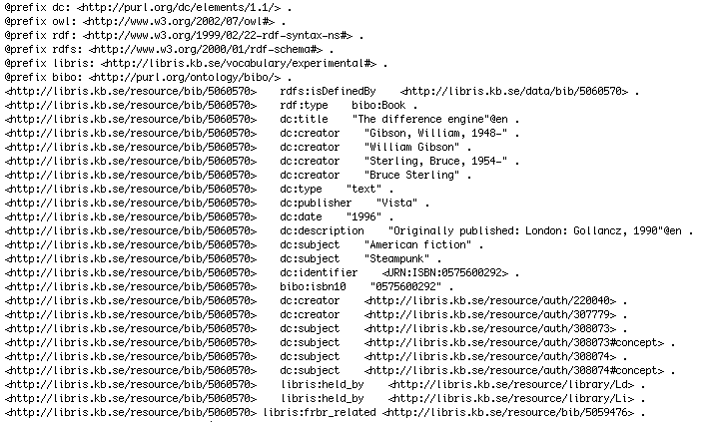
LIBRIS – Swedish National Library

Slide 30
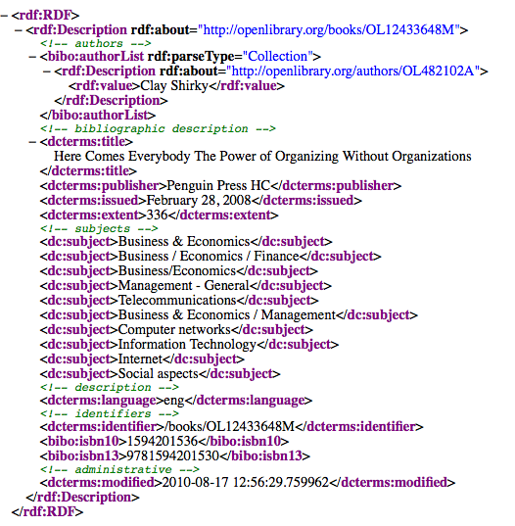
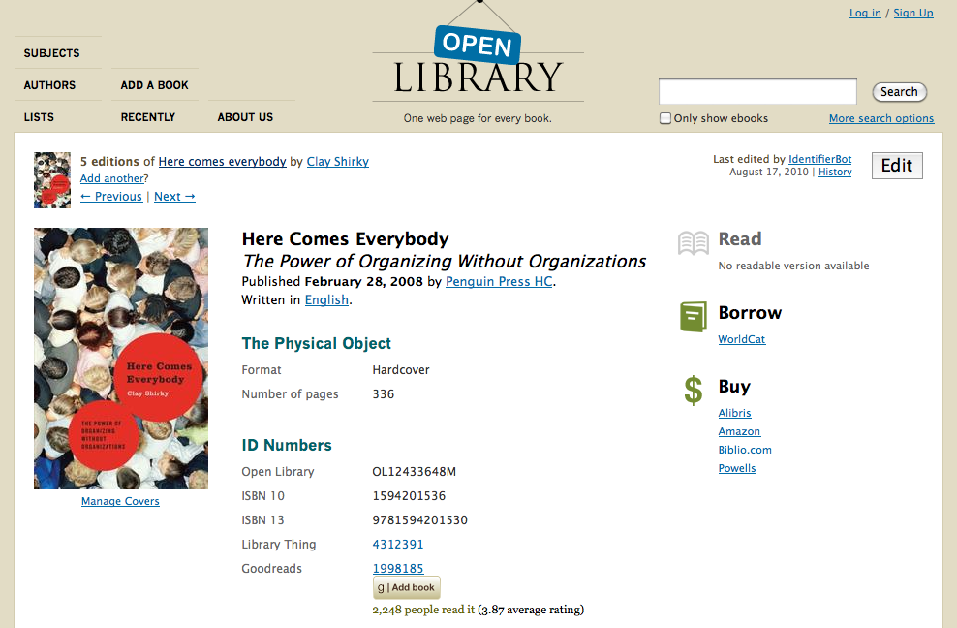
Open Library

Slide 31
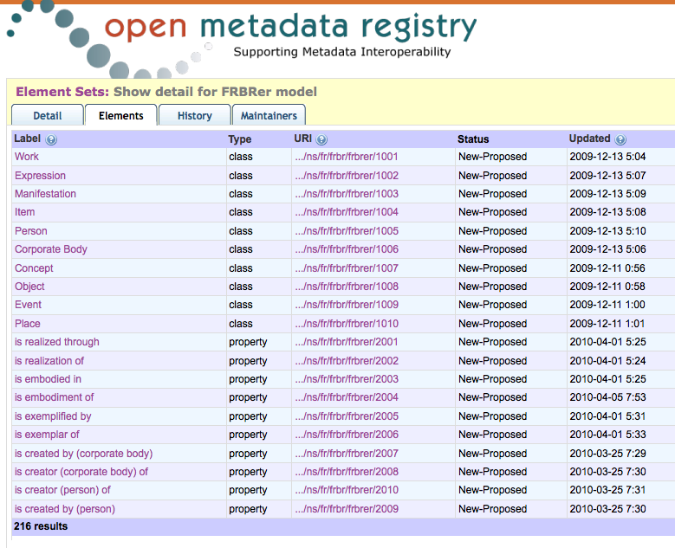
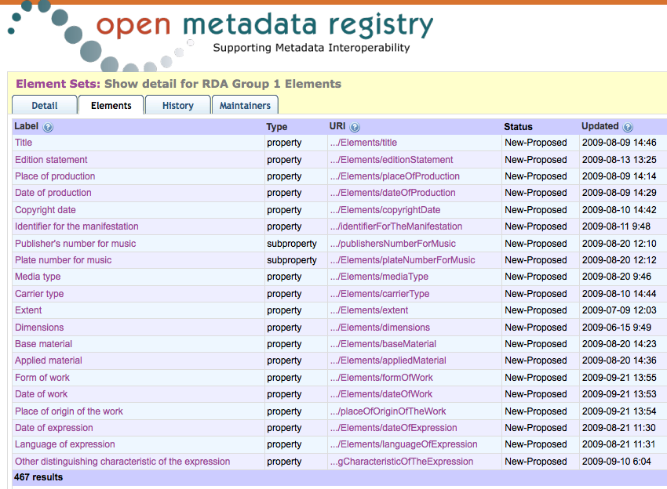
Registering FRBR and RDA properties

Slide 32
What about incorporating data from other sources?
BBC Wildlife Finder <http://www.bbc.co.uk/wildlifefinder/> Slide by Thomas Baker, “What Makes the Linked Data Approach Different,” NISO DCMI Webinar 2010. <http://dublincore.org/resources/training/NISO_Webinar_20100825/dcmi-webinar-02.pdf>

Slide 33
Challenges to implementing RDF in practice

Slide 34
How do you…
find all the triples you need?
know what predicates and URIs to use when creating new triples?
know what predicates and URIs to use when processing data?

Slide 35
What infrastructure needs to be built in order to…
negate an erroneous statement?
say that a statement is time-dependent?
judge the likely validity of a statement made by someone else?
…actually end up with machine-understandable data in the end???

Slide 36
Don’t run away!
These uncertainties do not give librarians permission to write off the entire model.
Incorporating new ideas doesn’t mean we have to give up our core principles.
We have an opportunity here:
to create classes and properties that represent data as we think it should be.
to bring new features to the model and to its implementations.
to provide some of the infrastructure that’s missing.
to participate in the discussion.

Slide 37
Let’s go!
Photo by Gregory Moine <http://www.flickr.com/photos/gregory-moine/4713276677/>
Creative Commons Attribution 2.0 Generic <http://creativecommons.org/licenses/by/2.0/deed.en>

Slide 38
For more information
jenlrile@indiana.edu
These presentation slides: <http://www.dlib.indiana.edu/~jenlrile/presentations/bbfall10/rdf/rdfForLibrarians.pptx>
Recording of talk on DLP Brown Bag page: <http://www.dlib.indiana.edu/education/brownbags/>
More resources on handout: <http://www.dlib.indiana.edu/~jenlrile/presentations/bbfall10/rdf/handout.pdf>
Thank you!

