Slide 1
Building Better Metadata Creation Tools
Jenn Riley
Metadata Librarian
Digital Library Program

Slide 2
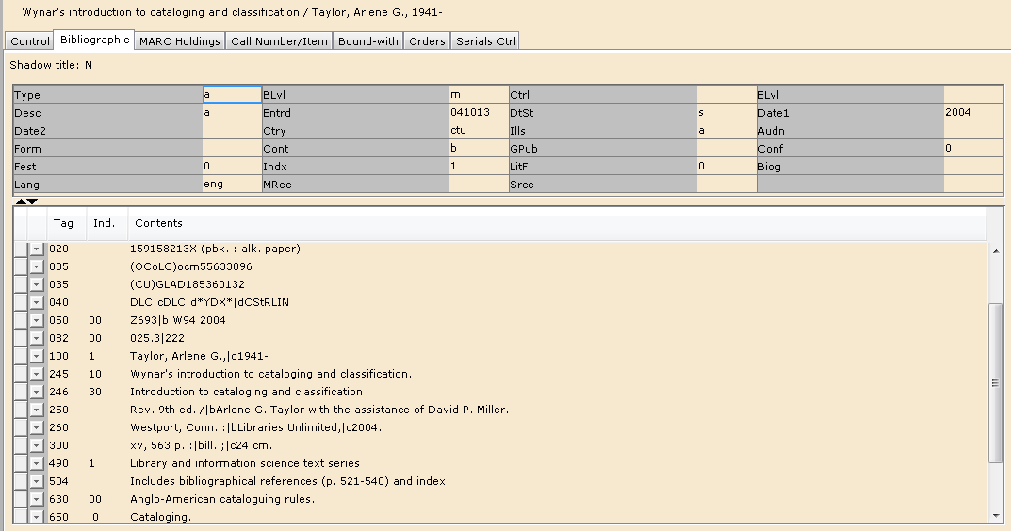

Slide 3
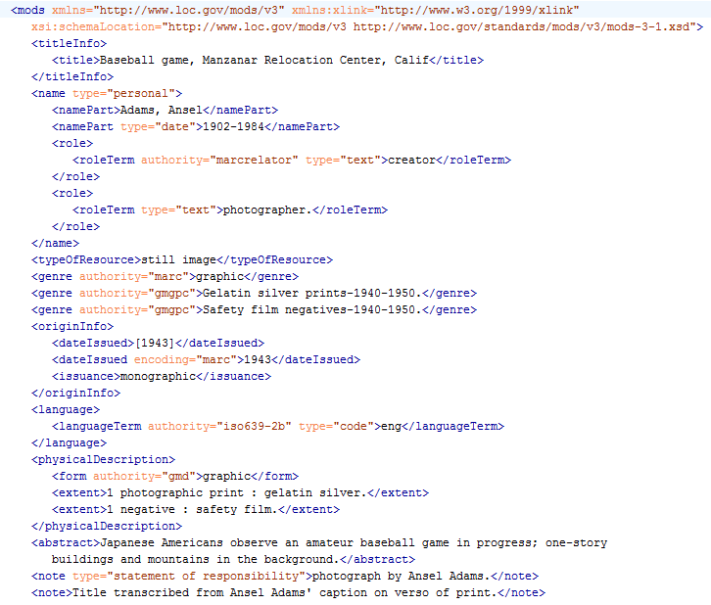

Slide 4
Let’s challenge some assumptions
Metadata creation interfaces should look like the underlying data
Metadata creation tools are for metadata experts (not content experts)
It’s not worth it to spend design time on internal tools; we’ll just train our staff to use them as they are
Efficient workflows mean only touching data for every resource once

Slide 5
Jenn’s first law of metadata creation tools:
Make it easy to do the right thing, and hard to screw up.

Slide 6
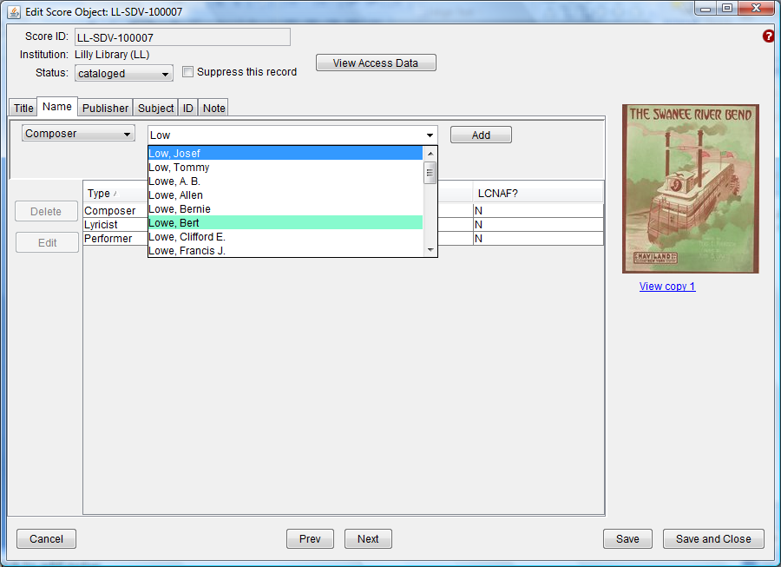

Slide 7
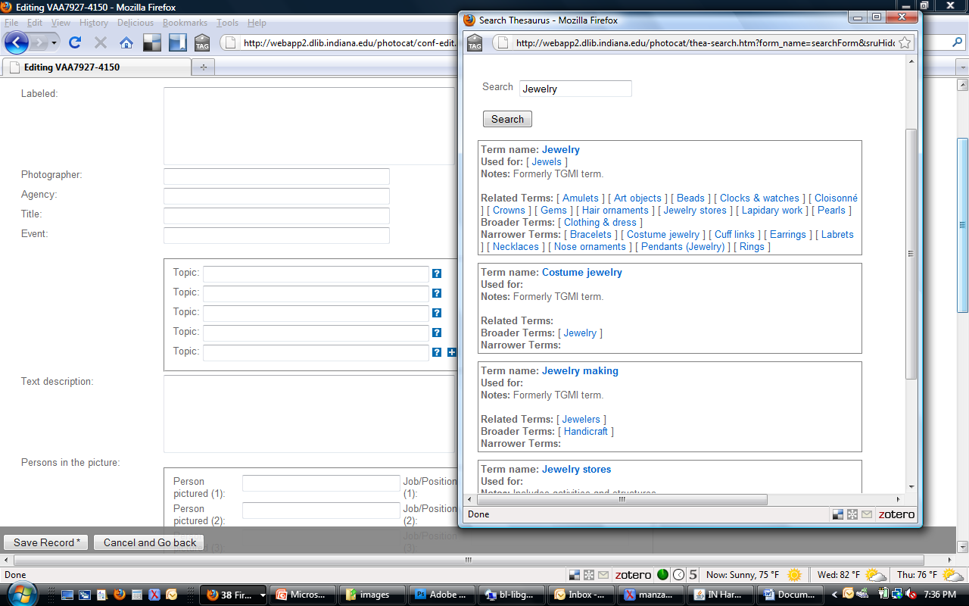

Slide 8
1/18/93

Slide 9
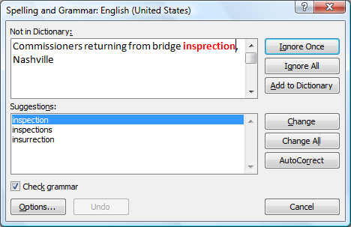

Slide 10
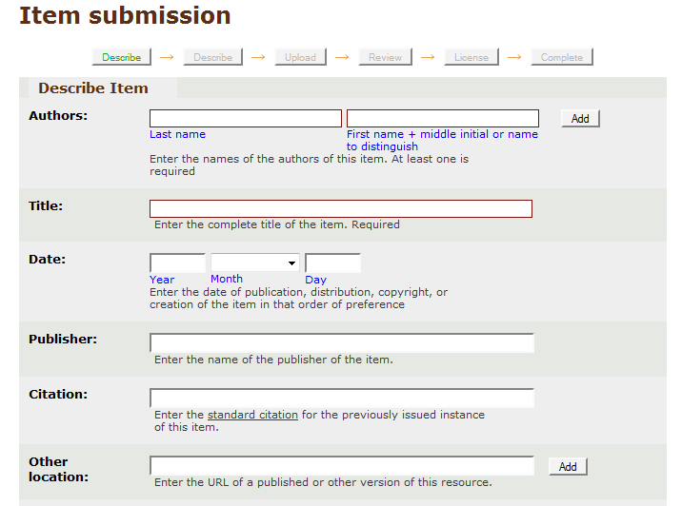

Slide 11
And more…
Batch editing
Record duplication
Search & replace
…

Slide 12
Jenn’s second law of metadata creation tools:
Hide complexity until you need it.

Slide 13
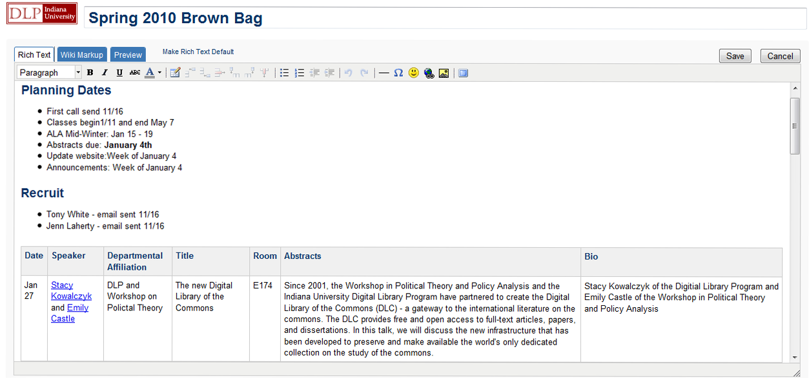
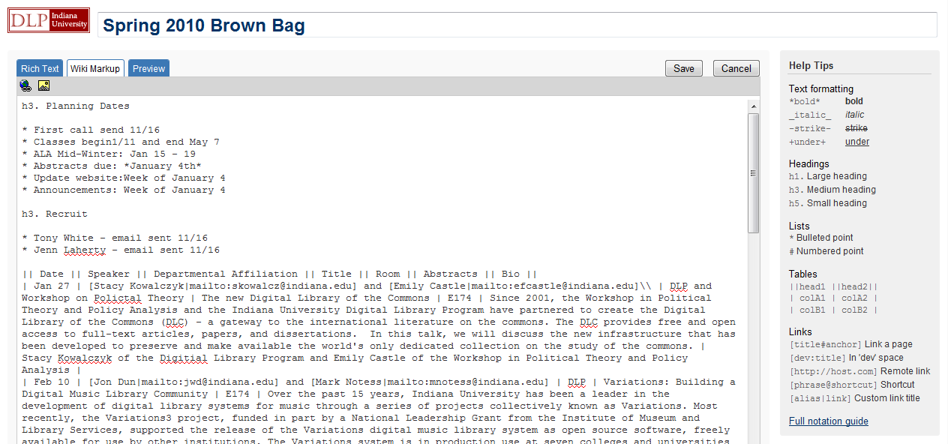

Slide 14
Showing just what they need
How much do users know about metadata principles?
How much do users know about the subject matter?
How much do users know about the overall system data flow?
How tech-savvy are the users?

Slide 15
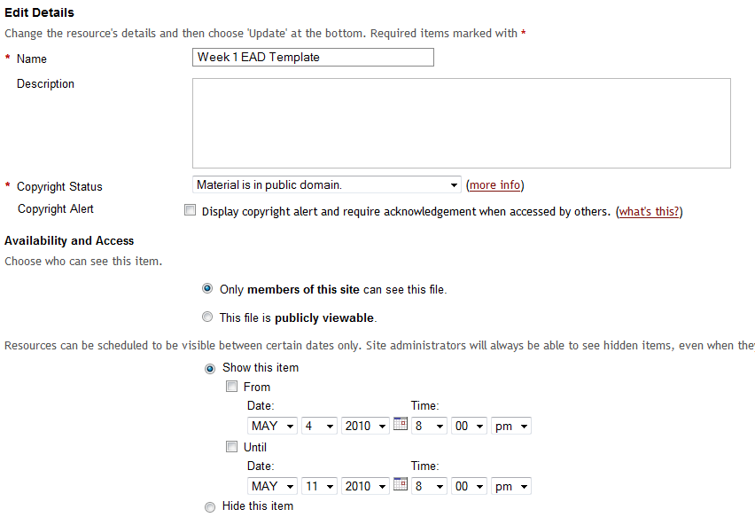
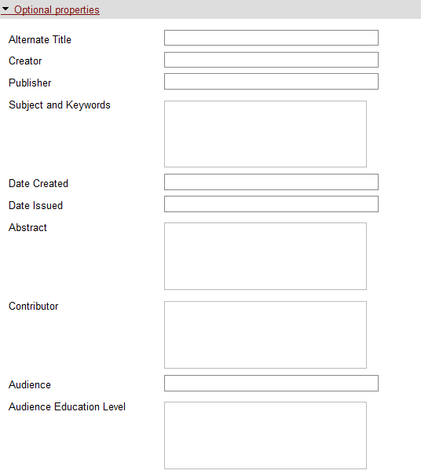

Slide 16
Jenn’s third law of metadata creation tools:
Match configurations to groups of materials.

Slide 17
Different types of stuff need different metadata setups. Deal with it.

Slide 18
Sorts of things to control in collection configurations
Mappings to underlying metadata formats
Field names displayed
Vocabularies used for controlled fields
Who can access what data
URL & ID patterns
Record statuses

Slide 19
Workflow integration
Allow record statuses to trigger outside actions
Allow different views of the data for different users
Let users see the whole picture on request
Let users see the raw underlying data on request
Powerful reporting features

Slide 20
Jenn’s fourth law of metadata creation tools:
Catalogers are people too.

Slide 21
Design for metadata creation tools
Honest attention to information architecture, matching design to users & tasks
Screen layout
Moving between tasks
Starting and ending a work session
Visually functional (& pleasing)
Usable!

Slide 22
Give them the correct tasks
Don’t ask people (and skilled ones at that) to perform tasks that can be done by machines
Work needs to be efficient and intellectually engaging
Don’t make them fill in values that can be automatically supplied
Show boilerplate data when necessary, but don’t let it get in the way
Avoid the “on a horse” problem!

Slide 23
They need all this stuff.
Really.
Keyboard shortcuts
Copy & paste
Drag & drop
Automation of repetitive tasks
Everything else mentioned earlier!

Slide 24
And then there are the hard problems
Allowing for that last bit of complexity needed some small % of the time
Handling the “special case”
CV integration
Keyword vs. left-anchored search
Alphabetical vs. hierarchical browse
Navigating relationships
Precoordinated vocabularies
Pattern headings
Adding to vocabularies inline
(And it doesn’t end here…)

Slide 25
Who’s in?
http://www.flickr.com/photos/seandreilinger/ / CC BY-NC-SA 2.0

Slide 26
Thank you!
These presentation slides: http://www.dlib.indiana.edu/~jenlrile/presentations/ bbspr10/mdtools/metadataTools.pptx
jenlrile@indiana.edu
Questions? Discussion?

