Slide 1
Enhancing Interoperability of FRBR-based Metadata
Jenn Riley
Indiana University
Digital Library Program
Notes:
11:40-12:05 (25 minutes)

Slide 2
FRBR and the V/FRBR Project

Slide 3
V/FRBR project @ Indiana U.
Concrete testbed for FRBR, using music (scores/recordings) as an example
Model for next-generation catalogs
Investigate FRBRized cataloging interfaces
Develop data model that embodies FRBR principles
Obviously this data must be interoperable
Opportunity to take advantage of data modeling work outside of libraries

Slide 4
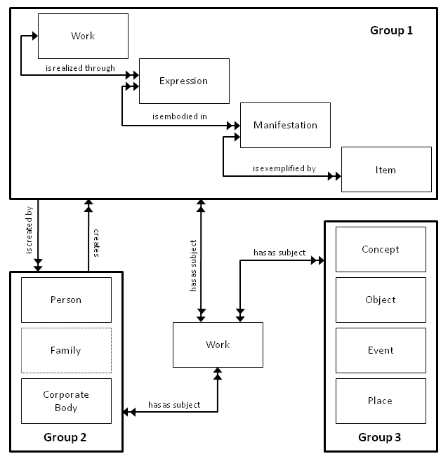
(selected) FRBR/FRAD entities & relationships

Slide 5
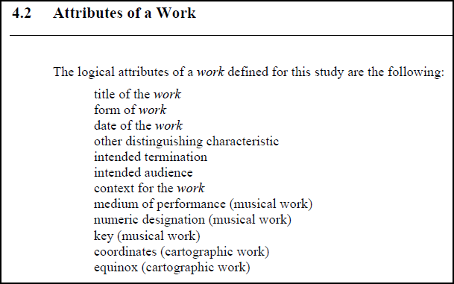
How literally to take FRBR attributes?

Slide 6
Looking for guidance
 | Focus on music? | Strictness of FRBR usage | Formal specifications public?
Probado (Bavarian State Library)
Music Australia
Music Ontology
Variazioni (European version; not Indiana’s)
DCMI/RDA Task Group
SWAP
-
-
-
-
-

Slide 7
Current status of data modeling activities
Lightweight specification in Excel
Listing formally all entities/attributes/relationships in FRBR/FRAD
Adding some features our project team believes are necessary to make FRBRized data useful in a production environment
Representation as W3C XML Schemas released
Data in XML format released
RDF/Linked Data representation work begun

Slide 8
XML Representation of FRBR/FRAD Data

Slide 9
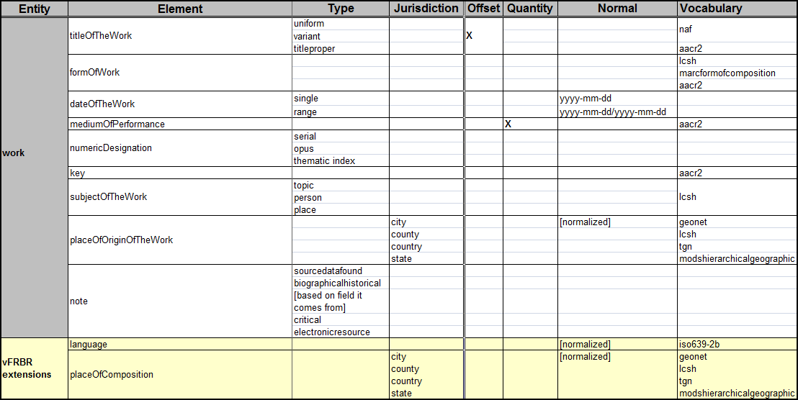
Data model specification
frbr
efrbr
vfrbr

Slide 10
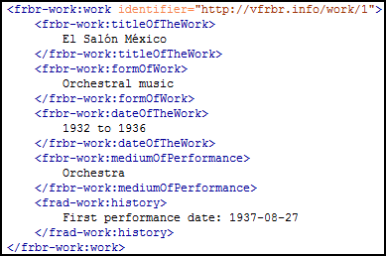
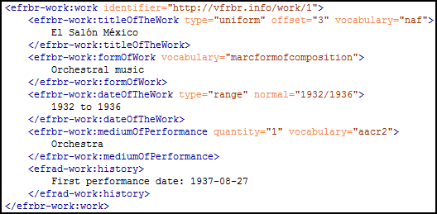
frbr
efrbr

Slide 11
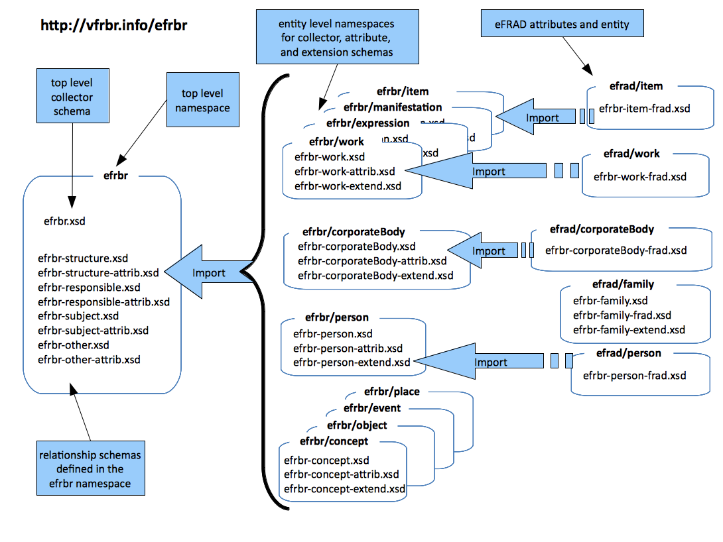

Slide 12
Data Interoperability Issues

Slide 13
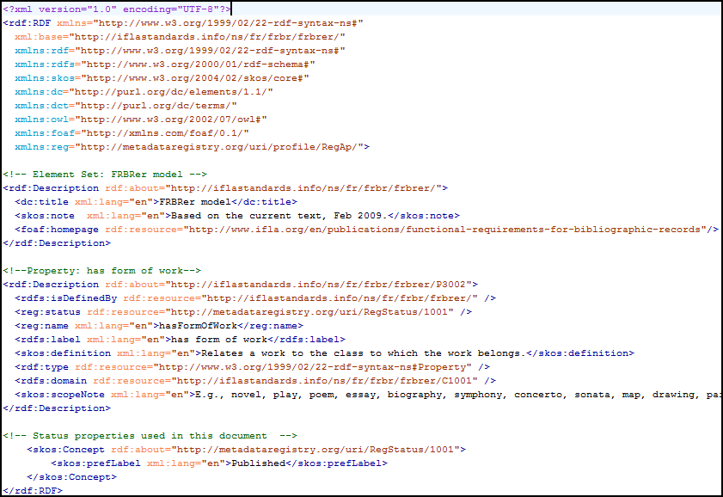
Working towards Linked Data (1)

Slide 14
Working towards Linked Data (2)
RDA registered properties
Music Ontology
FRBR in RDF (early model)
id.loc.gov
(etc.)
Potentially major complications conforming to formally specified domains and ranges.

Slide 15
Working towards Linked Data (3)
Need two versions of the data, in different properties?
This could be very easy, or very hard.

Slide 16
Interoperability levels
???
RDF/Linked Data would reach Level 2
Current XML representation at Level 1
http://dublincore.org/documents/interoperability-levels/index.shtml

Slide 17
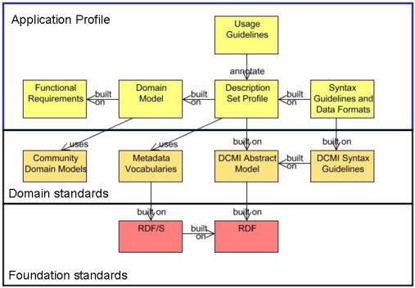
Singapore Framework
SWAP, potentially V/FRBR, and others are here – but share no formal specifications
FRBR is here – but it’s in human readable form only
Formal specification only enters here
http://dublincore.org/documents/singapore-framework/index.shtml

Slide 18
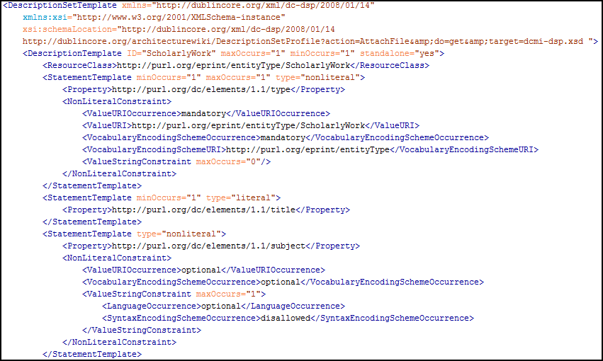
Is there a missing link?
This isn’t formally defined in RDF anywhere; and isn’t explicitly required to be by the DCAP guidelines.

Slide 19
Any changes needed here?
Stronger?
Necessary?

Slide 20
Better FRBR interoperability
Newly-minted official FRBR classes/properties provide a good starting point.
Shared/core FRBR DSP?
How can we bring RDA work in more tightly?
What should the V/FRBR project do next?
Any lessons here for the DCAM/DSP revision?

Slide 21
Thank you!
For more information:
http://vfrbr.info
XML Schemas: http://vfrbr.info/schemas
XML data download: http://vfrbr.info/data/1.0
Linked Data: hopefully on the way!
jenlrile@indiana.edu
These presentation slides:
http://www.dlib.indiana.edu/~jenlrile/presentations/ dc2010/riley.pptx
This project is made possible by a grant from the U.S. Institute of Museum and Library Services.

