Slide 1
Linked Data and Rda: Looking toward next generation cataloging
Jenn Riley
Head, Carolina Digital Library and Archives
Digital Discussions series
Twitter: #cdladigdisc

Slide 2
21st century information landscape
Everything interconnected
Build on others’ data
Semantic Web
Think of it as authority files on steroids
It’s all very meta
Libraries need to be a part of this

Slide 3
Linked Data
Use URIs as names for things
Use HTTP URIs so that people can look up these names
When someone looks up a URI, provide useful information, using standards
Include links to other URIs, so that they can discover more things
RDF is the most common and best practice standard for the implementation of Linked Data
Tim Berners-Lee, Linked Data – Design Issues http://www.w3.org/DesignIssues/LinkedData.html

Slide 4
Basics of RDF
Resource Description Framework
An abstract data model
Not a metadata schema
A suite of W3C standards
The way the web community is representing structured data today

Slide 5
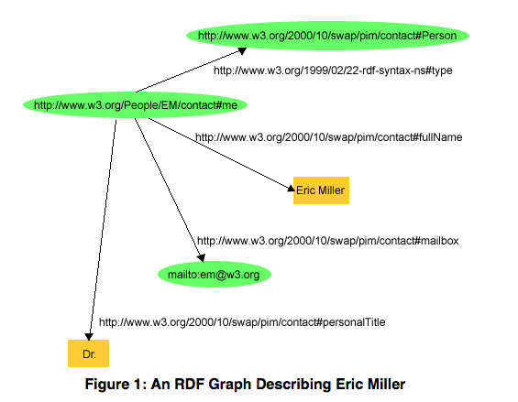
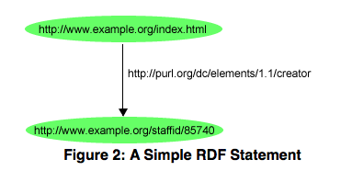
RDF has “statements” and “graphs”
This is a “statement,” aka a “triple”. A statement is made in a particular direction.
predicate
subject
object
Statements combine to form graphs. A graph is of no fixed size and contains no predetermined types of statements.
Figures from RDF Primer <http://www.w3.org/TR/rdf-primer/>

Slide 6
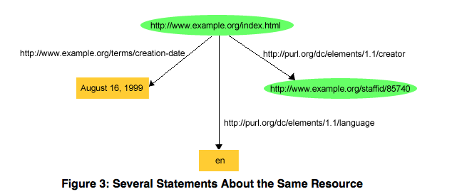
The role of URIs
subject: must be a URI
predicate: must be a URI
object: can be a URI, or a “literal”
Figure from RDF Primer <http://www.w3.org/TR/rdf-primer/>
Notes:
Literal = “constant value”

Slide 7
Properties and classes
Predicates are defined as RDF “properties.”
subject
predicate
Subjects and objects can be members of an RDF “class.”
object
Figure from RDF Primer <http://www.w3.org/TR/rdf-primer/>

Slide 8
Implications of statement structure (1)
Subjects are always formalized; know exactly what is being talked about
Subjects are only implicit in library metadata
Makes moot the 1:1 problem
Might still have content vs. carrier problem
Predicates are always formalized
Maybe not all that different than library/archive/museum metadata models
More obviously reusable

Slide 9
Implications of statement structure (2)
Representation of objects is flexible
Using a URI facilitates connecting this value into a larger graph
Literals allow more limited functionality; used when the value isn’t likely to be useful as part of a vocabulary
URI vs. literal a design choice; note the previous example used a literal where a URI might be better!
Making a statement that two different URIs refer to the same thing can join two graphs
Note, URIs aren’t necessarily dereferencable

Slide 10
How RDF is not like library standards
No predetermined set of properties to care about
No guarantee that the same person/item/place/whatever are always referred to with the same URI
No inherent mechanism/requirement for vetting properties, URIs, etc
But let’s be frank here. Are our library/archive/museum records really:
Complete?
Authoritative?
Consistent?
Accurate?
All that functional for what we want to do?

Slide 11
RDA in RDF
There’s another side to RDA, beyond the rules
As “data elements”
Grew out of a 2007 meeting between representatives from the JSC and DCMI
But it’s currently operating mostly independently
Vision is that RDA data elements could be the basis for machine interoperation of library data in a Linked Data environment in the future

Slide 12
Some RDA (FRBR) RDF classes
Work
Expression
Manifestation
Item
Subject
Name
Person
Family
Corporate Body
Concept
Object
Event
Place

Slide 13
Some RDA RDF properties
Identifier for the work
Date of work
Language of expression
Media type
Carrier type
Variant title
Preferred name for the person
Date of birth
Variant name for the corporate body

Slide 14
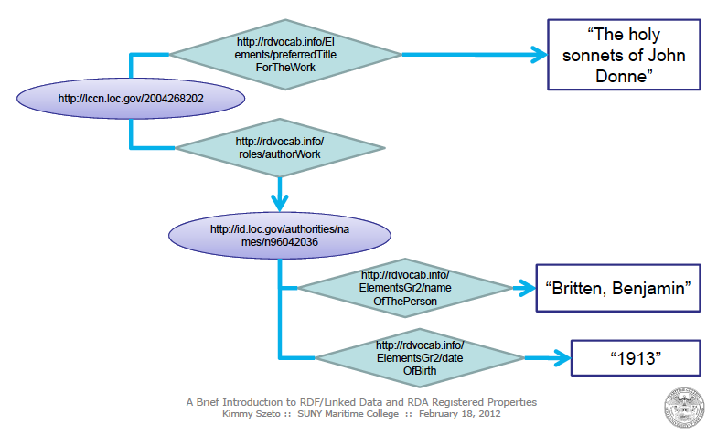
A simple graph of some library data
Graphic courtesy Kimmy Szeto, SUNY Maritime College

Slide 15
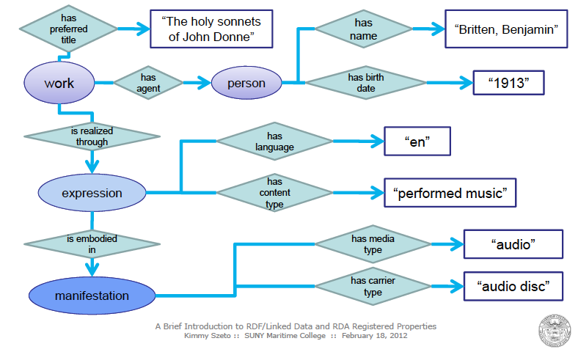
Adding some more…
Graphic courtesy Kimmy Szeto, SUNY Maritime College

Slide 16
Encoding a graph into data

Slide 17
Woah. Really?!?
Nobody is meant to create this data in this form by hand. Really.
Libraries encoding data in RDF (through good interfaces) opens up enormous possibilities for us to participate in the wider information community.
Let’s explore that idea.

Slide 18
This is the last of the XML, I promise.

Slide 19
Other important features of the Semantic Web/Linked Data environment
The RDF graph model is the most important thing; encoding triples in a specific syntax is secondary
The concept of a “record” isn’t really meaningful when looking at the information world as a graph
Open world assumption
Many vocabularies, with connections between them
Expectation that implementations will deal with data from multiple sources
Reasoners

Slide 20
Infrastructure that we’ll need
Ways to identify trusted data sources
Ways to identify and understand properties and classes defined by others
Best practices for data caching
Actual shared cataloging
We’ll need to stop downloading records. I mean that.
Better data creation, management, sharing, and exposure systems
Ones that actually work
Library community best practices on where to scope our data creation efforts

Slide 21
Large Linked Data initiatives to watch
Named graphs
Provenance WG
Also watch DC-Architecture

Slide 22
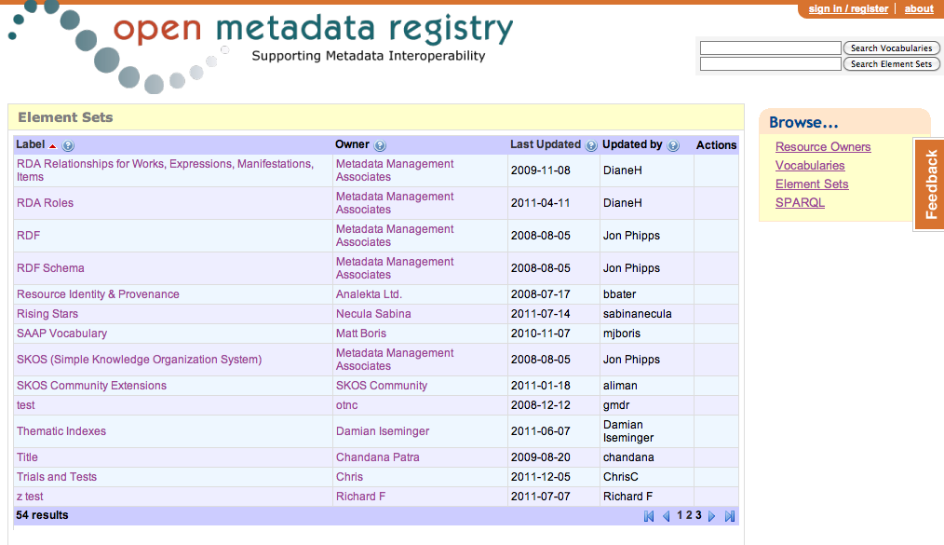
Here’s one part of that emerging infrastructure

Slide 23
What the library community is doing
Exposing authority (and more recently bibliographic) data, and vocabularies as Linked Data
W3C Linked Library Data Incubator Group
Stanford Linked Data Technology Plan
RDA as data elements in Open Metadata Registry
Still dancing around official endorsement
LC Bibliographic Framework Transition Initiative
“The new bibliographic framework project will be focused on the Web environment, Linked Data principles and mechanisms, and the Resource Description Framework (RDF) as a basic data model.” (From http://www.loc.gov/marc/transition/news/framework-103111.html)
Summer/Fall 2012 contract with Zephira

Slide 24
Who’s doing Linked Data?
id.loc.gov
VIAF
Open Library
Europeana
PubMed
Project Gutenberg
Wikipedia (as dbpedia)
BBC
last.fm
data.gov.uk
etc…

Slide 25
My burning question
What would it mean for libraries to be LD consumers, and not just publishers?

Slide 26
Some further resources
jennriley@unc.edu
These slides: http://www.lib.unc.edu/users/jlriley/presentations/digdisc/ldrda/linkedDataRDA.pptx
W3C LLD Incubator Group final report: http://www.w3.org/2005/Incubator/lld/XGR-lld-20111025/
Stanford Linked Data Technology Plan: http://www.clir.org/pubs/reports/pub152/LDWTechDraft_ver1.0final_111230.pdf
Open Metadata Registry: http://metadataregistry.org
Hillmann, Diane, Karen Coyle, Jon Phipps, and Gordon Dunsire. (January/February 2010) “RDA Vocabularies: Process, Outcome, Use.” D-Lib Magazine 16, no. 1/2. http://dlib.org/dlib/january10/hillmann/01hillmann.html

Slide 27
Digital Discussions
How was the session today? Take a quick survey: http://bit.ly/cdladigdisc
http://digitaldiscussions.web.unc.edu
Twitter: #cdladigdisc

