Slide 1
From Project to … Services?
Jenn Riley (@jenlrile)
Head, Carolina Digital Library and Archives
University of North Carolina at Chapel Hill
Notes:
You’ve heard of the shift from project to program. It’s cliché in our field at this point.
At UNC, we’ve begun to reframe this transition to one of services. This is happening throughout the library, but I’ll focus today on my unit, the Carolina Digital Library and Archives, which is heavily focused on classic “digital library” activities – digital collections and partnerships with faculty in the humanities on works of digital scholarship. What I’ll talk about today is how we’re approaching that transition and what I think it gets us that a programmatic focus doesn’t.

Slide 2
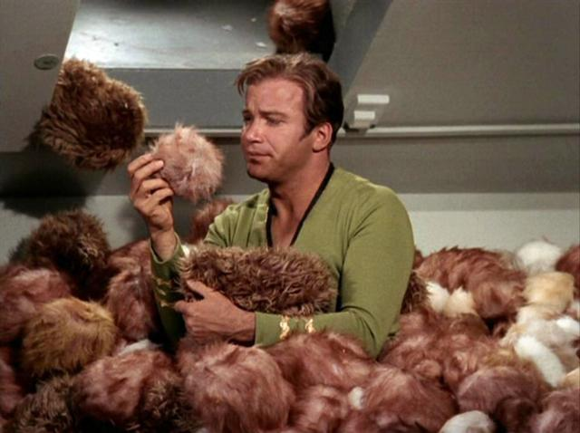
Here’s where we found ourselves
Notes:
Digital initiatives at UNC has had some significant successes. Early, high profile digital collections, successful faculty partnerships. Both digital collections style work that put manuscripts/photos/texts available online and more scholarly work with interpretation and original representation. To put it in Star Trek terms, we’d figured out that shifty guy was a Klingon, saved the space station– we’d set ourselves on a mission and accomplished it.
Yet you know the story of where we found ourselves when we stepped back to evaluate where we were - we had grant funded projects, technical experiments, project-centric technology stacks. Even if things are built well and applicable to other pools of content, we’d need to run a second software instance. Suddenly there were Tribbles everywhere.
We've put a lot of effort into CONTENTdm, but it's just a bigger silo.
We have a preservation repository (with some access) but it's also just a bigger silo.

Slide 3
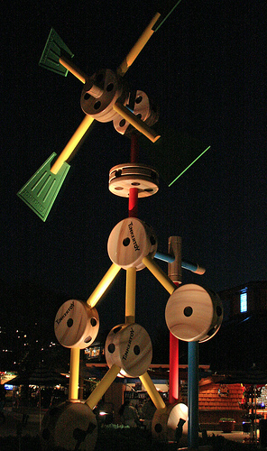
Our immediate goals
Scalability
Sustainability
Light bulb photo by Pablo S Rios, http://www.flickr.com/photos/pablosrios/3658162172/, CC by-nc-sa 2.0
Tinkertoys photo by Bill Barber, http://www.flickr.com/photos/wdwbarber/4357545622/, CC by-nc 2.0
Notes:
Here are our most immediate needs for digital scholarship support in the library, particularly for the humanities. Our approach is to start with some core needs and work outward from there.
We need sustainability
We can and should put effort into keeping SELECTED content alive over time, and user interfaces that remain relevant as user expectations evolve. The traditional project to program transition looks at core technical infrastructure, funding models, staff with base expertise so you don't have to hire for it with grant funds every time. This is good. This is where a programmatic approach really pays off. We’ll be doing that.
Many at this point will ask a critical question – does all this stuff really need to be sustained, to be preserved? What a great question. I do know some scholars that aren’t concerned about long-term viability of their works, but I know many more that are. Let’s start with the ones that do need and care about sustainability. I’ll address how we’re thinking about the more skunkworks style efforts later. I see the much needed focus on those in our community recently, and we all have a lot to learn in this area. But the sustainability need is still there, despite the attention otherwise. And it’s one we’re focusing concerted attention on right now.
We need scalability
We don’t want to have 2-3 grant projects each lasting 2-3 years working with faculty to build innovative works of scholarship. We want to enable UNC scholars to do 400 projects in 2 years, both with and without grant funding. I'm looking for a way for us in the library to prepare for the day when every humanist (faculty and graduate student) on our campus is doing a digital project or two or three. We have 933 faculty in our College of Arts and Sciences.
And here’s where innovation comes in. The sustainable core can be scaled out to new things that may or may not find that path to sustainability that we love to talk about. Here again, we need core services that can provide these in the large number of cases where it’s necessary.
I want both sustainability and scalability. And I think core services is likely to be more effective to promote this transition rather than a programmatic focus. These services have to have a programmatic basis, though, so the way I define our project to services transition includes the “program” bit.

Slide 4
Our landscape
CRADLE
Notes:
CDHI: $1.3m from Mellon, 3 faculty hires, DH focus for graduate students
DICE = “Data Intensive Cyber Environments” (iRODS comes out of this)
CRADLE = Center for Research & Development of Digital Libraries
DIL = wordpress plugins for objects on maps, telling spatial stories
- Some big, high profile, new
- big list of things going on, lots of overlap, no clear boundaries now and won't be for a while. we need to accept that and move forward despite this uncertainty
- we need to reframe ourselves to be involved in many different types of initiatives, in many different ways, not just the ones we do the administrative support and technology hosting for

Slide 5
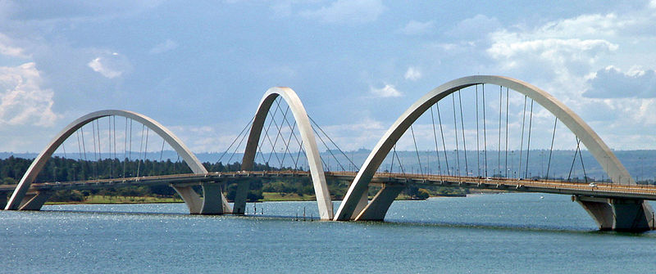
Services
Juscelino Kubitschek Bridge, Brasilia, Brazil
Photo by Mario Roberto Duran Ortiz, http://en.wikipedia.org/wiki/File:BSB_Ponte_JK_Panorama_05_2007_266.jpg
Notes:
…which leads us to services as the way we frame this involvement
Consider core tech infrastructure cast as a service. Project vs service is not just a question of semantics. If we think about what core services we need to offer to meet defined campus needs, and think about them the way we think about other library services (eg reference, circulation, cataloging) we start reaching different decisions about how to implement specific things than if we were looking at a way to do a specific project most efficiently and effectively. A services focus forces us to identify relationships between things, analyze implications, think about scalability, to generalize based on patterns.
My department has in the last year really ramped up services to library staff, including weekly office hours, project facilitation and planning help, and a monthly presentation/discussion series, and we’re starting to turn this service orientation to digital scholarship support for the campus.

Slide 6
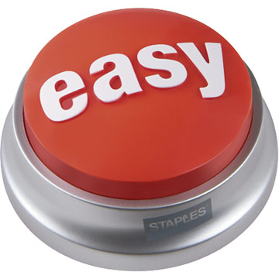
Start here
Notes:
We are looking for tech infrastructure that makes the easy stuff easy. we see this as a service. provide the infrastructure and shrink the scalability/sustainability problem to 20% of what it was - the core inf takes care of the other 80%
I am NOT trying to say that we think DH is easy. Quite the opposite. We’re looking to minimize the effort spent on things that aren’t the main intellectual focus of the work and allow the intellectual effort that characterizes DH as a field be most effectively focused.
Impact of this for the library: we can strategically look at that last 20% and decide for each initiative who on campus (and beyond) is best poised to collaborate on/support it. the library can be less fearful about participating in some of those 20% activities since they're smaller and represent less of an investment and risk.
- what's that? LESS risk?
we say we want to embrace more risk taking in libraries. i believe we should. but it's a process, and scaling down the size of the risk is (IMO) a good way to start to build this culture. can/should it grow later? i don't know yet. but this is how i'm working to find out. I’m a pragmatist – I believe in my core values and work towards them but think it’s still better to take steps towards something even when it’s not implementing the whole vision at first.
- also opens up ripe area for librarianship innovation: gluing systems together, modular architectures, interoperability, effective reuse rather than "not invented here" style building

Slide 7
A pilot, as technology and a service
Notes:
Omeka as the most promising next step of this architecture for digital scholarship services at UNC
Omeka isn’t new to you, and probably many of you use it to create and disseminate digital scholarship
pilot Fall 2012 - Fall 2013
Goal of pilot = define what a production service will look like, how much it will cost, what its boundaries will be, how we’ll set it up technically. We’re treading carefully here, because of our past experience. I think that’s OK. Our first goal, again, is sustainability and scalability.
Also to help us define the 80% to cover easily and the 20% to strategically focus on
describe scope for faculty projects, library exhibits
Resources
Library systems for system setup (4 instances), plugin work, customization work
-- some focused startup time from sysadmin (less than a full time person tho, then some maintenance)
-- 10 hrs/ mo appdev time
CDLA staff for user management, theme development, training, assessment
-- ~10% of my time and Natasha’s, ~5% of Mike’s,, 10 hrs/wk from CALA, ca 10 hrs/wk of a student
Assessment
Interviews with pilot testers, other scholars w/ dh experience, library systems
Group review of highlights
Focus on what needs are/aren’t being met

Slide 8
So what has this taught us about casting our work as services?
Notes:
So what you’ve seen here is a relatively conservative approach, at least for the first few steps I’ve described here. “Digital scholarship” and “conservative” aren’t necessarily the best match, especially given the pace of change right now. And I hear the admonishments out there of the dangers of casting library DH support as a service, most notably from Bethany Nowiskie and Trevor Munoz, and I understand their concerns. If we at UNC were to stop with Omeka, I think we’d fall into the trap that Bethany and Trevor lay out.
But I truly don’t think we are falling into that trap. And I think the picture many are painting of the digital scholarship landscape is a bit rose colored. In our zeal to promote the experimental, experiential, joyful aesthetic of the digital humanities, to make that excitement infectious for libraries and to get us drawing on whiteboards and pushing the envelope together with our faculty, we’re forgetting, or perhaps even hiding, that there really is a great deal of the “other” stuff going on. And I truly don’t believe that this exploratory character of DH is inherently antithetical to a service orientation.
Trevor has a post entitled “Digital humanities in the library is not a service.” There he says that "Digital humanities involves research and teaching and building things and participating in communities both online and off. In libraries, digital humanities should involve those same things" and "Librarianship is intellectual work. Doing digital humanities in the library should be (re)centered on the research questions and intellectual agendas of librarians."
I agree completely. I believe we at UNC are on a path to recentering, and are starting to define our own research agenda. We feel we need to do some plumbing work before we do the painting, though. Our approach shrinks the sustainability and scalability problems to allow us to be comfortable (resource wise) participating in the out-front intellectual work in the area of librarianship. We’re hoping to move further along this path with our current strategic planning process, which I’ll describe momentarily.
Bethany fears library services are born out of an "impulse ... to provide a level of self-effacing service – quiet and efficient perfection – with a goal of not distracting the researcher from his work". She goes on to describe a danger of this approach as making the library a black box and losing an opportunity for faculty to be advocates for funding the library as infrastructure. I see just how closely the approach I’ve described here mirrors just what she and Trevor are warning us against. But for whatever reason, I don't think my library and my unit carry this particular bit of baggage. We don't view services as quiet and efficient perfection. We (and I) view them as tools, as key parts of scholarly work. When we say we’re saving both our and our faculty's time for the more interesting stuff by providing core services it’s as much out of a desire to draw these researchers in as to protect their time. They will learn something from this collaboration, from using our services. We believe we’re not protecting them from distraction – quite the opposite: we’re providing an environment where they’re encouraged to go further in the DH space.
Both Noviskie and Munoz talk about paths to sustainability from experimental work (Munoz calls it tech transfer). We don’t have a skunkworks within the UNC Library in place right now. We’re still looking at the best way to get there for our organization. But even when we do, I don’t want that to be the unit that “does” DH. The library needs to do DH. And that means across departments, with the most bleeding edge faculty and grad students, and with those in the middle as well. I want to open up DH methods to more people. Not just the ones that can get a coveted faculty fellowship or go through something like the praxis program as a grad student. That means a suite of services with different areas of focus. Services like the ones we’re planning on offering will do that, and complement the other efforts on campus.

Slide 9
Our proposal for Library-based DH support services
Digitize library collections
Offer Library staff as research partners on digital humanities projects in areas of specialization
Periodically offer structured formal training and guidance on select digital humanities activities
Provide consultation on best practices for producing sustainable digital humanities initiatives
Facilitate research and pedagogical use and re-use of digital material managed by the Library
Provide select core infrastructure and services for digital humanities work
Partner on select initiatives that advance the state of the art in the digital humanities field and grow digital infrastructure in the Library
Notes:
Proposed by CDLA as part of strategic planning process
Digitize library collections.
Facilitate research and pedagogical use and re-use of digital material managed by the Library. Not just the browser – machine access too
Provide select core infrastructure and services for digital humanities work. Eg omeka. Make this easy to get to and use
Partner on select initiatives that advance the state of the art in the digital humanities field and grow digital infrastructure in the Library. This is the library’s research agenda
Offer Library staff as research partners on digital humanities projects in areas of specialization. Subject specialists don’t just provide the methodological help but actually be a resource in the scholarly domain too
Periodically offer structured formal training and guidance on select digital humanities activities. Workshops, tutorials, connection to good resources
Provide consultation on best practices for producing sustainable digital humanities initiatives.
We think these services aren’t invisible; they position us as partners. They help build and leverage the inherent playfulness that characterizes DH. They get us to where we want to be.
We have many steps to get to providing these services – staffing, technology, lots of others. But as a strategic direction this gives us a framework in which to work.

Slide 10
(Shall I say it?)
jennriley@unc.edu
This work is licensed under a Creative Commons Attribution-ShareAlike 3.0 Unported License.
Notes:
Please forgive my geekiness if I say we’re positioning ourselves “to boldly go” forward along this path. I’m looking forward to the other panelists perspectives on these issues and the group discussion coming up later. Thank you.

