Slide 1
Innovating in The gaps
Jenn Riley
Metadata Librarian
Indiana University Digital Library Program
DLF Fall Forum 2009

Slide 2
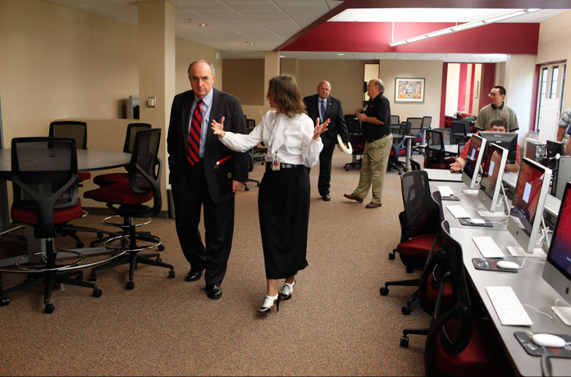
It’s easy to justify innovative approaches to these…
Photo by Aaron Bernstein http://newsinfo.iu.edu/asset/page/normal/7748.html

Slide 3
And these…
http://catalog.hathitrust.org

Slide 4
But what about these?
Courtesy of Indiana University http://newsinfo.iu.edu/asset/page/normal/6785.html
Notes:
Indiana University Research and Teaching Preserve's new Field Laboratory, an ecology and environmental sciences research station and classroom facility on the Bloomington campus. The Field Laboratory will likely be designated IU Bloomington's first "silver" LEED-certified structure when the approval process is complete.

Slide 5
And these?
http://biblios.net
Notes:
This is the biblios.net cataloging interface. There’s one really interesting thing about this – it’s web based and open, not tied to a specific ILS. But it looks like every other MARC cataloging interface.

Slide 6
We too often have internal tools that work like this…
http://www.flickr.com/photos/elsie/ / CC BY 2.0

Slide 7
When what we need is this
http://www.flickr.com/photos/mollydot/ / CC BY-NC 2.0

Slide 8
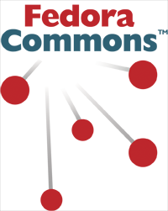
Look at all the things we need to effectively hook together
Notes:
Allowing and encouraging time to innovate in the under the hood systems is even more important as we start to focus more and more on digital preservation issues. BagIt and Sword are two examples of the types of tools that help us accomplish these goals, and are in as much of a need of innovative approaches as anything else we do.

Slide 9
Workflow tools need attention
Identifier assignment
Quality assurance (objects and metadata)
Managing object status
Moving files around
Repository ingestion
Process logging, especially errors that require action

Slide 10
These tools need to be…
Usable
Efficient
Sustainable
Interconnected
Automated where appropriate
Notes:
Efficiency and sustainability

Slide 11
Ooo, shiny!
http://www.flickr.com/photos/tim_ellis/ / CC BY-NC 2.0
Notes:
We must remove both the stigma and the rapture from the “shiny” phenomenon. The light bulb over the head is a great thing, and should be rewarded. But shiny alone is not enough. A big challenge for any community is finding the right way to feed innovative work into the production environment. I have a few thoughts on methodologies to help do this in some way.

Slide 12
Lesson #1
It’s OK to re-architect existing systems.
Notes:
Technologies change over time, as does institutional context. To be sustainable, systems need to be upgraded. We can innovate in this area by doing this in a planned and creative way, rather than the “plugging the leak” approach. Our in the trenches development staff know how these systems work better than anyone – they know where the inefficiencies and brittle parts are. Give them license to work on under-the-hood improvements. It’s not sexy to do a bunch of work and have essentially the same service in the end; but it’s essential to do this from time to time, to plan for doing this, and to give the right people these tasks.

Slide 13
Lesson #2
It’s all about balance.
Notes:
Innovation really needs to have a basis in reality. Otherwise you’re working on solving the wrong problems. Innovation is building upon what’s already out there - need to provide resources and set expectations for staying abreast of the state of the art in any given field. Otherwise too much duplication of effort and misdirected focus.
EVERYONE can come up with creative approaches to something; everyone has their own individual talents. Give individuals environments where they can find their own fit. Innovation isn’t necessarily an individual thing, though. While some work best being left alone to experiment, many others are at their most creative in a like-minded but still diverse team, bouncing ideas off one another and keeping the scope in check. Find time for group brainstorming, for example, outside of a traditional 4-item 1-hour meeting agenda.
Everything any given person does isn’t going to be innovative. Give them opportunities to take tasks in new directions, set high expectations for creative solutions, but at the same time reward production regardless of its nature.

Slide 14
Lesson #3
Set the same expectations/goals/rewards for the small scale as for the large.
Notes:
Little things can make a big difference, and big things don’t always have the world-changing impact we expect them to. Innovative work can AND SHOULD happen at any scale. Especially if we acknowledge the need for balance, that any individual can contribute innovative work and that not all the work any given individual done is innovative, innovating on the small scale is a good thing. It gives people an opportunity to find the right place for their contribution (since there are SO many small parts that make up our systems and workflows), experiment with a lower degree of risk, and more easily succeed quickly. That’s a foundation that can be easily built upon, helping to shape a culture of innovation at an insititution.

Slide 15
Lesson #4
It’s OK to focus on good workflows.
Notes:
Making your own life easier can be both motivating and inspiring. Workflows supporting the creation and management of data in our systems are a key part of our work, yet they’re rarely well thought out or efficient. Too often they’re a reflection of legacy systems, lack of targeted attention, or workarounds for quirks in current systems. How many of you have processes that require a skilled programmer to monitor and hit a button every 10 minutes? These workflows are hard to learn, break down easily, and use the time of skilled staff in an inefficient manner.
There’s a lesson to be learned her from discussion in the Technical Services community - Eliminate or automate low value tasks with better workflows. Use human time for tasks that need it, and automate the routine stuff.
Small scale innovation opportunities frequently relate to data management workflows and their relationship to digital library infrastructure. This area is ripe for innovation, and those that can improve these workflows are the same individuals that use them every day. It’s OK to focus on data management workflows – they’re back end operations and don’t have the visibility or sexiness of public systems, but these workflows are what allow us to deliver and preserve content in the first place. It’s essential that they work efficiently.

Slide 16
Lesson #5
Focus on the goal. The process is negotiable.
Notes:
There’s rarely (never?) one single way to do something. We become attached to our processes; they’re familiar and generally are in place for a good reason. But things change. Processes become out of date over time, especially technologically. Encouraging a focus on the goal – the result of the process – rather than the process itself sets a tone that allows innovation. New processes can be developed that meet the same goals, using more current technologies, operate more efficiently, or perhaps operating even better. Authority control as an example – this is a process; goal is collocation and disambiguation.

Slide 17
Area ripe for innovation #1
Metadata creation tools
Notes:
We put a great deal of time and effort into making our end-user systems usable but rarely systems intended for staff use. Thought is “we can just train them how to use it.” But this is inefficient to say the least. These systems need to WORK. There’s a sea-change in metadata creation coming, but only if we can ensure the tools exist to support this work. Not a good track record in this area!
Make it easy to do the right thing and hard to screw up.
Integrate tools for content analysis
Usable by subject specialists
Structured data from end users

Slide 18
Area ripe for innovation #2
Routine customization
Notes:
I’m serious.
We can’t treat all content the same, but we also can’t start from scratch for every new group of stuff. An end-user display needs different labels and even different fields for a work of fiction than a scholarly monograph than a film than a dataset. End-user interaction with an object needs to be different for a paged object than for a moving image or for a learning-focused system. Our delivery systems need to work for our end users, and the requirements for them will differ depending on the content and the type of user. These same principles apply to other aspects of our systems as well. Yet the technical means by which we customize and our planning workflows tend to require a great deal of struggling. Every little thing we can do to make it easy to standardize and customize simultaneously will be well worth the effort. But this is a hard problem which will require innovative and creative approaches.

Slide 19
Area ripe for innovation #3
research -> practice -> production
Notes:
Like many disciplines, the difference between research and practice in digital libraries is wide. Part of the cause is the wide variety of fields from which digital libraries can draw, including computer science, informatics, information retrieval, information science, etc. One barrier to effective adoption of research outputs in the more traditional “library” side of digital library operations is the cult of perfection. But ideas from research can and should be incorporated into real systems and workflows – it just takes a bit of creativity and innovation to find the right place and insert the right level of human oversight.
Similarly, the DL community has a long history of trying out innovative things in one system or project, but letting them stop there instead of integrating them into production workflows on a larger scale. The main reason of course is that moving anything from a one-off attempt into production is hard. But we have to find ways to do this, and those ways will be as innovative as any of the other activities we’re hearing about at this conference.

Slide 20
Thank you!
jenlrile@indiana.edu
These presentation slides: http://www.dlib.indiana.edu/~jenlrile/presentations/dlfFall2009/riley.pptx
(Please work on better metadata creation tools. kthxbye.)

