Slide 1
Introduction to metadata for IDAH fellows
Jenn Riley
Metadata Librarian
Digital Library Program

Slide 2
Many definitions of metadata
“Data about data”
“Structured information about an information resource of any media type or format.” (Caplan)
“Structured information that describes, explains, locates, or otherwise makes it easier to retrieve, use, or manage an information resource.” (NISO)
“Metadata is constructed, constructive, and actionable.” (Coyle)
…

Slide 3
Some uses of metadata
By information specialists
Describing “non-traditional” materials
Cataloging Web sites
Navigating within digital objects
Managing digital objects over the long term
By novices
Preparing Web sites for search engines
Depositing materials into an institutional repository
Managing citation lists
iTunes
Tagging – flickr, del.icio.us, etc.
LibraryThing

Slide 4
Good metadata…
Meets a defined purpose
Conforms to accepted standards and/or best practices
Is created as close to the source as possible
Doesn’t have to be created by humans

Slide 5
Metadata formats
Predefined sets of features likely to be necessary or useful for a specific purpose
Choosing a format others also use improves interoperability
Can be:
Official standards
Backed by professional organization
Backed by trusted institution
Locally developed
In the library world, most referred to by acronyms: MARC, MODS, DC, METS, TEI, EAD…

Slide 6
Creating and storing metadata
HTML <meta> tags
Spreadsheets
Databases
XML
Library catalogs
Specialized user interfaces for a specific type of content
Digital library/content management systems

Slide 7
Some types of metadata
Descriptive metadata
Technical metadata
Structural metadata
Markup languages

Slide 8
How metadata can be used

Slide 9
Descriptive metadata
A description of a resource for display to users
Provides the context they need to understand a resource
For discovery
Includes both search and browse
In a controlled environment designed to match target users with interesting resources
Pushed out to the network for others to make use of
Can be both objective and subjective
Usually human-generated

Slide 10
Some possibilities relevant to IDAH projects
Date
That a work was performed
That an interview was conducted
Geographic places in support of a map-based interface
Topics discussed in an interview
Language of the text of a musical work
Likely browse entry points such as genre of musical composition
Links to supplementary content
Ephemera
Source materials
Original interpretive text and scholarly annotation
How will users find representations of your output on the Web?

Slide 11
Descriptive metadata for discovery

Slide 12
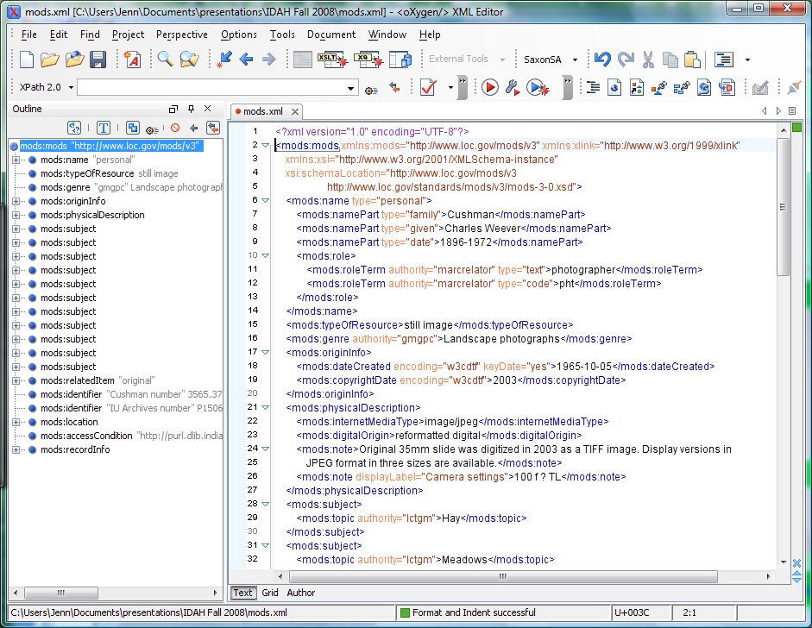
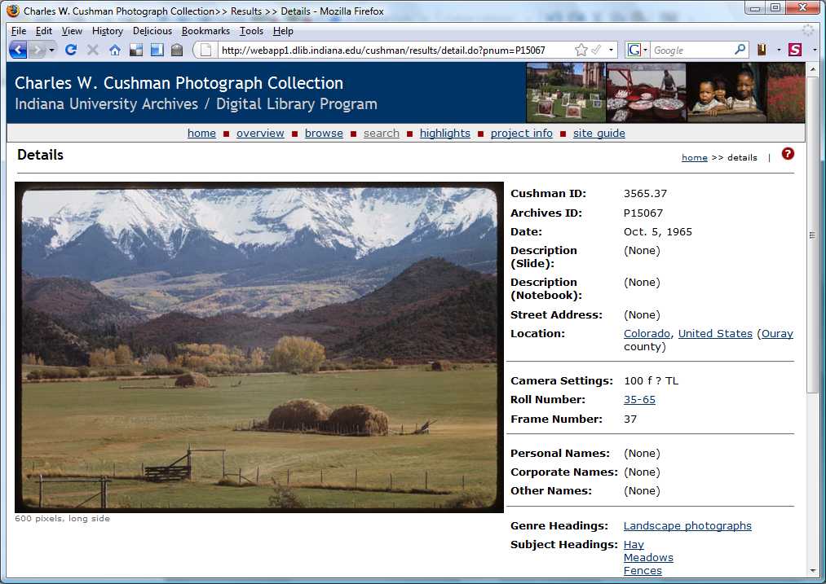
Descriptive metadata – an example

Slide 13
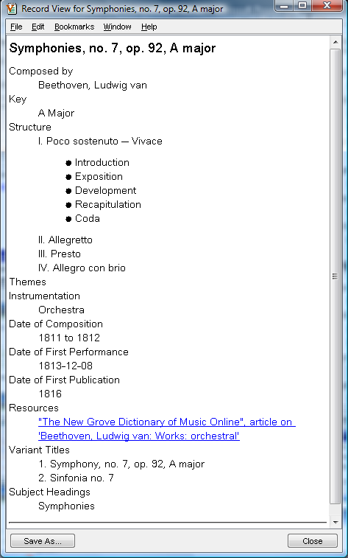
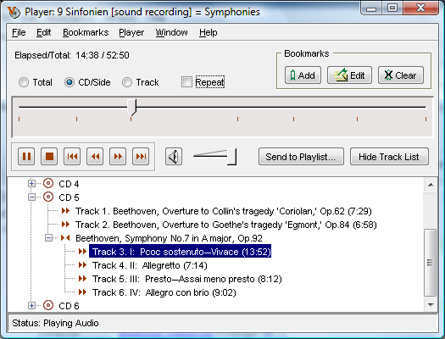
Descriptive metadata – another example

Slide 14
Technical metadata
Allows systems to manage and process resources in appropriate ways
Essential for the preservation of digital materials
Generally format-specific
Generally machine-generated
Not the digital resource itself, but essential information required to understand it

Slide 15
Some possibilities relevant to IDAH projects
Lighting systems in use during a performance
Playback information for audio files
Movements and shapes represented in a virtualized representation
CAD or other 3-D rendering data
What data is needed to understand your digital files into the future?

Slide 16
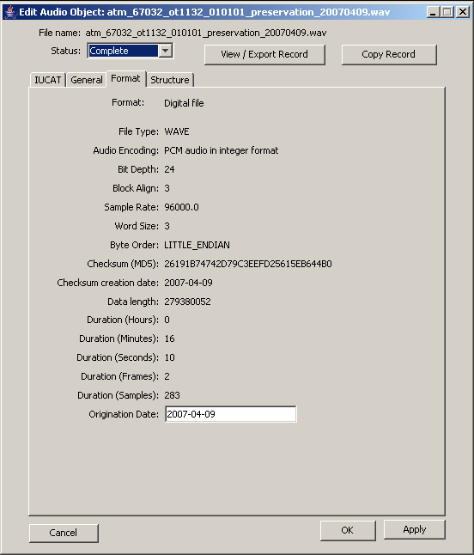
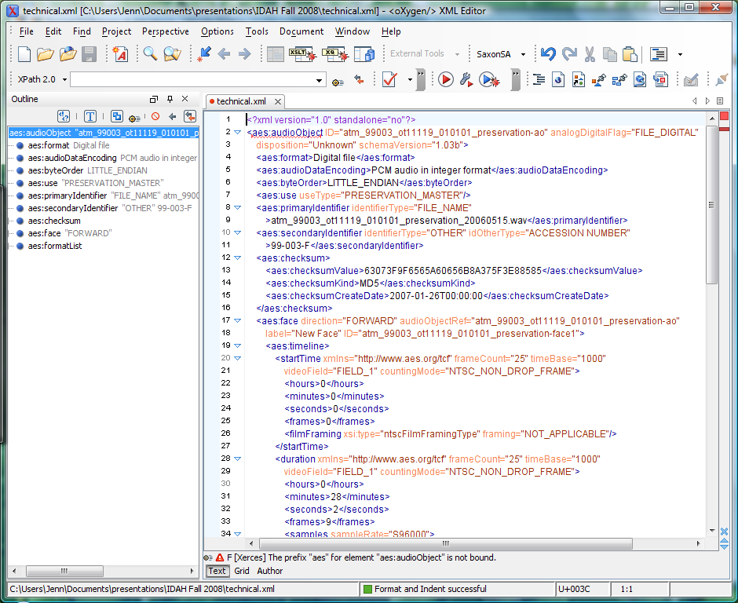
Technical metadata example

Slide 17
Structural metadata
Describes relationships
Points of interest within a resource
Between parts and wholes
Between different representations of the same content
When resources should be presented in sequence
When resources should be presented in parallel
Often machine generated

Slide 18
Some possibilities relevant to IDAH projects
Connecting together the primary source documents that influence an artistic performance with media documenting the performance itself
Performance plan vs. audio recording vs. video recording
Gathering source data from which a visualization is created
How will users move within and between resources that your project will provide?

Slide 19
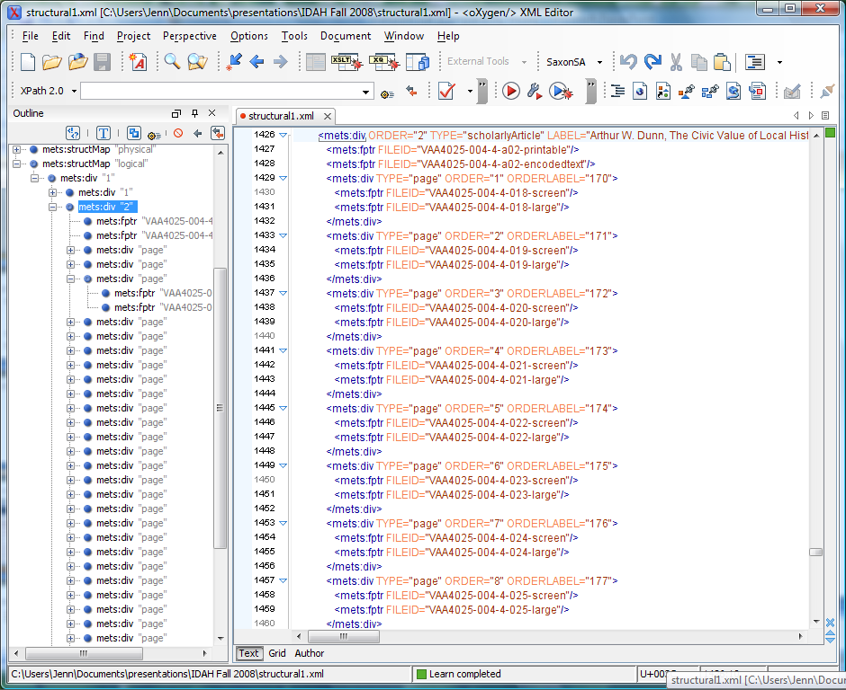
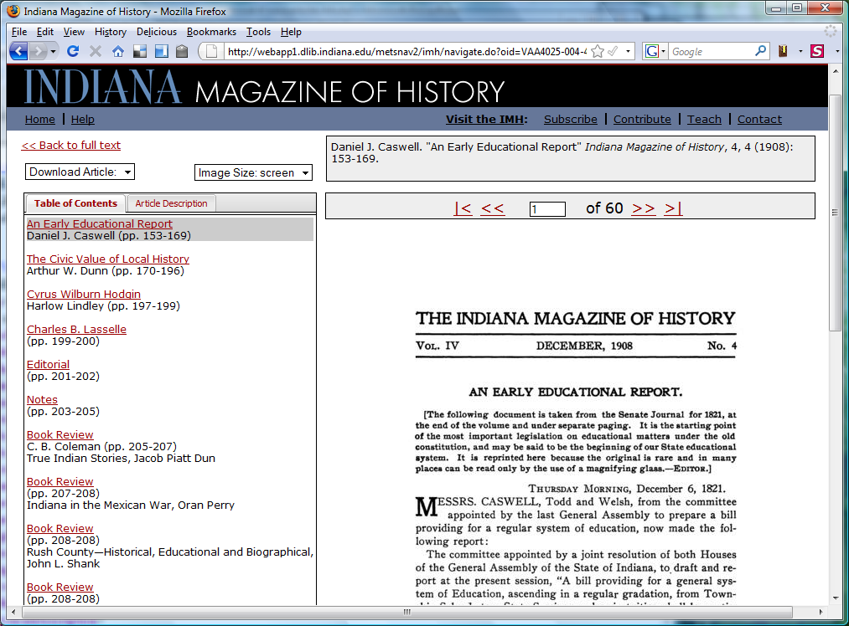
Structural metadata – an example

Slide 20
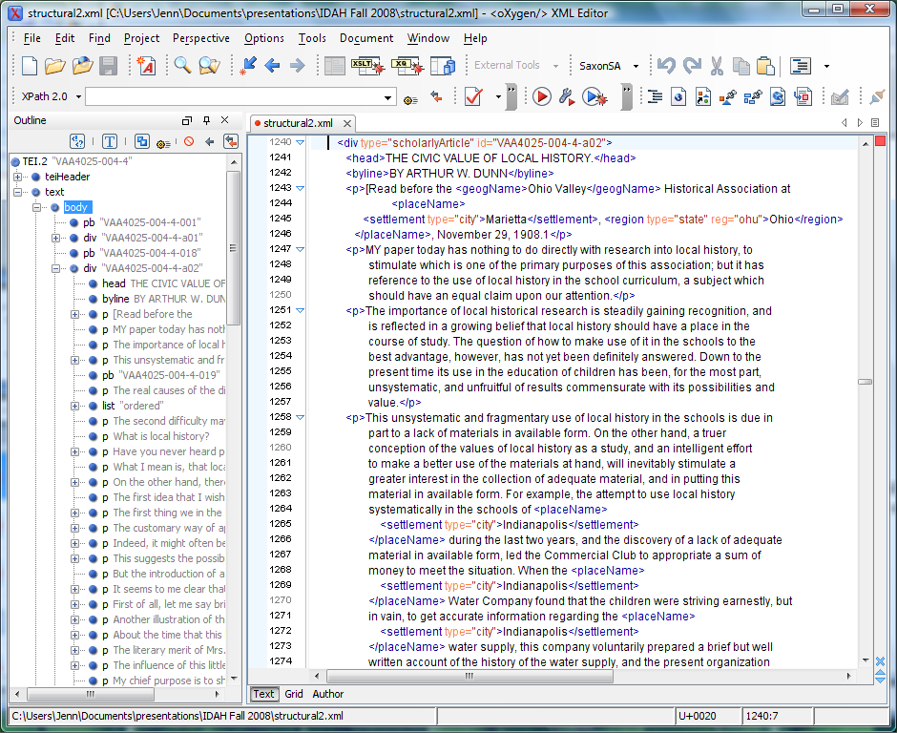
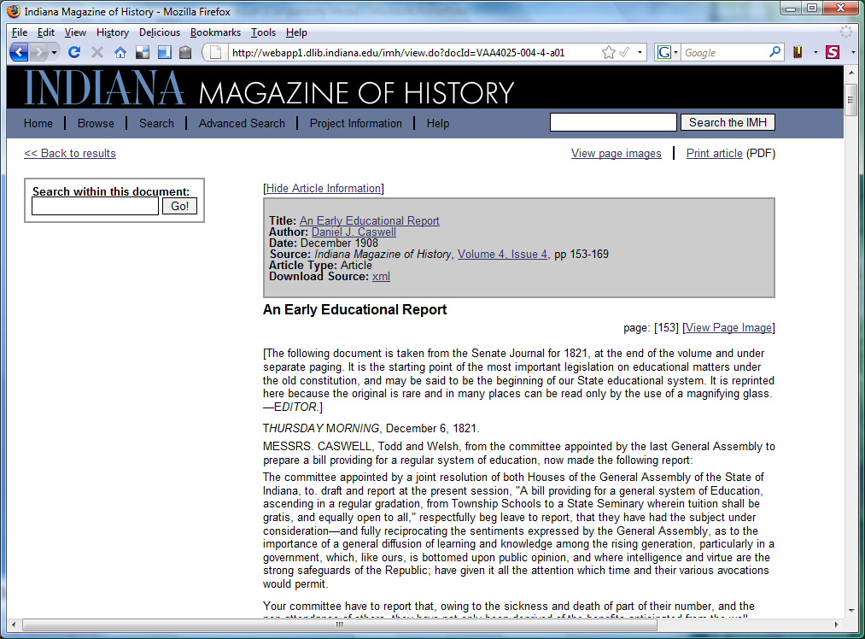
Structural metadata – another example

Slide 21
Markup languages
Mix metadata with data (resource content)
Insert flags into arepresentation of the content of a resource, signaling what bits of content are or what they mean
Generally have a “header” with descriptive metadata too
Either human- or machine-generated

Slide 22
Some possibilities relevant to IDAH projects
Detailed structural annotation of an interview transcript
Documenting and preserving musical notation approximating an innovative performance
Do the resources you provide need documentation of their internal structure and meaning?

Slide 23
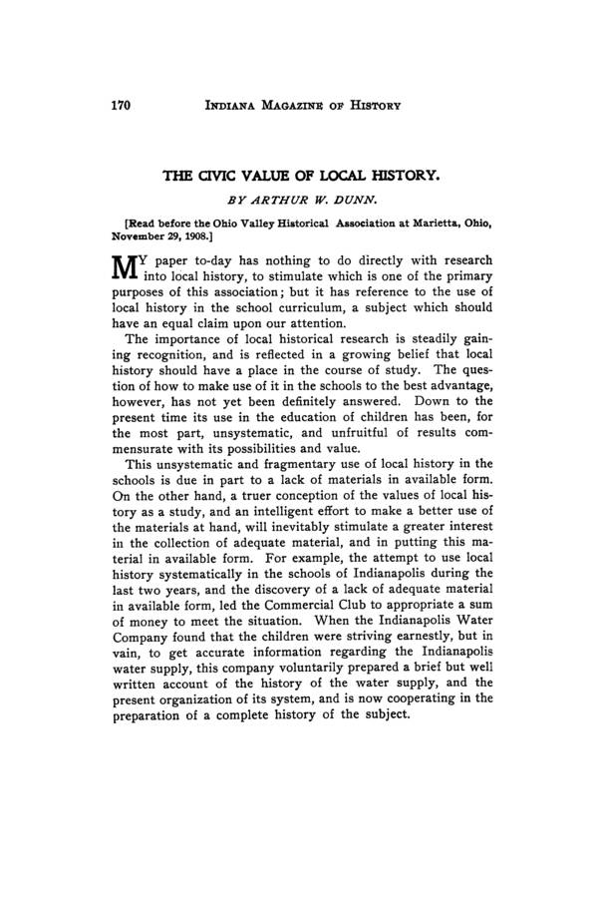
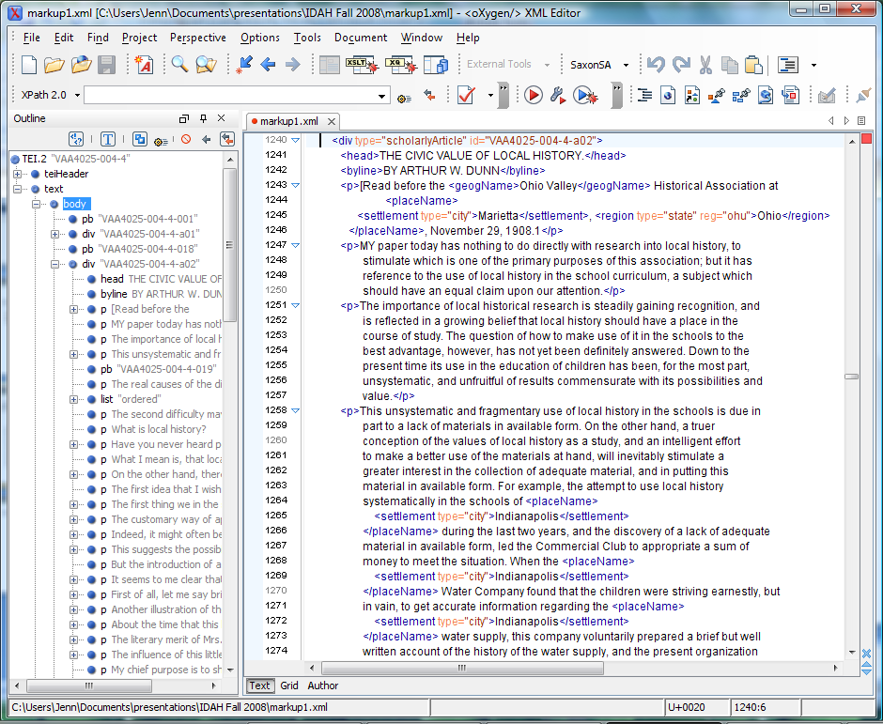
Markup languages – an example

Slide 24
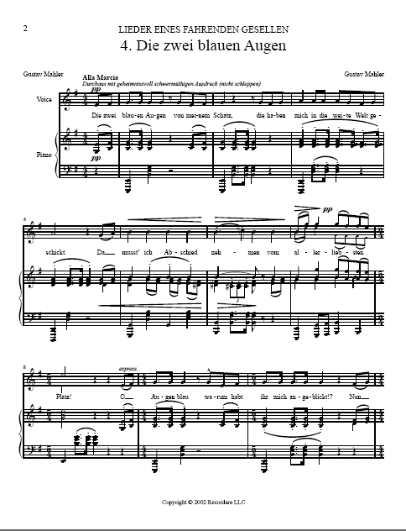
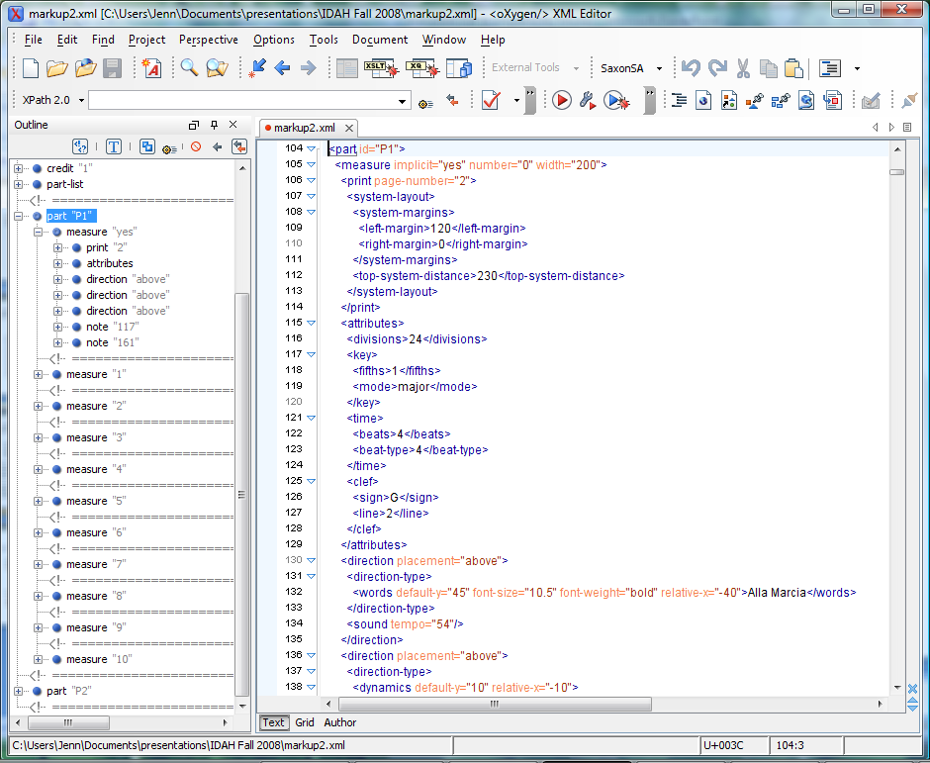
Markup languages – another example

Slide 25
What next?
What do you want to deliver as an end product to students and researchers?
What from your project is it important to preserve into the future?
How could structured metadata support the goals of your IDAH fellowship project?
How can the metadata creation/use tools and metadata expertise in the DLP help you?
Presentation slides: <http://www.dlib.indiana.edu/~jenlrile/presentations/ idah2010/metadata.ppt>

