Slide 1
Imagining the next generation of online Magic Lantern materials
Jenn Riley
Metadata Librarian
Indiana University Digital Library Program

Slide 2
Early efforts

Slide 3
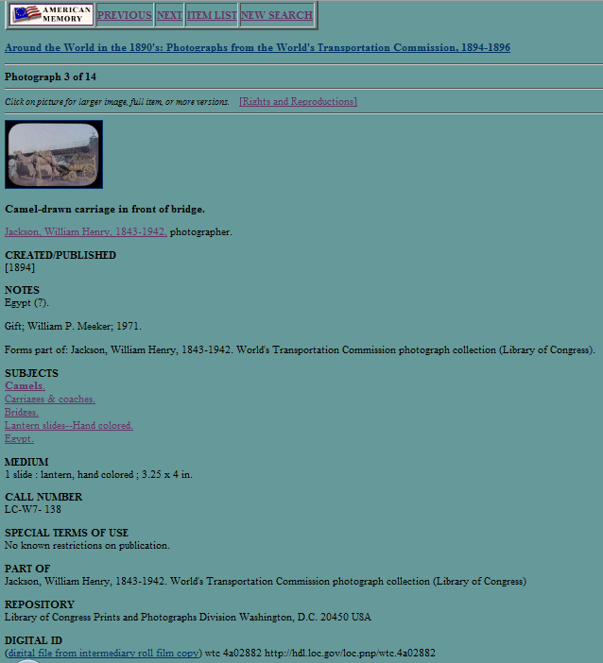

Slide 4
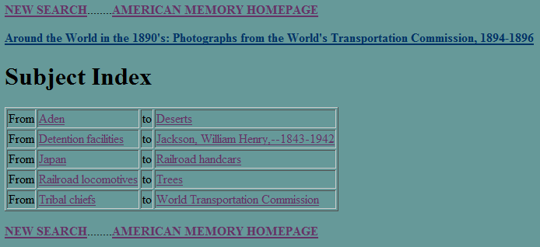

Slide 5
We’re looking to build a useful online service

Slide 6
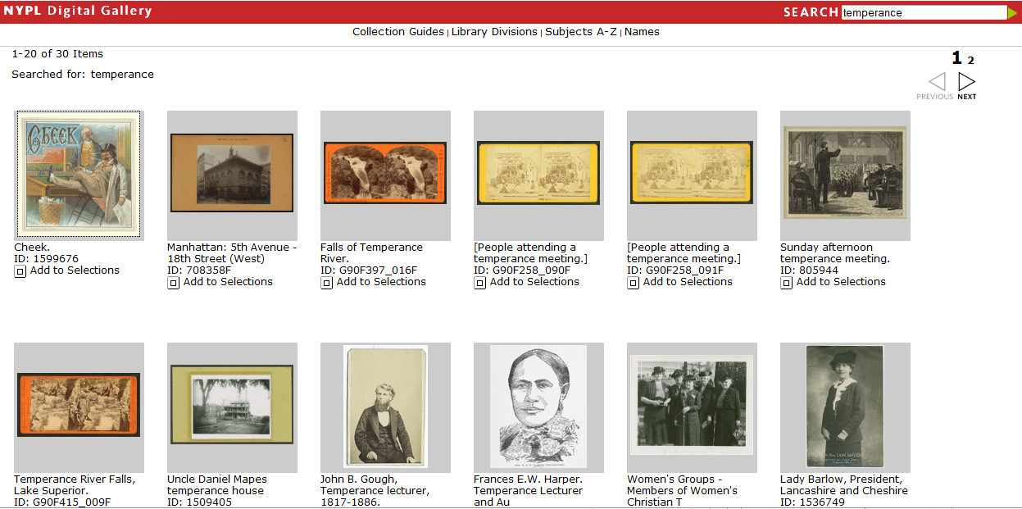

Slide 7
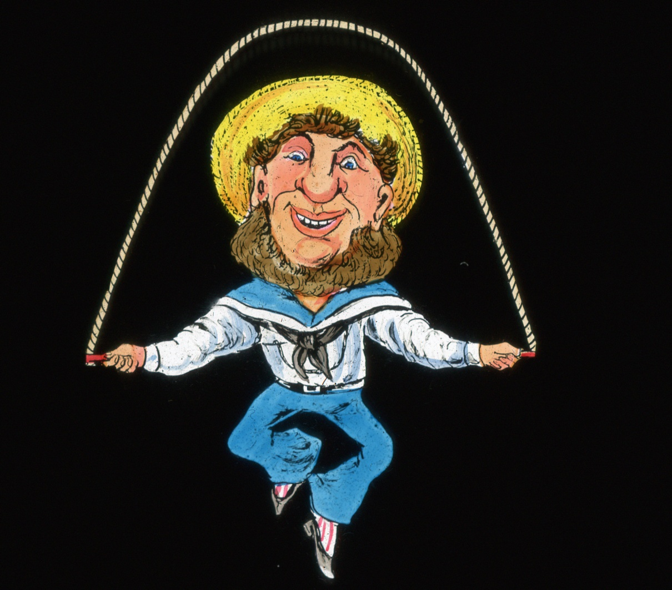
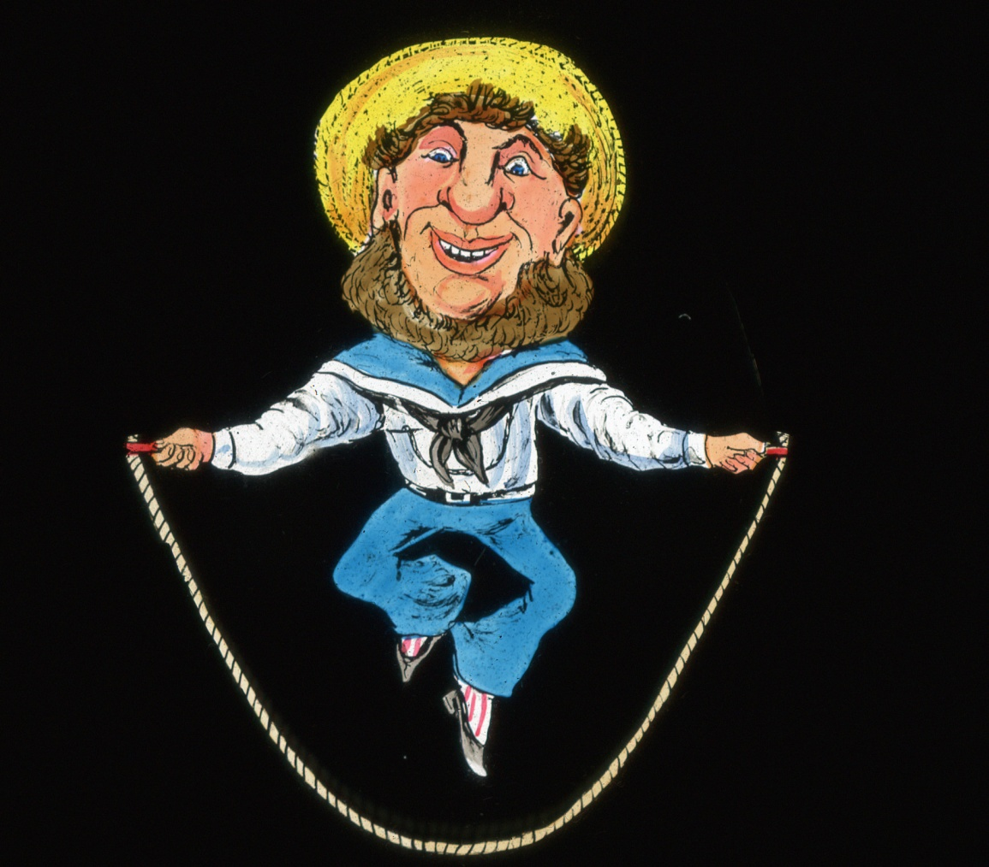

Slide 8
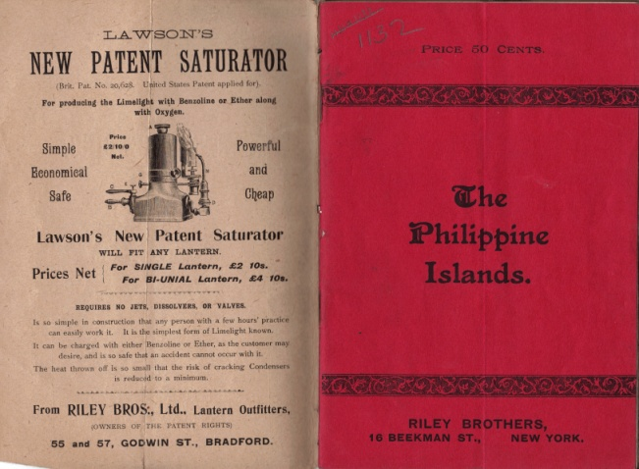
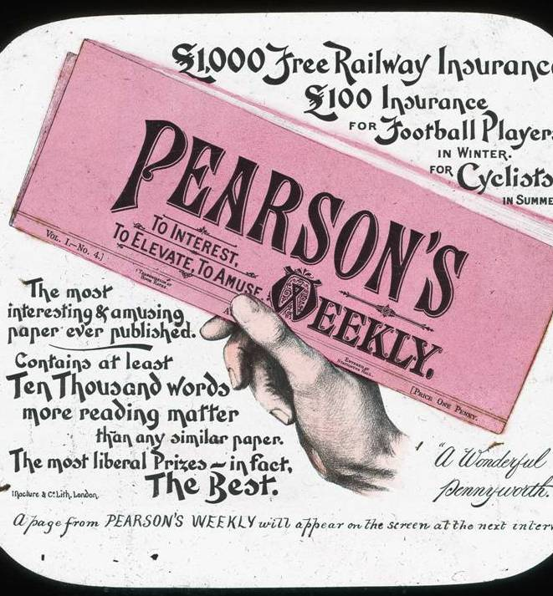
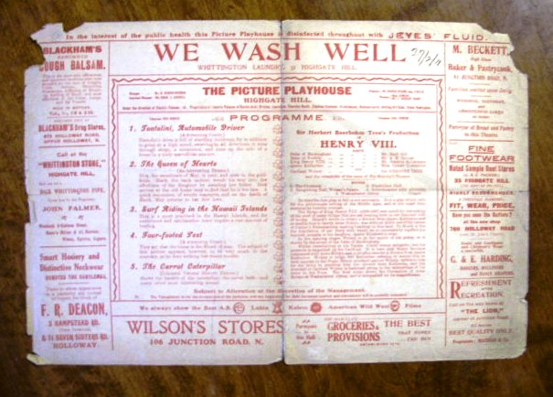
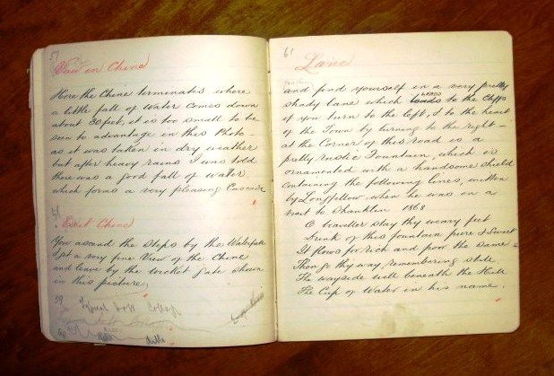
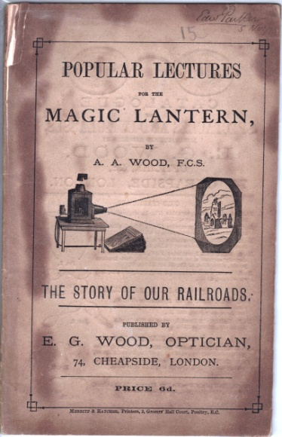

Slide 9
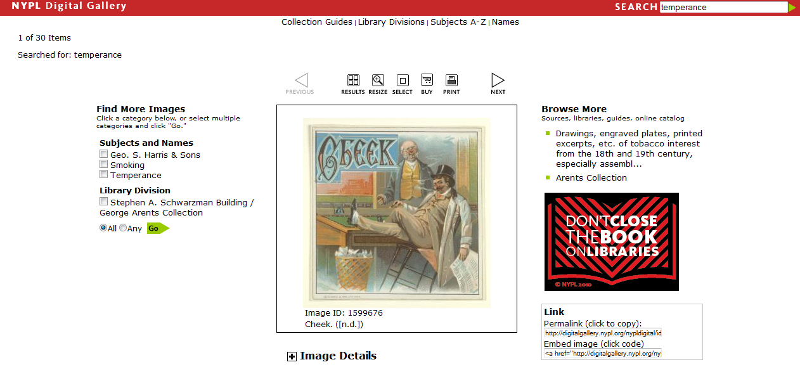

Slide 10
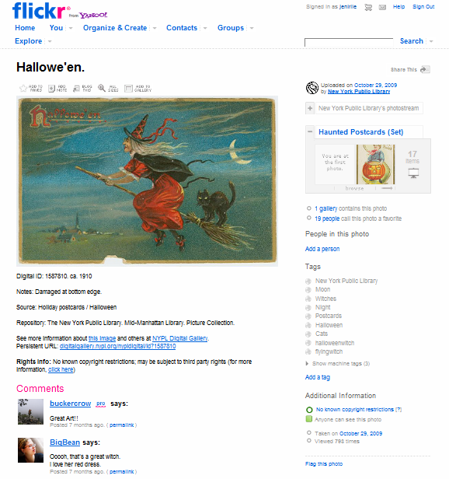

Slide 11
What can libraries provide?
Sustainability (or at least helping along this path)
Technical expertise
Interoperability
Access to additional funding sources
Basically… partners.

Slide 12
Current grant application
Will learn of funding decision in Sept. 2010
Project will last from Oct. 1, 2010 – Sept. 30, 2013
Will incorporate content from David Francis collection, and others
Site will allow user generation of content: slide shows, analytical text, etc.
Will develop site governance model to mediate user contributions
IU Libraries and IDAH providing technical support, content delivery, and tool building

Slide 13
Build and participate in the site governance process
Most important role for the community:

