Slide 1
FRBRized discovery and cataloging
Jenn Riley
MLA 2010 Annual Meeting
March 23, 2010
San Diego, CA

Slide 2
What if a catalog could answer questions like…
Which recordings can I listen to with Vladimir Ashkenazy as a conductor, rather than a pianist?
How scores of Chopin’s E major etude Op. 10 No. 3 can I compare?
Who was playing bass with Benny Goodman on this particular take?
What pieces can I as a cellist perform with my friend the soprano? Or my other friend the violinist?
And even…
What works were composed by women in Vienna in the 18th century?
What recordings do you have with other people singing songs that Bob Dylan wrote?
Can the catalog become a research tool rather than just a finding tool?

Slide 3
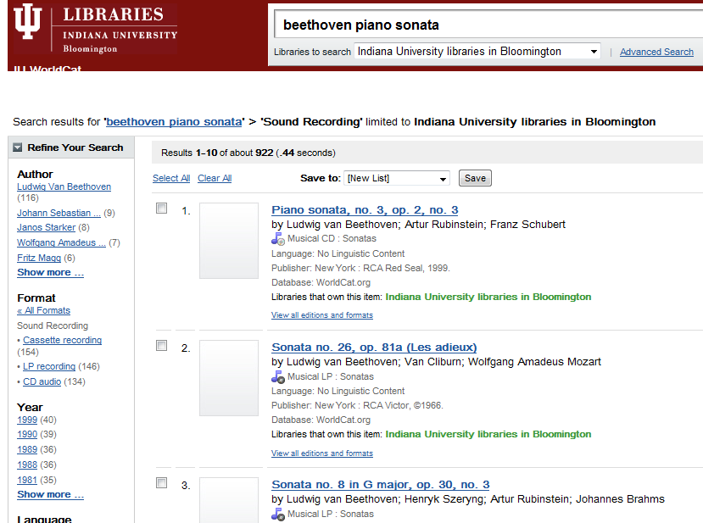
WorldCat’s FRBRization – it’s a start.

Slide 4
Variations/FRBR project
Funded by an Institute of Museum and Library Services National Leadership Grant
October 1, 2008 - September 30, 2011
Staff from IU Digital Library Program, Music Library, and Technical Services contributing
In “Demonstration” category
Primary mission: provide a model for other FRBRized catalogs
Secondary mission: provide a useful and sustainable discovery system for music at IU

Slide 5
First goal: FRBRize Variations
Provide a public and concrete testbed for FRBR
with real data
in a production environment
as a response to the call in the LC WG on the Future of Bibliographic Control report
Follow through on long-standing vision for improved Variations searching
Provide a sustainable path for Variations metadata outside of our local catalog

Slide 6
Other project goals
To provide an openly-accessible web search interface to the FRBRized data in Variations, for community analysis;
To make supporting data, including data model documentation and FRBRized data, available to the community for analysis; and
To apply innovative, evidence-based interface design techniques to Variations cataloging and search interfaces to make the most of the FRBR-compliant data model.

Slide 7
Search system – early decisions
Sometimes users want Works, sometimes Manifestations
Give results right away with easy mechanisms to refine
Starting with only recordings to reduce complexity
This is a VERY early working version - lots of things to overlook or imagine!

Slide 8
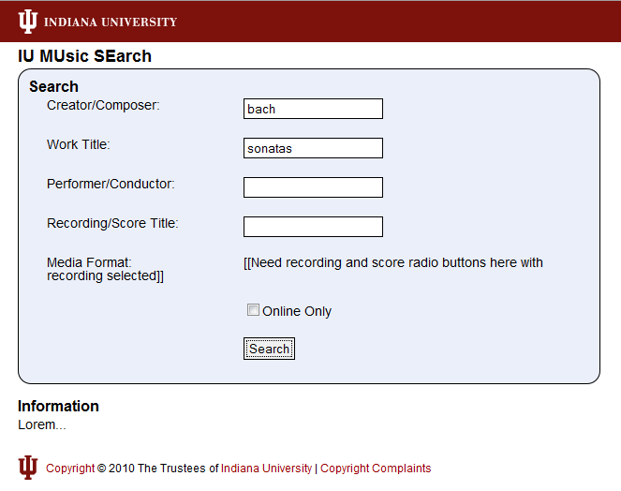
← Ignore that
↑ And that
← And that

Slide 9
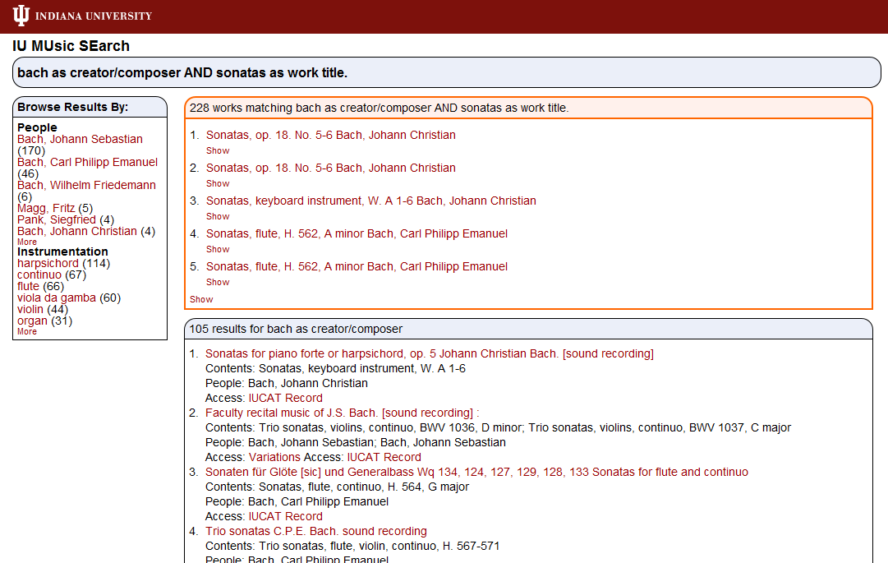
← Sort by # of hits? Alphabetically? Something else?
← Ignore that
↑Which facets to include?
What details to display here? ↓

Slide 10
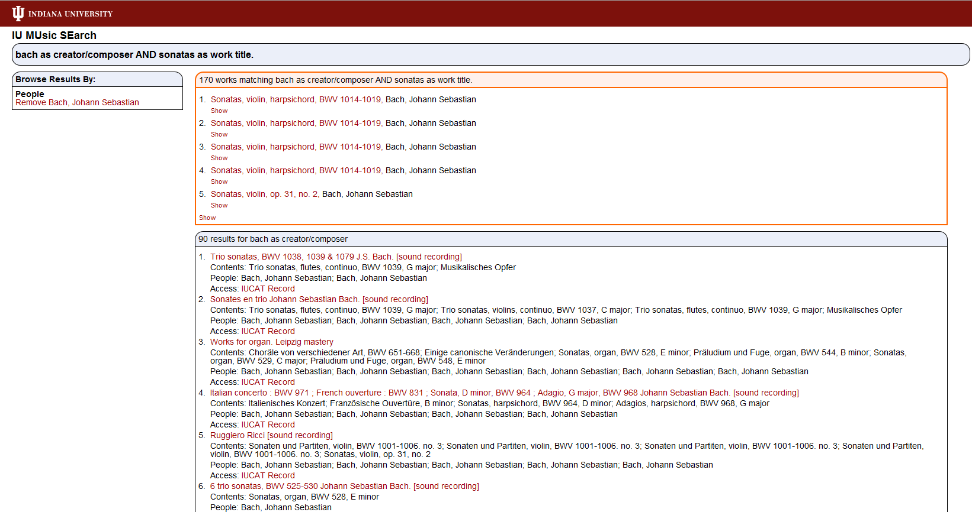

Slide 11
Metadata creation
Remember, this is a model for moving forward to next-generation catalogs
Our workflow:
FRBRize MARC as best we can; (multi-)work identification is most important part and nobody has done this well
Enhance (as necessary, and with appropriate priorities) the imported records
Good FRBR-aware metadata creation interfaces will be necessary in the future as the data becomes more FRBRized
Good algorithms to pull FRBR data from MARC will also be necessary
Strong need for statistics on time/$ to upgrade and create new records

Slide 12
What should a FRBRized metadata creation interface look like?
Hide the complexity of the model whenever possible
New Manifestation -> New Expression ->New Work not three separate actions
Easy to apply the same performer, etc to a bunch of Expressions on the same Manifestation
Don’t assume 1 entity = 1 window or 1 form
Make it easy to find entities that already exist in the system
Automatically get metadata from as many sources as possible
Fair warning: we haven’t actually built this yet

Slide 13
IU Header
Variations Header
v/frbr-ct
EDIT Item (/Container) [show all fields]
Record Number:
ABC123456
Record Status:
STATUS
Title/Description [hide]
Title:
Oklahoma! [sound recording] : original cast album.
[other titles…] (0) [series titles] (0)
Type:
Sound Recording
Publication Information [hide]
Publisher:
Decca Broadway
Edition:
Description:
1 sound disc : digital; 4 3/4 in.
[Publisher/Plate Numbers…] (1) [Languages…] (0)
Format:
CD
Date of Copyright:
2000
Date of Publication:
1943, 1945; 2000
Place of Publication:
New York, NY
Contributors [show]
Structure [show]
[delete]
[ok] [cancel]
Copyright © 2009 The Trustees of Indiana University | diglib@indiana.edu

Slide 14
Contributors [hide]
*
Andie McKaie (1973-). Producer/Reissuer
Ron O’Brien (1940-2008). Producer.
[add contributor]
[edit contribution] [remove]
[edit contribution] [remove]

Slide 15
Contributors [hide]
*
Andie McKaie (1973-). Producer/Reissuer
Ron O’Brien (1940-2008). Producer.
[edit contribution] [remove]
[edit contribution] [remove]
[link] [link] [link] [link] [link]
Name:
Preeno, Max
[create new] [new search] [search]

Slide 16
Contributors [hide]
*
[add contributor]
[Variations (1)] [IUCAT(0)] [MusicBrains (1)] […]
Name:
Preeno, Max
[create new] [new search] [search]
Variations (1)
Preeno, Max (1957-).
hide | zoom
[link]
IUCAT (0)
hide | zoom
MusicBrainz (1)
Preeno, Max (1957-).
hide | zoom
[import & link]

Slide 17
IU Header
Variations Header
v/frbr-ct
EDIT Item (/Container) [show all fields]
Record Number:
ABC123456
Record Status:
STATUS
Title/Description [hide]
Title:
Oklahoma! [sound recording] : original cast album.
[other titles…] (0) [series titles] (0)
Type:
Sound Recording
Publication Information [show]
Contributors [hide]
*
Andie McKaie (1973-).
Ron O’Brien (1940-2008).
Max Preeo (1957-).
[add another contributor]
Role:
Producer
Role:
Producer
Role:
Producer
Structure [show]
[delete]
[ok] [cancel]
Copyright © 2009 The Trustees of Indiana University | diglib@indiana.edu

Slide 18
Contents [hide]
*
Expression #1 Title. [Other…]
Expression #2 Title. [Other…]
Expression #3 Title. [Other…]
[view/edit] [copy] [remove]
[view/edit] [copy] [remove]
[view/edit] [copy] [remove]
//Work Data//
5.8” background
Work Title:
5.8” background
Composer:
5.8” background
Date of Composition:
Variations (5)
Work Title. Composer (Dates).
Work Title. Composer (Dates).
Work Title. Composer (Dates).
Work Title. Composer (Dates).
Work Title. Composer (Dates).
[select]
[select]
[select]
[select]
[select]
Resource
Variations [n]
IUCAT [n]
MusicBrainz [n]
Other Resource [n]
…
_______________
Composer
Composer1 (Dates)
Composer2 (Dates)
Composer3 (Dates)
Date of Composition
Before X
X+0Y’s
X+1Y’s
X+2Y’s
X+3Y’s
X+4Y’s
Since X+5Y
Language
English
German
Urdu
Instrumentation
Cello
Spoons
Kazoo
*
hide | zoom
IUCAT (7)
Work Title. Composer (Dates).
Work Title. Composer (Dates).
Work Title. Composer (Dates).
Work Title. Composer (Dates).
Work Title. Composer (Dates).
Work Title. Composer (Dates).
[import & select]
[import & select]
[import & select]
[import & select]
[import & select]
[import & select]
hide | zoom
MusicBrainz (6)
Work Title. Composer (Dates).
Work Title. Composer (Dates).
Work Title. Composer (Dates).
Work Title. Composer (Dates).
Work Title. Composer (Dates).
Work Title. Composer (Dates).
[import & select]
[import & select]
[import & select]
[import & select]
[import & select]
[import & select]
hide | zoom
//Expression Data//

Slide 19
Contents [hide]
*
Expression #1 Title. [Other…]
Expression #2 Title. [Other…]
Expression #3 Title. [Other…]
[view/edit] [copy] [remove]
[view/edit] [copy] [remove]
[view/edit] [copy] [remove]
//Work Data//
5.8” background
Work Title:
//Title…//
5.8” background
Composer:
//Composer Name (Dates)//
5.8” background
Date of Composition:
//Composition Date//
//Expression Data//
5.8” background
Performance Date:
5.8” background
Performance Place:
5.8” background
Instrumentation:
Genre:
[add new]
Languages:
[add new]
Contributors:
[add new]
Notes:
[add new]
5.8” background
Notation (Scores):
5.8” background
Copyright Decl.:
[create new work]
[new search] [search]

Slide 20
IU Header
Big Header
Variations Header
Variations
Search Box
Song/Work
Recording/Score
Person/Group
Search
Copyright © 2009 The Trustees of Indiana University | diglib@indiana.edu

Slide 21
Other metadata creation use cases
Clean up batch loaded data
Systematically enhance a set of Person, Work, etc. records
Probably many more!

Slide 22
What next?
Obviously we still have a long way to go
Release search system to end-users and music library staff
Start programming work on cataloging interface
FRBRized XML Schema release
Stay tuned – we’ll need your help!

Slide 23
For more information
These presentation slides: http://www.dlib.indiana.edu/~jenlrile/presentations/ mla2010/frbr/rileyFRBR.pptx
Project home page: http://www.dlib.indiana.edu/project/vfrbr
Subscribe to project RSS feed
I’m here and love to talk about this stuff.
jenlrile@indiana.edu

