Slide 1
Sheet Music Consortium: Tools for Data Providers
Jenn Riley
Head, Carolina Digital Library and Archives
The University of North Carolina at Chapel Hill
(formerly co-PI on SMC project at Indiana University)

Slide 2
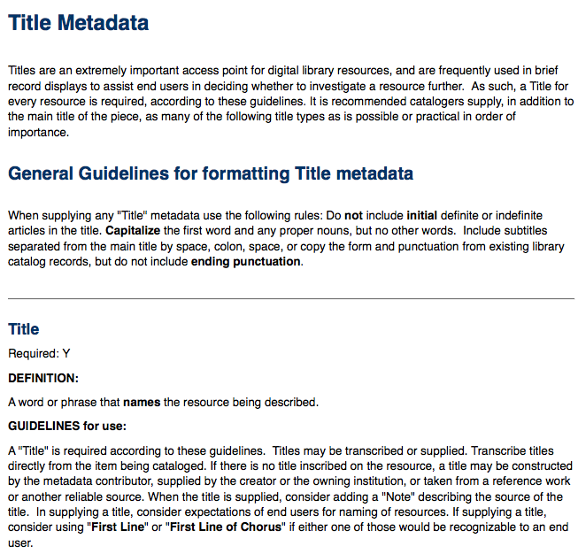
Metadata guidelines (in progress)
Notes:
For those just getting started
Don’t have to follow, but a guide to good practice
Goal is to show you the functionality that’s possible by following a certain recommendation
Based on shareable metadata principles
Will be released “soon”

Slide 3
Metadata guidelines (in progress)
Notes:
This one is more functionality oriented

Slide 4
How OAI-PMH works
Digital asset management system
QDC
MODS
Metadata creation module
OAI data provider module
Transformation
DC
MARCXML
Metadata creation system/workflow
Static Repository Gateway
Transformation
OAI Harvester
QDC
MODS
Metadata creation system
Stand-alone OAI data provider
Transformation
DC
MARCXML

Slide 5
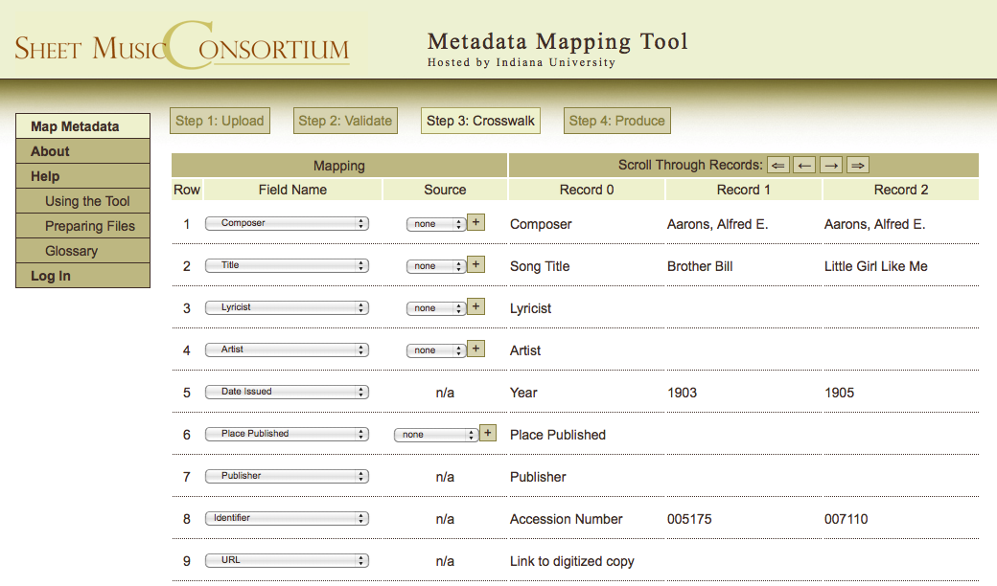
Online data mapping tool
Notes:
Remember, doesn’t have to be digitized collection
Alternative to oai-pmh, for example if you don’t have your sm in contentdm
Tool based on emory code (show link)
In final testing, will be stable public release soon
Can update any time you want

Slide 6
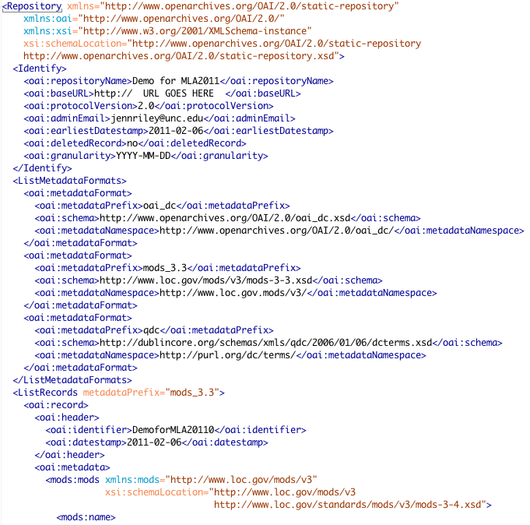
Output of mapping tool

Slide 7
Registering your XML file

Slide 8
“Report card” checks planned
Most important elements present (title, name, date, subject)
Conformance to a CV indicated where browse indexes are planned
Basic record integrity (maybe)
Correct patterns for dates, URLs, etc
Highlight which data elements will be indexed
Notes:
Development started
Don’t “have” to pass – just informative
Will be available both as part of mapping tool and separately

Slide 9
Might look something like…

Slide 10
Some helpful URLs
Open Archives Initiative Protocol for Metadata Harvesting: http://www.openarchives.org
Sheet Music Consortium OAI-PMH Static Repository Gateway (where you register a Static Repository File): http://oaigateway.library.ucla.edu/ (in development)
Sheet Music Consortium Metadata Mapping Tool: http://www.dlib.indiana.edu/smcmigrator (in development)
Emory Metadata Migrator on which SMC Mapping Tool is built: http://www.metascholar.org/sw/mm/
Thank you!

