Slide 1
RDA and Linked Data: Moving Beyond the Rules
Jenn Riley
Head, Carolina Digital Library and Archives
The University of North Carolina at Chapel Hill

Slide 2
21st century information landscape
Everything interconnected
Build on others’ data
Semantic Web
Think of it as authority files on steroids
It’s all very meta

Slide 3
Linked Data
Use URIs as names for things
Use HTTP URIs so that people can look up these names
When someone looks up a URI, provide useful information, using standards
Include links to other URIs, so that they can discover more things
Tim Berners-Lee, Linked Data – Design Issues http://www.w3.org/DesignIssues/LinkedData.html

Slide 4
RDA as data elements
There’s another side to RDA, beyond the rules
Grew out of a 2007 meeting between representatives from the JSC and DCMI
But it’s currently operating mostly independently
Vision is that RDA data elements could be the basis for machine interoperation of library data in a Linked Data environment in the future

Slide 5
Off to Kimmy…

Slide 6
Encoding a graph into data

Slide 7
Woah. Really?!?
Nobody is meant to create this data in this form directly. Really.
Libraries encoding data in this form opens up enormous possibilities for us to participate in the wider information community.
Let’s explore that idea.

Slide 8
This is the last of the XML, I promise.

Slide 9
Other important features of the Semantic Web/Linked Data environment
The RDF graph model is the most important thing; encoding triples in a specific syntax is secondary
The concept of a “record” isn’t really meaningful when looking at the information world as a graph
Open world assumption
Many vocabularies, with connections between them
Expectation that implementations will deal with data from multiple sources
Reasoners

Slide 10
Large Linked Data initiatives to watch
Named graphs
Provenance WG
Also watch DC-Architecture

Slide 11
Infrastructure that we’ll need
Ways to identify trusted data sources
Ways to identify and understand properties and classes defined by others
Best practices for data caching
Actual shared cataloging
We’ll need to stop downloading records. I mean that.
Better data creation, management, sharing, and exposure systems
Ones that actually work
Library community best practices on where to scope our data creation efforts

Slide 12
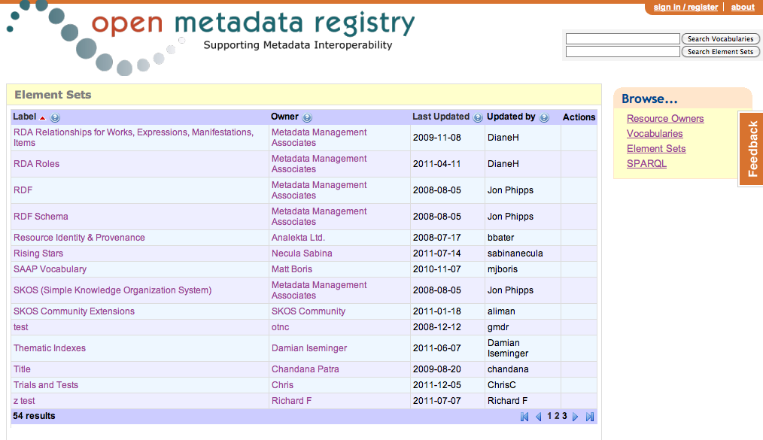
Here’s one part of that emerging infrastructure

Slide 13
What the library community is doing
Exposing authority (and more recently bibliographic) data, and vocabularies as Linked Data
W3C Linked Library Data Incubator Group
Stanford Linked Data Technology Plan
RDA as data elements in Open Metadata Registry
Still dancing around official endorsement
LC Bibliographic Framework Transition Initiative
“The new bibliographic framework project will be focused on the Web environment, Linked Data principles and mechanisms, and the Resource Description Framework (RDF) as a basic data model.” (From http://www.loc.gov/marc/transition/news/framework-103111.html)

Slide 14
Who’s doing music Linked Data?
Last.fm
BBC Music
MusizBrainz
Discogs
DBtune
Magnatune
Many more, and growing

Slide 15
My burning question
What would it mean for libraries to be LD consumers, and not just publishers?

Slide 16
Thanks!
jennriley@unc.edu
These slides: http://www.lib.unc.edu/users/jlriley/presentations/mla2012/jennMLA-RDA.pptx
W3C LLD Incubator Group final report: http://www.w3.org/2005/Incubator/lld/XGR-lld-20111025/
Stanford Linked Data Technology Plan: http://www.clir.org/pubs/reports/pub152/LDWTechDraft_ver1.0final_111230.pdf
Open Metadata Registry: http://metadataregistry.org
Hillmann, Diane, Karen Coyle, Jon Phipps, and Gordon Dunsire. (January/February 2010) “RDA Vocabularies: Process, Outcome, Use.” D-Lib Magazine 16, no. 1/2. http://dlib.org/dlib/january10/hillmann/01hillmann.html

