Slide 1
Variations/FRBR Project Overview
Jenn Riley
Indiana University Digital Library Program
NEMISIG, January 2010

Slide 2
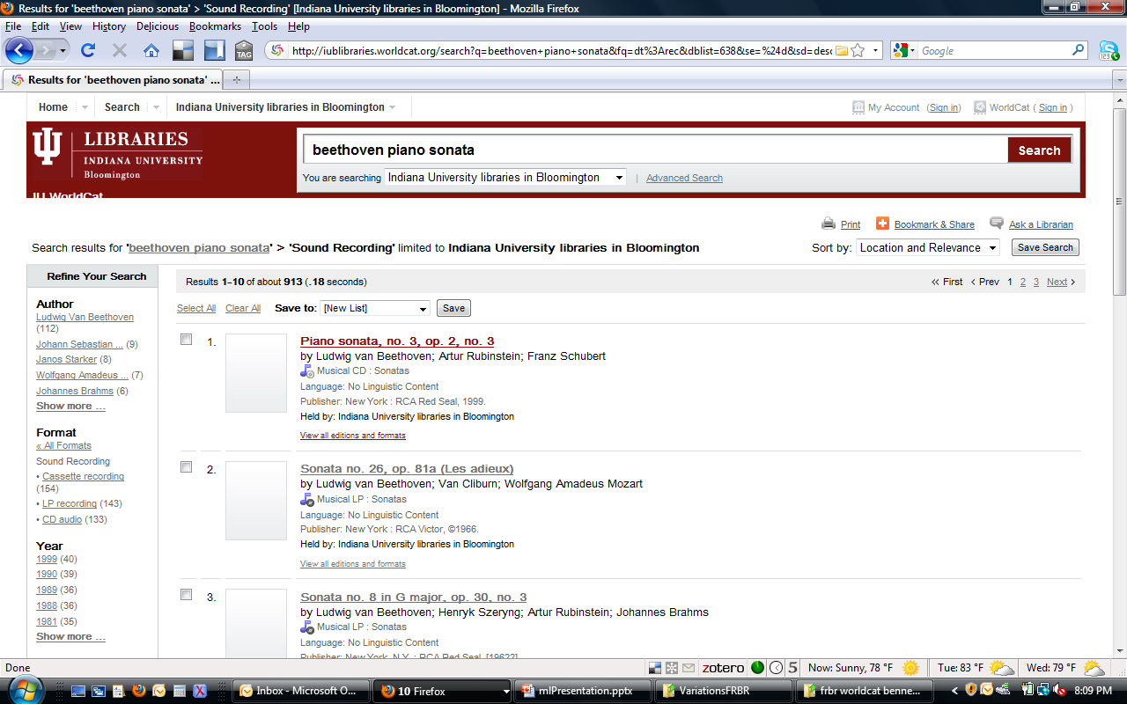
Library systems don’t deal well with music

Slide 3
What if a catalog could answer questions like…
Which recordings of Van Halen (David Lee Roth only, of course) can I listen to from home?
Which recordings can I listen to with Vladimir Ashkenazy as a conductor, rather than a pianist?
How many editions of the score of [some interesting work] can I compare?
What pieces can I as a cellist perform with my friend the soprano? Or my other friend the violinist?
Who was playing bass with Benny Goodman on this particular take?
And even…
What works made famous by female singers were later covered by men?
How many times has Queen been sampled in later work?
Can the catalog become a research tool rather than just a finding tool?

Slide 4
Initial launch – results
WORKS
Various facets, to be determined
RECORDINGS

Slide 5
We’re always interested in potential partners!
http://www.dlib.indiana.edu/project/vfrbr
jenlrile@indiana.edu

