Slide 1
Variations at Indiana University: Feeding, Facilitating, and Archiving Your Research
Jenn Riley
Head, Carolina Digital Library and Archives
The University of North Carolina at Chapel Hill
(formerly @ Indiana University Digital Library Program)

Slide 2
Variations and MIR
Not just a digital library, but a research and learning system
Though admittedly much of the recent work is pretty library-focused
Once upon a time handled MusicXML in addition to sound and bitmapped scores; probably could again
Can provide you with:
tools for the documentation of your work
ground truth
means for visualizing your results

Slide 3
Sound analysis tools

Slide 4
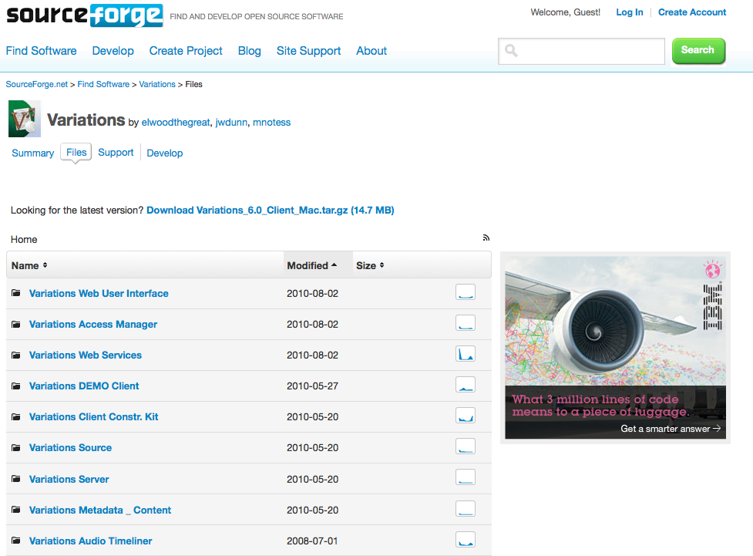
Some open source code

Slide 5
User behavior data
Search terms
Works listened to
Recordings listened to
Scores viewed
Patterns of viewing/listening vs. interacting

Slide 6
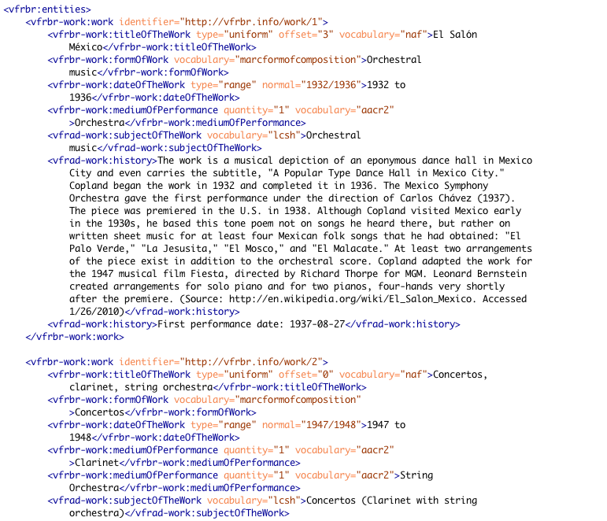
Metadata about works/songs

Slide 7
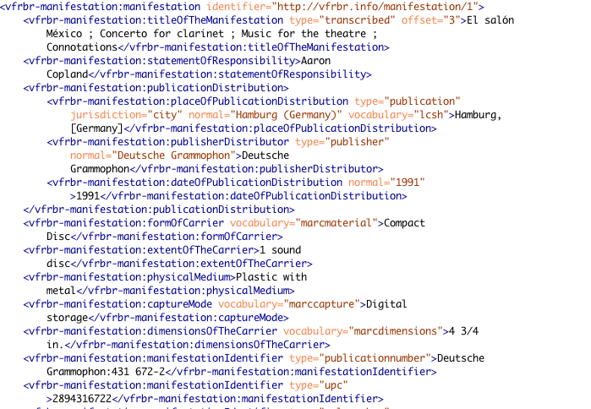
Metadata about recordings

Slide 8
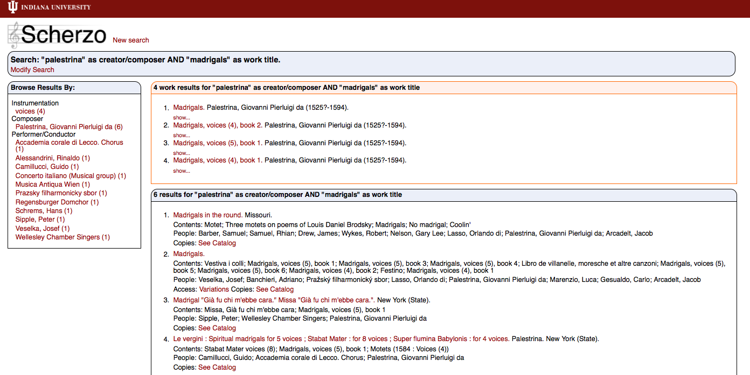
Discovering new music for your work

Slide 9
And don’t forget your library!
We’ll partner on:
Collection development
Metadata sharing
Archiving your research (data and papers)
Facilitating research collaborations
Identifying and compiling data for your research

