Slide 1
Metadata for
Visual Resources
Jenn Riley
Head, Carolina Digital Library and Archives
The University of North Carolina at Chapel Hill

Slide 2
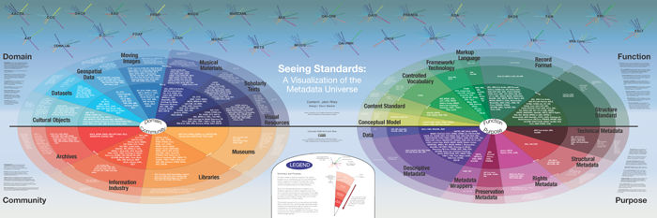
How in the world am I supposed to deal with this?!?

Slide 3
Don’t panic. You can make good decisions with the right information.
We’ll begin with some theory, and then move on to practice.

Slide 4
Many definitions of metadata
“Data about data”
“Structured information about an information resource of any media type or format.” (Caplan)
“Structured information that describes, explains, locates, or otherwise makes it easier to retrieve, use, or manage an information resource.” (NISO)
“Metadata is constructed, constructive, and actionable.” (Coyle)
…

Slide 5
Refining a definition
Other characteristics
  Structure
  Control
Origin
  Machine-generated
  Human-generated
The difference between data, metadata, and meta-metadata is often one of perspective

Slide 6
Some uses of metadata in cultural heritage institutions
Catalog cards
Slide labels
VR databases
Online catalogs
Finding aids
Inventories
Registers

Slide 7
Some types of metadata
Type | Use
Descriptive metadata | Searching Browsing Display Interoperability
Technical metadata | Interoperability Digital object management Preservation
Preservation metadata | Interoperability Preservation
Rights metadata | Interoperability Digital object management
Structural metadata | Navigation

Slide 8
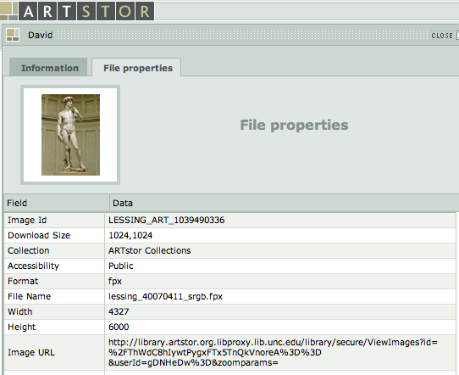
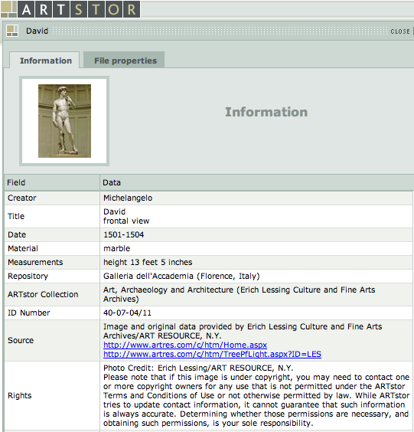
Metadata in action
Descriptive metadata
Technical metadata
Rights metadata
Navigating between multiple views of the same image would be structural metadata.

Slide 9
But…
The lines between these types are rarely clear
We’ll primarily talk about descriptive metadata today

Slide 10
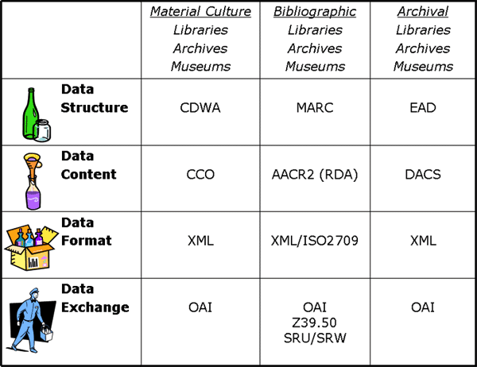
And you also need to know about…
Chart by Elings & Waibel, “Metadata for All” <http://firstmonday.org/htbin/cgiwrap/bin/ojs/index.php/fm/article/view/1628/1543>

Slide 11
General principles to apply
Tie your choice of standards to your purpose
  Art images vs. documentary images
  Pedagogical vs. museum object management vs. archival
Look to the community for best practices
Know why you’re doing something a certain way
  Display, search, browse
  Current and reasonable future discovery needs
  If it’s not immediately justifiable, ask the hard questions
Avoid the temptation to over-describe
Document your decisions
Consider uses of your metadata beyond your local system

Slide 12
So now what?
Let’s look at some options.

Slide 13
Some metadata standards of use to VR professionals
Data structure (descriptive)
  VRA Core
  CDWA
  CDWA Lite
  MARC
  MODS
  Dublin Core
Data structure (technical)
  MIX
Data content
  CCO
  AACR2/RDA
  DACS

Slide 14
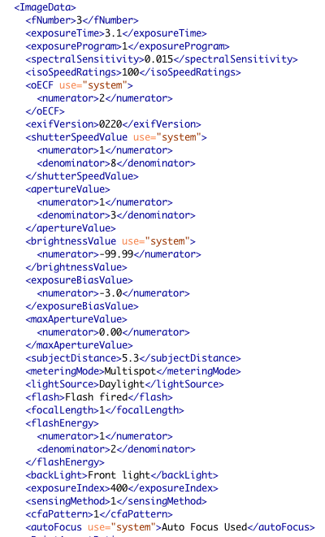
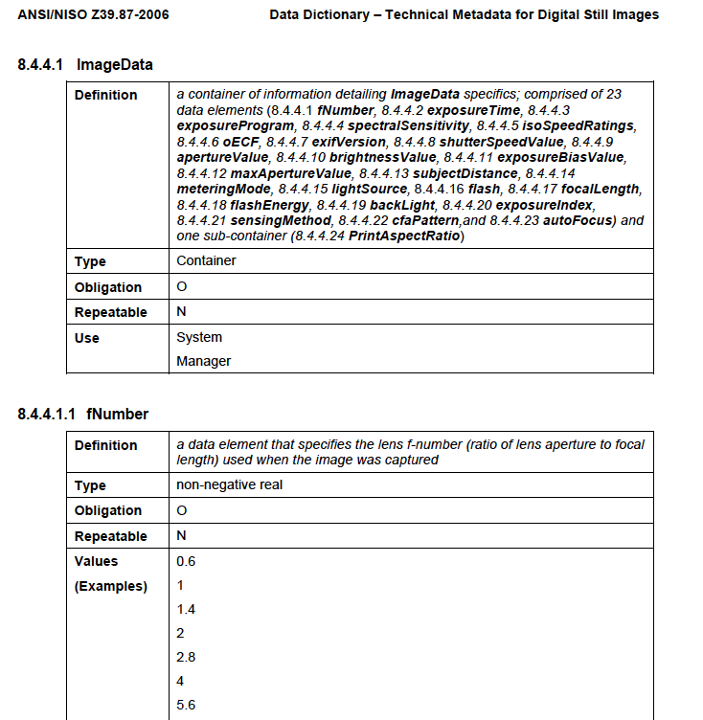
MIX technical metadata
Caveat: this example is MIX 1.0, and the current version is 2.0.

Slide 15
Using MIX
Not many do, actually
Most of it should be automatically generated
Few if any systems the VR community uses support it
Much more common in the “digital library” world, for long-term preservation purposes

Slide 16
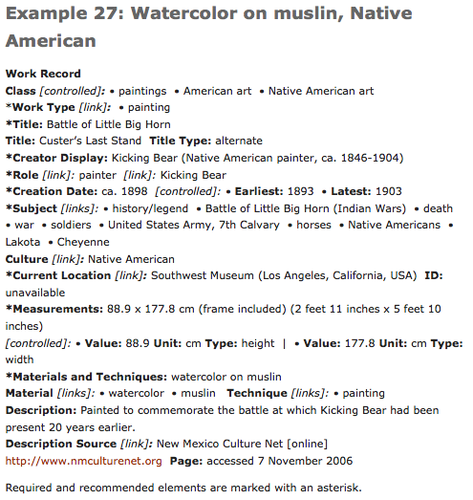
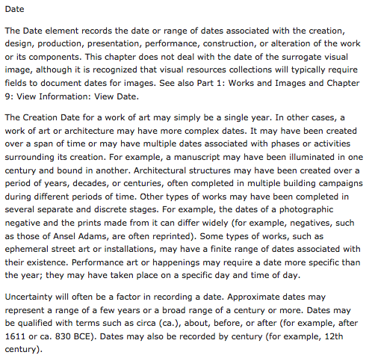
CCO content standard
From http://cco.vrafoundation.org/

Slide 17
Using a content standard
It’s OK to pick and choose when to apply it
It’s just a set of rules (that humans wrote) and therefore is wide open to interpretation
  Try to constrain the full standard for your local implementation
  Don’t fret too much if your case isn’t covered or you find it ambiguous
Provided examples are useful, but they’re not the rules
Alternatives to CCO
  AACR2/RDA if you want a more “bibliographic” approach
  DACS if you want a more archival approach, focusing on the description of whole collections rather than individual items

Slide 18
Visual Resources Association Core Categories (VRA Core)
THIS is the metadata structure standard that you really need to know
Designed by visual resources specialists
Distinguishes between collection, work, and image
Schemas for “unrestricted” and “restricted” versions
Provides for values for both display and indexing
  This isn’t common in other metadata standards
Focus on creation, style, culture
Best used on collections of reproductions of works of art & architecture

Slide 19
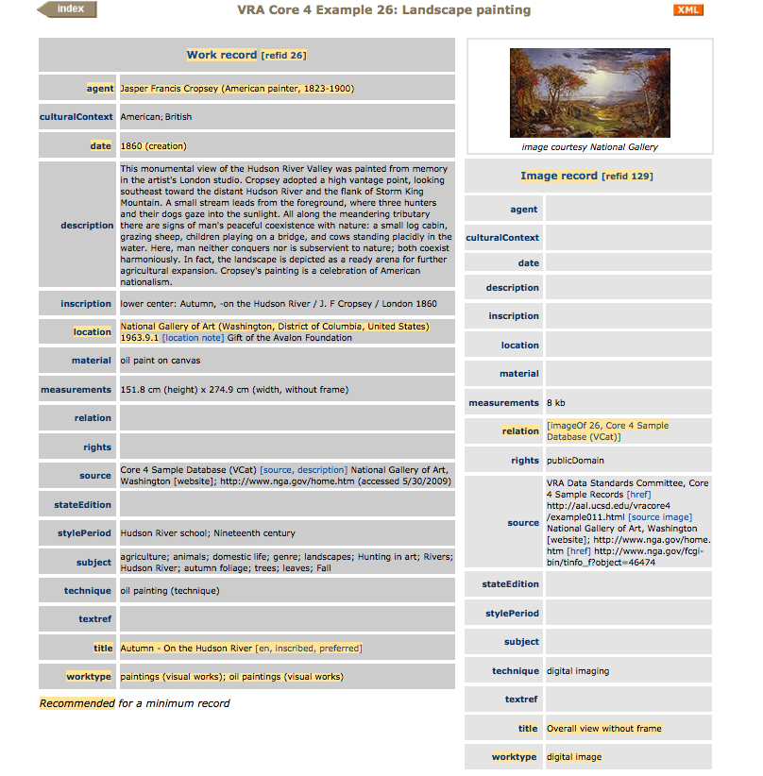
This record in XML
Notes:
Things to point out:
* Work and image in separate records
*Separate elements for display and indexing values
*Use of controlled vocabularies
*Connections to research relevant to the work

Slide 20
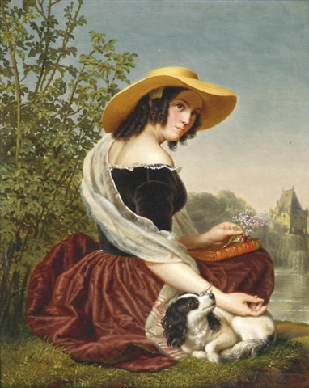
Let’s practice!
Description: "Good memories" by Ange Francois, Belgian painter (1800-1867)
Date: Unknown but not later than 1867
Author: Ange Francois
Don’t worry about data values for now; we’ll get to that in a bit.
http://commons.wikimedia.org/wiki/File:MemoriesAngeFrancois.jpeg

Slide 21
Categories for the Description of Works of Art (CDWA)
Strong museum, curatorial focus
Strong on culture, physical location
Meant to describe original works, not surrogates or reproductions
Best used for unique materials owned and managed by your institution
Base metadata format for many museum collection management systems
No formally specified encoding, but recommends storing data in a relational structure
Guidelines are nearly as prescriptive as a content standard

Slide 22
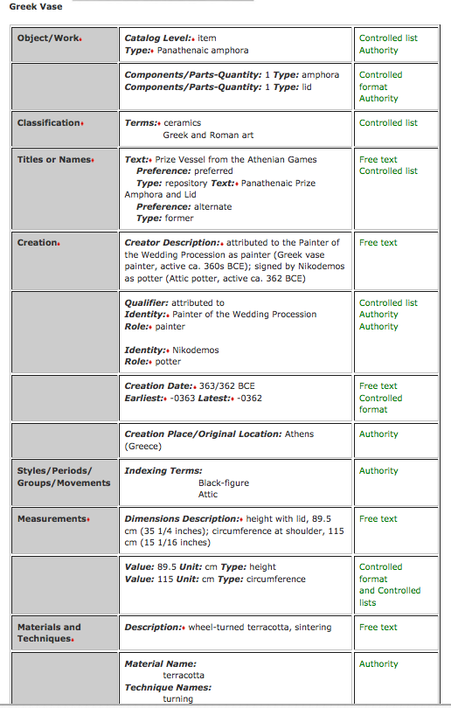
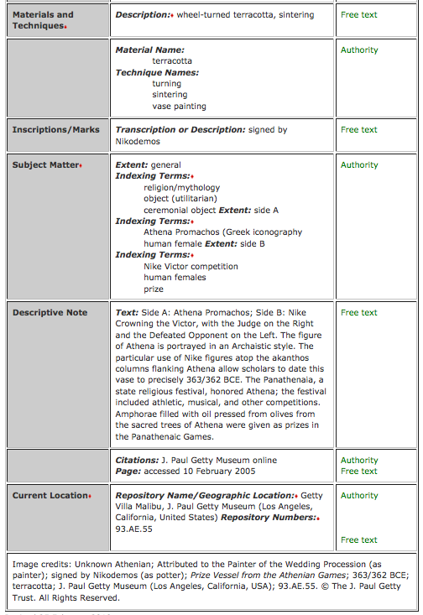
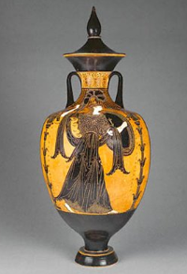

Slide 23
And again…
Description: "Good memories" by Ange Francois, Belgian painter (1800-1867)
Date: Unknown but not later than 1867
Author: Ange Francois
Don’t worry about data values for now; we’ll get to that in a bit.
http://commons.wikimedia.org/wiki/File:MemoriesAngeFrancois.jpeg

Slide 24
CDWA Derivatives
CDWA Lite = Simplified version of the full CDWA
  In XML
  For data sharing
Light Information Describing Object (LIDO)
  Expansion of CDWA Lite
  Combined with museumdat

Slide 25
MARC
Used in library catalogs
Might use if
  You wanted discovery through the library catalog
  Your unit is an integral part of an academic library system and does not invest in an image database for teaching
You can do it, but it’s not a great fit
MARCXML sometimes used when MARC exists but an XML form is needed
I won’t suggest that we do a MARC exercise here. (Woohoo!)

Slide 26
Metadata Object Description Schema (MODS)
Still “bibliographic” in nature
No natural places for some data elements, such as cultural origin of an object
Doesn’t make work vs. image distinction
Might use if:
  You’re integrating your VR material material into a wider digital library context
  You are describing documentary images rather than art images
  You already have a system that can handle it

Slide 27
And again…
Description: "Good memories" by Ange Francois, Belgian painter (1800-1867)
Date: Unknown but not later than 1867
Author: Ange Francois
Don’t worry about data values for now; we’ll get to that in a bit.
http://commons.wikimedia.org/wiki/File:MemoriesAngeFrancois.jpeg

Slide 28
Simple Dublin Core
An extremely basic metadata structure standard, originally developed for documents on the web
Intended to be core across all resource domains
This is the format used for the OAI-PMH metadata sharing protocol
Rarely if ever used as a native metadata format in the cultural heritage sector

Slide 29
Qualified Dublin Core
A more robust version of simple Dublin Core
  Additional elements
  Element qualifiers
  Syntax encoding schemes
Native format in some digital library systems
  DSpace
  CONTENTdm
Might use if:
  You’re integrating your VR material material into a wider digital library context
  You are describing documentary images rather than art images
  You already have a system that can handle it

Slide 30
And again…
Description: "Good memories" by Ange Francois, Belgian painter (1800-1867)
Date: Unknown but not later than 1867
Author: Ange Francois
Don’t worry about data values for now; we’ll get to that in a bit.
http://commons.wikimedia.org/wiki/File:MemoriesAngeFrancois.jpeg

Slide 31
But that’s only the first step.
Let’s think more carefully about what goes in those fields.
Content standards + vocabulary control

Slide 32
Vocabulary control
Also known as:
  Controlled vocabularies
  Authority control
Use it for fields where:
  You want browseability
  Many different resources will have the same value in a field
  One thing might be known by different names and it would be useful to discover those things together

Slide 33
Which fields in VRA core would benefit from vocabulary control?

Slide 34
Controlled vocabularies are highly specialized – other communities may have some that are useful for you
Most have a mechanism for new terms to be proposed
Let’s look at some controlled vocabularies useful for VR collections

Slide 35
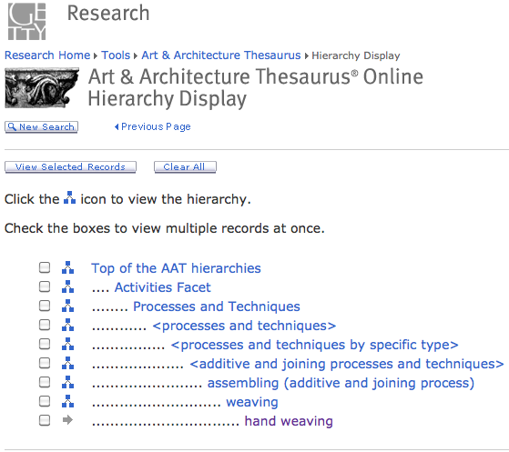
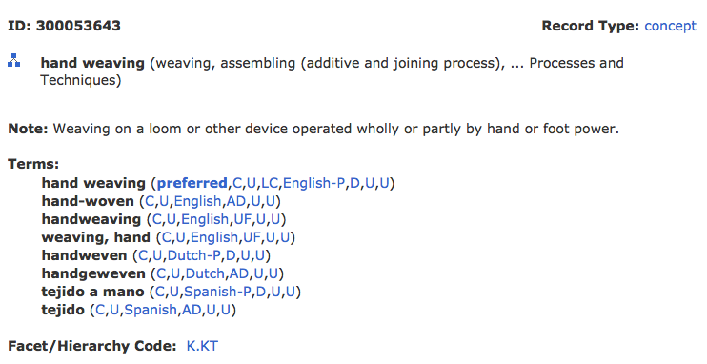
Art & Architecture Thesaurus (AAT)

Slide 36
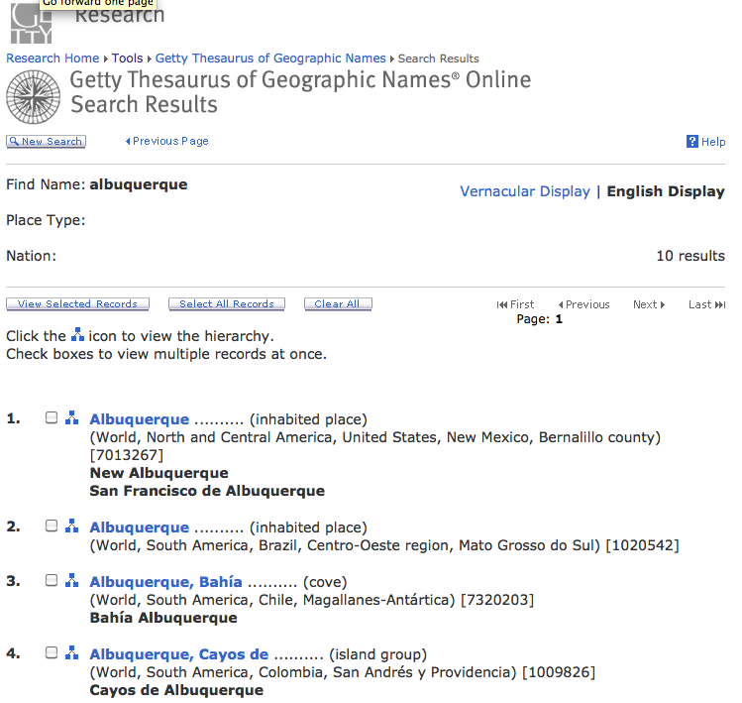
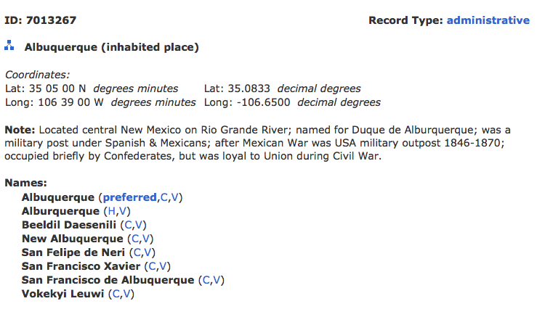
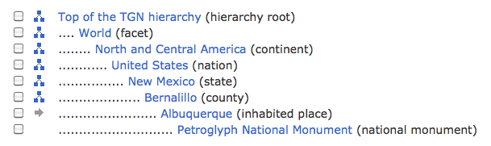
Thesaurus for Geographic Names (TGN)

Slide 37
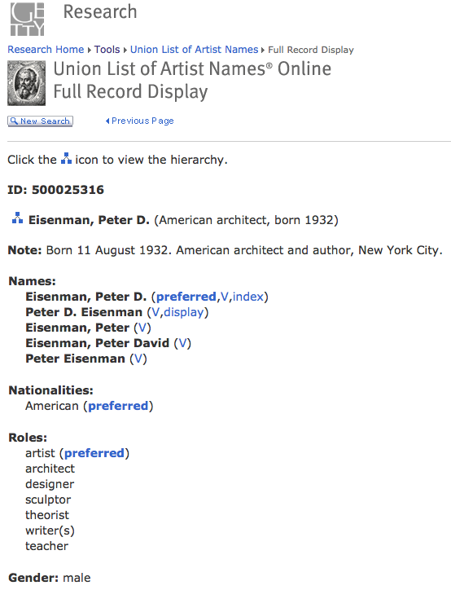
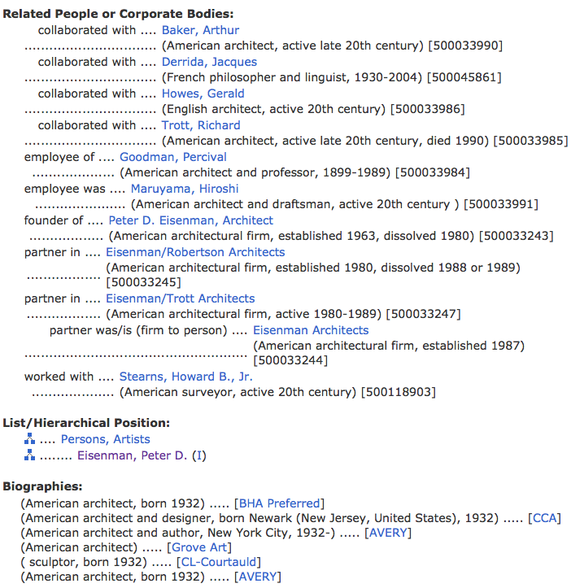
Union List of Artists’ Names (ULAN)

Slide 38
Cultural Objects Name Authority (CONA)
Forthcoming 2012 from Getty vocabularies
Will include records at several different levels: item, group, collection, etc
Accepting contributions now
Records may include:
  Creator
  Creation date
  Measurements
  Materials
  Current location
  Etc.

Slide 39
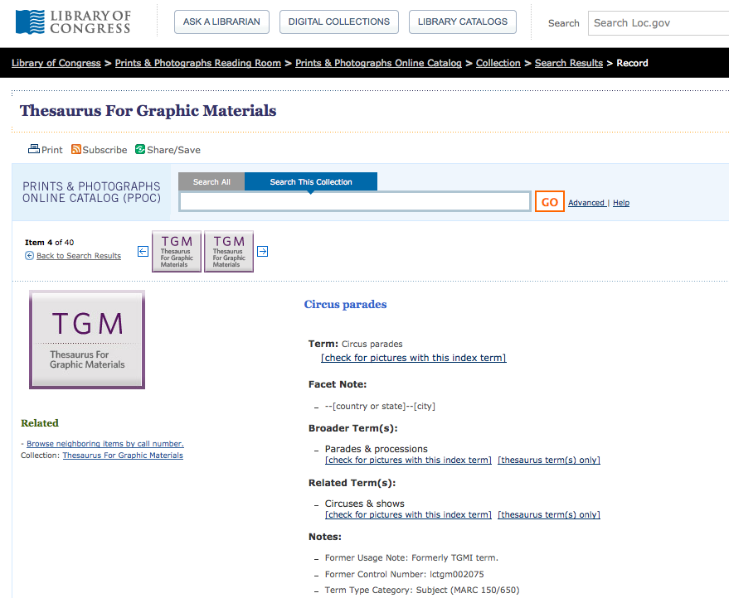
Thesaurus for Graphic Materials (TGM) I & II

Slide 40
Metadata mapping
Surprise! You’ve done some of this already today.
VRA Work Title ≈ CDWA Title Text ≈ MODS <titleInfo><title>
A documented crosswalk lays the groundwork for automatically transforming metadata from one structure standard into another.
Notes:
Mappings performed via XSLT, or a full programming language.

Slide 41
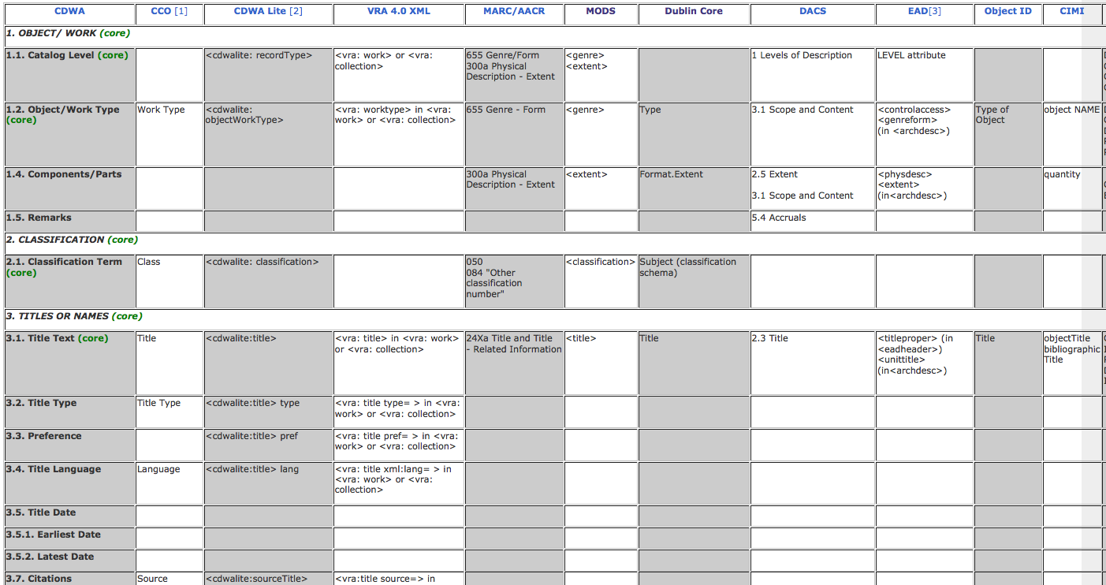
Much mapping work pre-exists for you
  How does our work matching up data between metadata formats compare to this?
  http://www.getty.edu/research/publications/electronic_publications/intrometadata/crosswalks.html

Slide 42
And that’s not all!
Let’s think about some additional implementation issues:
  Store metadata internal to an image file or externally?
  Store natively in XML or in a relational database or some other way?
  How widely can/will you share your metadata?
  What will your workflow look like?
    Description vs. authority control
    Digitize first or describe first?
    Is there any pre-existing metadata you can reuse?
  What can you to in today’s implementation to make migration to future systems easier?
Notes:
Have a group discussion about these issues.

Slide 43
Your interaction with the system
All of the systems you heard about earlier this week have limitations. (Sorry.)
Be informed so you can push where reasonable, and contribute effectively to system selection and implementation process
Be careful about hacking your data to accommodate a local system quirk

Slide 44
What’s next?
There’s an active metadata community to talk with
Increasingly catalogers are working closely with technical staff
Get some hands on practice!
I’d be happy to talk further: jennriley@unc.edu
This work by Jenn Riley is licensed under a Creative Commons Attribution-NonCommercial-ShareAlike 3.0 Unported License.

