Slide 1
If you don’t have printed handouts…
Download these copies:
http://bit.ly/Ltjp4D (Worksheet)
http://bit.ly/MxWA0C (Reference)

Slide 2
Metadata Overview
Jenn Riley
Head, Carolina Digital Library and Archives
The University of North Carolina at Chapel Hill

Slide 3
How in the world am I supposed to deal with this?!?

Slide 4
Don’t panic. You can make good decisions with the right information.
We’ll begin with some theory, and then move on to practice.

Slide 5
Many definitions of metadata
“Data about data”
“Structured information about an information resource of any media type or format.” (Caplan)
“Structured information that describes, explains, locates, or otherwise makes it easier to retrieve, use, or manage an information resource.” (NISO)
“Metadata is constructed, constructive, and actionable.” (Coyle)
…

Slide 6
Refining a definition
Other characteristics
Structure
Control
Origin
Machine-generated
Human-generated
Don’t get stuck on the difference between data, metadata, and meta-metadata

Slide 7
Some uses of metadata in cultural heritage institutions
Catalog cards
Slide labels
VR databases
Online catalogs
Finding aids
Inventories
Registers

Slide 8
Some types of metadata
Type | Use
Descriptive metadata | Searching Browsing Display Interoperability
Technical metadata | Interoperability Digital object management Preservation
Preservation metadata | Interoperability Preservation
Rights metadata | Interoperability Digital object management
Structural metadata | Navigation

Slide 9
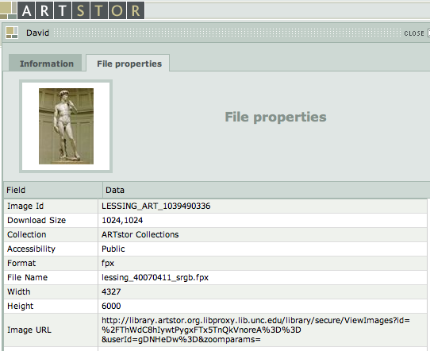
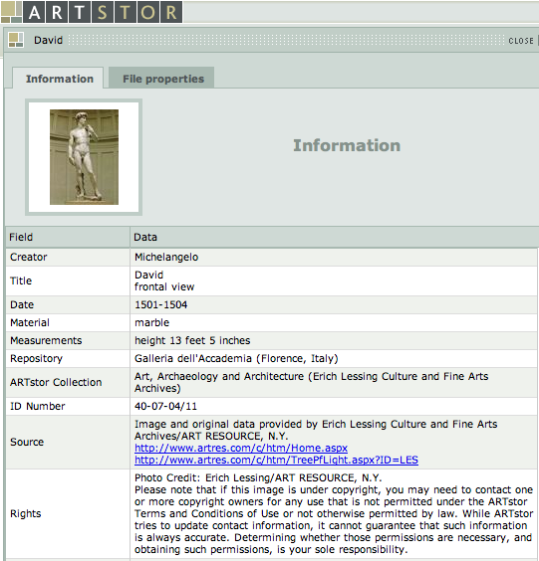
Metadata in action
Descriptive metadata
Technical metadata
Rights metadata
Navigating between multiple views of the same image would be structural metadata.

Slide 10
But…
The lines between these types are rarely clear
We’ll primarily talk about descriptive metadata this morning

Slide 11
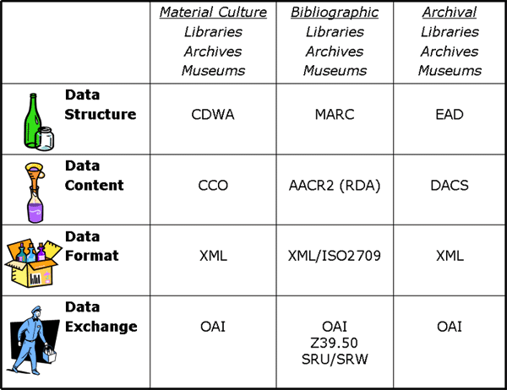
And you also need to know about…
Chart by Elings & Waibel, “Metadata for All” <http://firstmonday.org/htbin/cgiwrap/bin/ojs/index.php/fm/article/view/1628/1543>

Slide 12
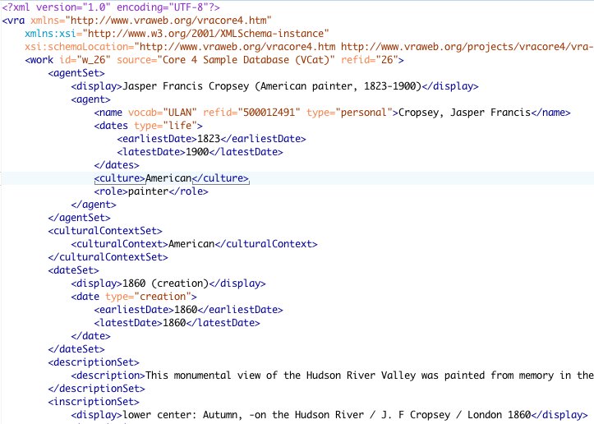
2 minutes on XML

Slide 13
General principles to apply
Tie your choice of standards to your purpose
Art images vs. documentary images
Pedagogical vs. museum object management vs. archival
Look to the community for best practices
Know why you’re doing something a certain way
Display, search, browse
Current and reasonable future discovery needs
If it’s not immediately justifiable, ask the hard questions
Avoid the temptation to over-describe
Document your decisions
Consider uses of your metadata beyond your local system

Slide 14
So now what?
Let’s look at some options.

Slide 15
Some metadata standards of use to VR professionals
Data structure (descriptive)
VRA Core
CDWA
CDWA Lite
MARC
MODS
Dublin Core
Data structure (technical)
MIX
EXIF (mostly)
Data content
CCO
AACR2/RDA
DACS

Slide 16
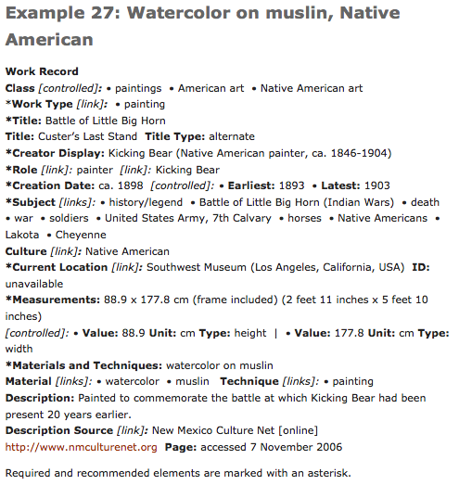
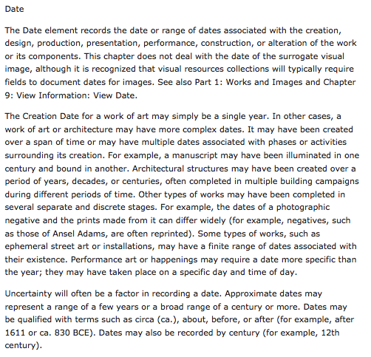
CCO content standard
From http://cco.vrafoundation.org/

Slide 17
Using a content standard
It’s OK to pick and choose when to apply it
It’s just a set of rules (that humans wrote) and therefore is wide open to interpretation
Try to constrain the full standard for your local implementation
Don’t fret too much if your case isn’t covered or you find it ambiguous
Provided examples are useful, but they’re not the rules
Alternatives to CCO
AACR2/RDA if you want a more “bibliographic” approach
DACS if you want a more archival approach, focusing on the description of whole collections rather than individual items

Slide 18
Visual Resources Association Core Categories (VRA Core)
THIS is the metadata structure standard that you really need to know
Designed by visual resources specialists
Distinguishes between collection, work, and image
Schemas for “unrestricted” and “restricted” versions
Provides for values for both display and indexing
This isn’t common in other metadata standards
Focus on creation, style, culture
Best used on collections of reproductions of works of art & architecture

Slide 19
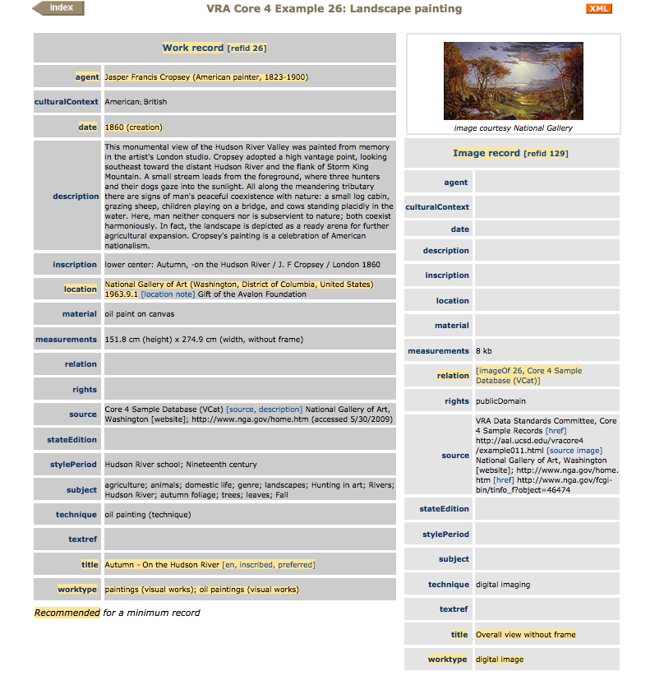
This record in XML
Notes:
Things to point out:
* Work and image in separate records
*Separate elements for display and indexing values
*Use of controlled vocabularies
*Connections to research relevant to the work

Slide 20
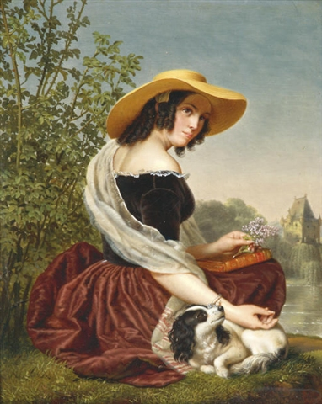
Let’s create some VRA!
Description: "Good memories" by Ange Francois, Belgian painter (1800-1867)
Date: Unknown but not later than 1867
Artist: Ange Francois
Don’t worry about data values for now; we’ll get to that in a bit.
http://commons.wikimedia.org/wiki/File:MemoriesAngeFrancois.jpeg

Slide 21
Categories for the Description of Works of Art (CDWA)
Strong museum, curatorial focus
Strong on culture, physical location
Meant to describe original works, not surrogates or reproductions
Best used for unique materials owned and managed by your institution
Base metadata format for many museum collection management systems
No formally specified encoding, but recommends storing data in a relational structure
Guidelines are nearly as prescriptive as a content standard

Slide 22
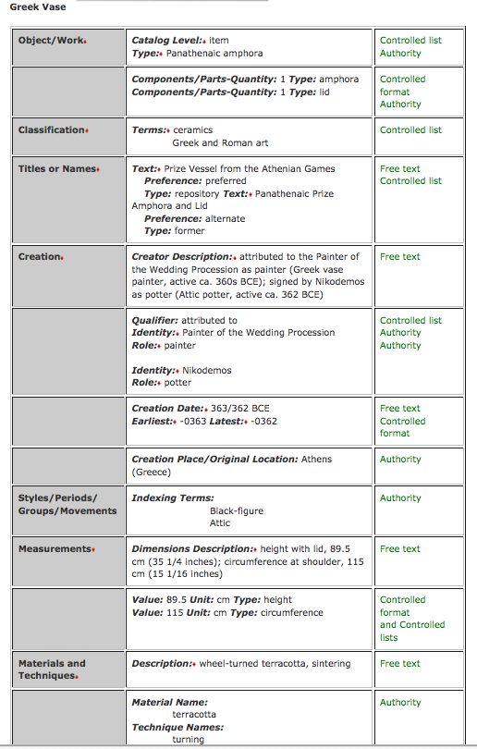
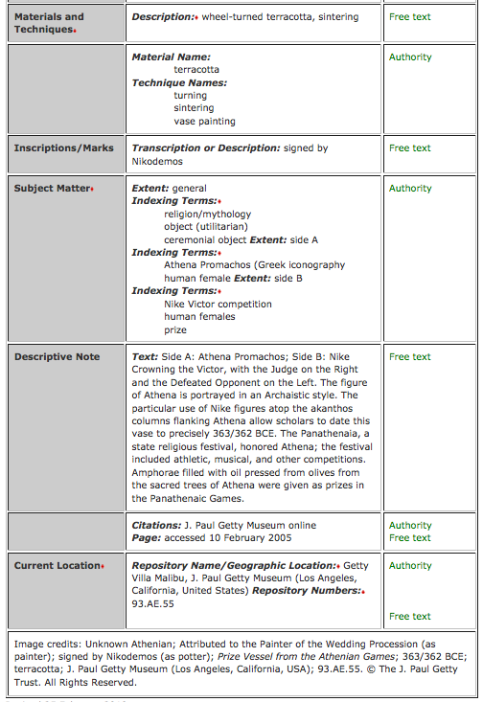
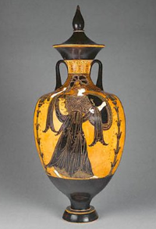

Slide 23
And again, in CDWA…
Description: "Good memories" by Ange Francois, Belgian painter (1800-1867)
Date: Unknown but not later than 1867
Artist: Ange Francois
Don’t worry about data values for now; we’ll get to that in a bit.
http://commons.wikimedia.org/wiki/File:MemoriesAngeFrancois.jpeg

Slide 24
CDWA Derivatives
CDWA Lite = Simplified version of the full CDWA
In XML
For data sharing
LIDO = Lightweight Information Describing Objects
Expansion of CDWA Lite
Combined with museumdat
Also intended for use in data harvesting, between institutions

Slide 25
MARC
Used in library catalogs
Might use if
You wanted discovery through the library catalog
Your unit is an integral part of an academic library system and does not invest in an image database for teaching
You can do it, but it’s not a great fit
MARCXML sometimes used when MARC exists but an XML form is needed
I won’t suggest that we do a MARC exercise here. (Woohoo!)

Slide 26
Metadata Object Description Schema (MODS)
“Bibliographic” in nature
No natural places for some data elements crucial for visual resources, such as cultural origin of an object
Doesn’t make work vs. image distinction
Might use if:
You’re integrating your VR material material into a wider digital library context
You are describing documentary images rather than art images
You already have a system that can handle it

Slide 27
And again, this time in MODS…
Description: "Good memories" by Ange Francois, Belgian painter (1800-1867)
Date: Unknown but not later than 1867
Artist: Ange Francois
Don’t worry about data values for now; we’ll get to that in a bit.
http://commons.wikimedia.org/wiki/File:MemoriesAngeFrancois.jpeg

Slide 28
Simple Dublin Core
An extremely basic metadata structure standard, originally developed for documents on the web
Intended to be core across all resource domains
This is the format used for the OAI-PMH metadata sharing protocol
Rarely if ever used as a native metadata format in the cultural heritage sector

Slide 29
Qualified Dublin Core
A more robust version of simple Dublin Core
Additional elements
Element qualifiers
Syntax encoding schemes
Native format in some digital library systems
DSpace
CONTENTdm
Might use if:
You’re integrating your VR material material into a wider digital library context
You are describing documentary images rather than art images
You already have a system that can handle it

Slide 30
And now in Qualified Dublin Core…
Description: "Good memories" by Ange Francois, Belgian painter (1800-1867)
Date: Unknown but not later than 1867
Author: Ange Francois
Don’t worry about data values for now; we’ll get to that in a bit.
http://commons.wikimedia.org/wiki/File:MemoriesAngeFrancois.jpeg

Slide 31
But this is only the first step.
Let’s think more carefully about what goes in those fields.
Content standards + vocabulary control

Slide 32
Vocabulary control
Also known as:
Controlled vocabularies
Authority control
Use it for fields where:
You want browseability
Many different resources will have the same value in a field
One thing might be known by different names and it would be useful to discover those things together

Slide 33
Which fields in VRA core would benefit from vocabulary control?

Slide 34
Controlled vocabularies are highly specialized – other communities may have some that are useful for you
Most have a mechanism for new terms to be proposed
Let’s look at some controlled vocabularies useful for VR collections

Slide 35
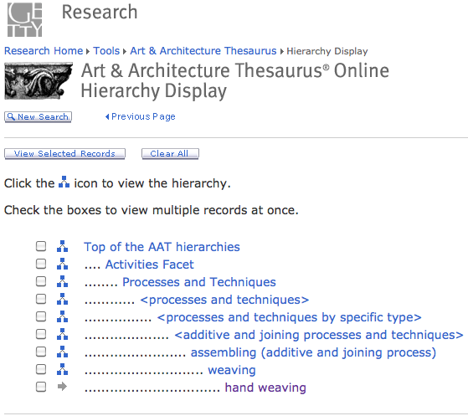
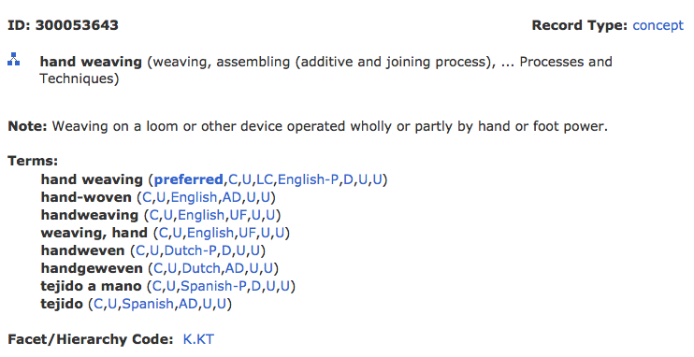
Art & Architecture Thesaurus (AAT)
Notes:
Facets:
Associated concepts
Physical attributes
Styles and periods
Agents
Activities
Materials
Objects
Brand names

Slide 36
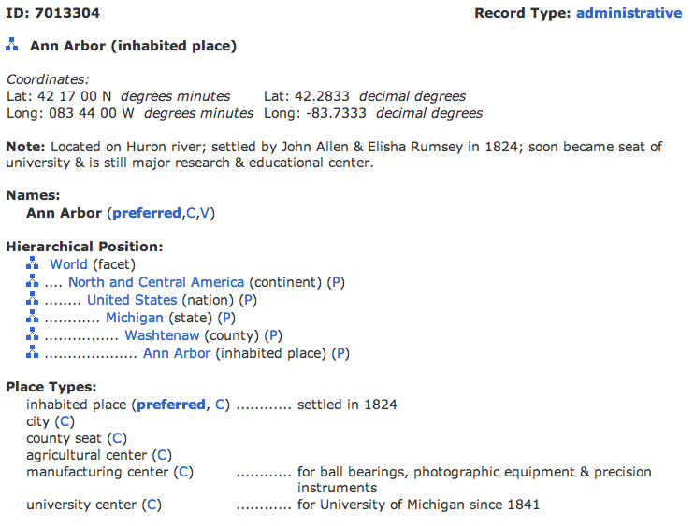
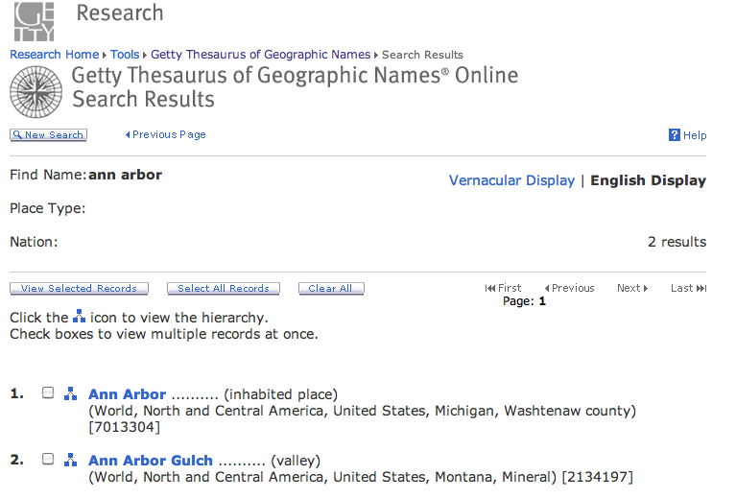
Thesaurus for Geographic Names (TGN)

Slide 37
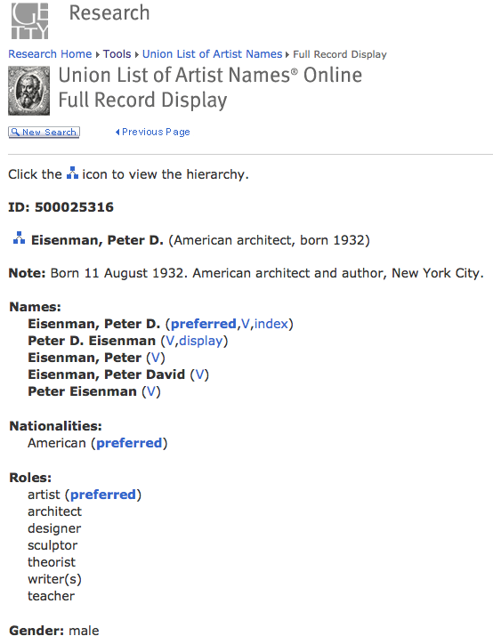
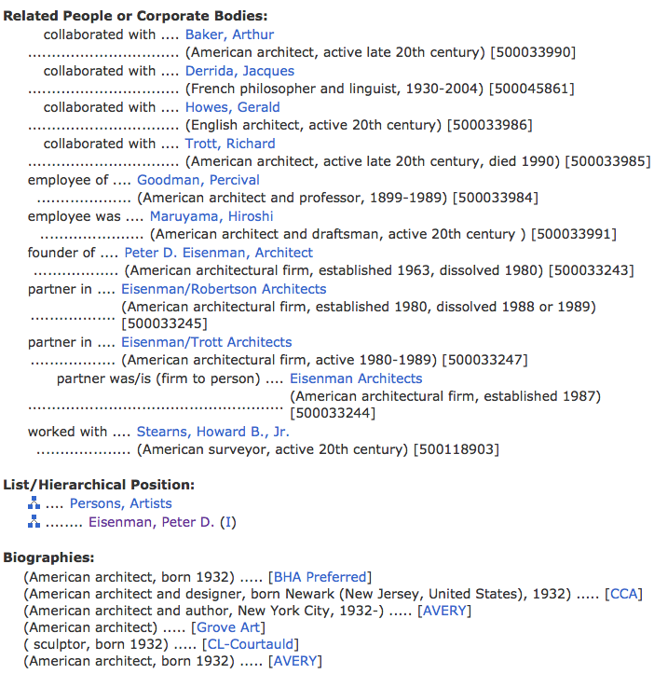
Union List of Artists’ Names (ULAN)

Slide 38
Cultural Objects Name Authority (CONA)
A work authority file
Forthcoming from Getty vocabularies
Will include records at several different levels: item, group, collection, etc
Accepting contributions now
Records may include:
Creator
Creation date
Measurements
Materials
Current location
Etc.

Slide 39
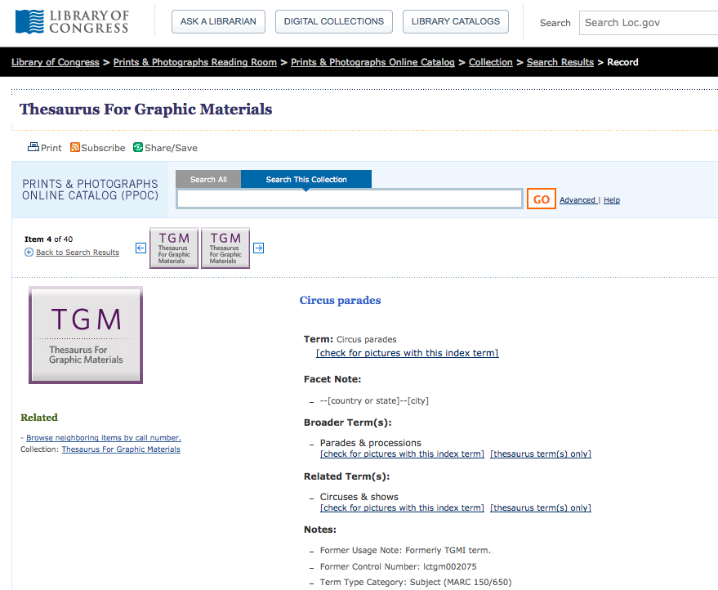
Thesaurus for Graphic Materials (TGM) I & II

Slide 40
Getting from one format to another; aka, metadata mapping
Surprise! You’ve done some of this already today.
VRA Work Title ≈ CDWA Title Text ≈ MODS <titleInfo><title>
A documented crosswalk lays the groundwork for automatically transforming metadata from one structure standard into another.
Notes:
Mappings performed via XSLT, or a full programming language.

Slide 41
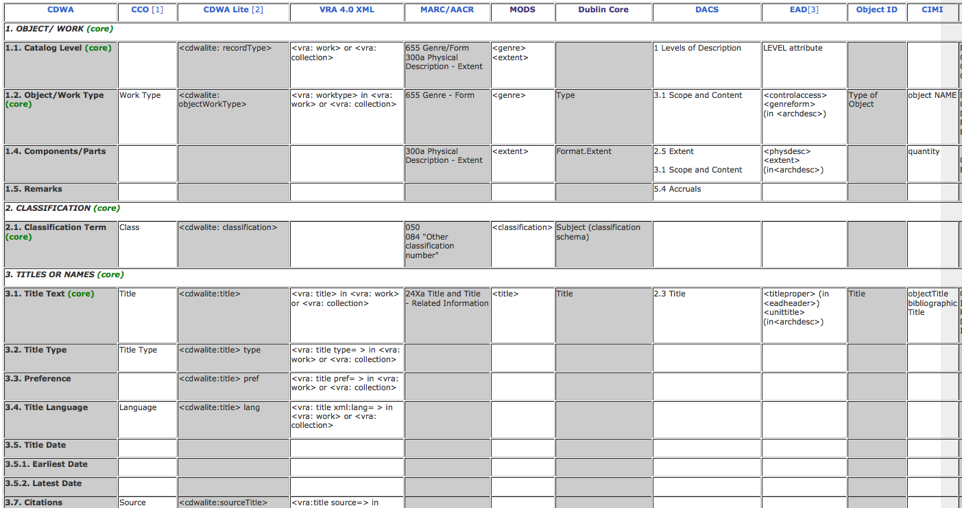
Much mapping work pre-exists for you
How does our work matching up data between metadata formats compare to this?
http://www.getty.edu/research/publications/electronic_publications/intrometadata/crosswalks.html

Slide 42
There will be many implementation issues
Store metadata internal to an image file or externally?
Store natively in XML or in a relational database or some other way?
How widely can/will you share your metadata?
What will your workflow look like?
Description vs. authority control
Digitize first or describe first?
Is there any pre-existing metadata you can reuse?
What can you to in today’s implementation to make migration to future systems easier?
Notes:
Have a group discussion about these issues.

Slide 43
Your interaction with the system
All discovery and digital asset management systems have limitations.
Be informed so you can push where reasonable, and contribute effectively to system selection and implementation process
Be careful about hacking your data to accommodate a local system quirk

Slide 44
What’s next?
There’s an active metadata community to talk with
Increasingly catalogers are working closely with technical staff
Get some hands on practice!
I’d be happy to talk further: jennriley@unc.edu
This work by Jenn Riley is licensed under a Creative Commons Attribution-NonCommercial-ShareAlike 3.0 Unported License.

