Slide 1
If you don’t have the handouts…
Download these copies:
http://bit.ly/12ca24p (Worksheet)
http://bit.ly/14LJ6nW (Reference)

Slide 2
Metadata Overview
Jenn Riley
Head, Carolina Digital Library and Archives
The University of North Carolina at Chapel Hill

Slide 3
How in the world am I supposed to deal with this?!?

Slide 4
Don’t panic. You can make good decisions with the right information.
We’ll begin with some theory, and then move on to practice.

Slide 5
Many definitions of metadata
“Data about data”
“Structured information about an information resource of any media type or format.” (Caplan)
“Structured information that describes, explains, locates, or otherwise makes it easier to retrieve, use, or manage an information resource.” (NISO)
“Metadata is constructed, constructive, and actionable.” (Coyle)
“Data which removes from a user (human or machine) the need to have full advance knowledge of the existence or characteristics of things of potential interest in the environment.” (Dempsey)
“An item of metadata is a relationship that someone claims to exist between two entities.” (<indecs>)
…

Slide 6
Refining a definition
Characteristics
Structure
Control
Origin
Machine-generated
Human-generated
Increasingly conceived as a relationship
Don’t get stuck on the difference between data, metadata, and meta-metadata

Slide 7
Some uses of metadata in cultural heritage institutions
Catalog cards
Slide labels
VR databases
Online catalogs
Finding aids
Inventories
Registers

Slide 8
Some types of metadata
Type | Use
Descriptive metadata | Searching Browsing Display Interoperability/exchange
Technical metadata | Interoperability/exchange Digital object management Preservation
Preservation metadata | Interoperability/exchange Preservation
Rights metadata | Interoperability/exchange Digital object management
Structural metadata | Navigation

Slide 9
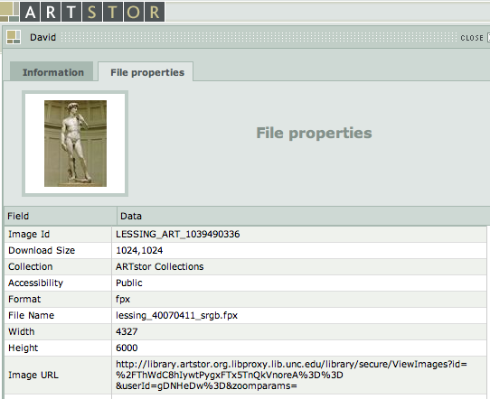
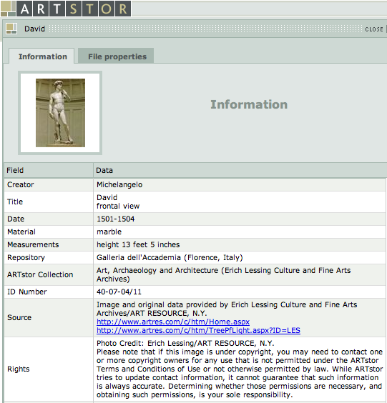
Metadata in action
Descriptive metadata
Technical metadata
Rights metadata
Navigating between multiple views of the same image would be structural metadata.

Slide 10
But…
The lines between these types are rarely clear
We’ll primarily talk about descriptive metadata this morning

Slide 11
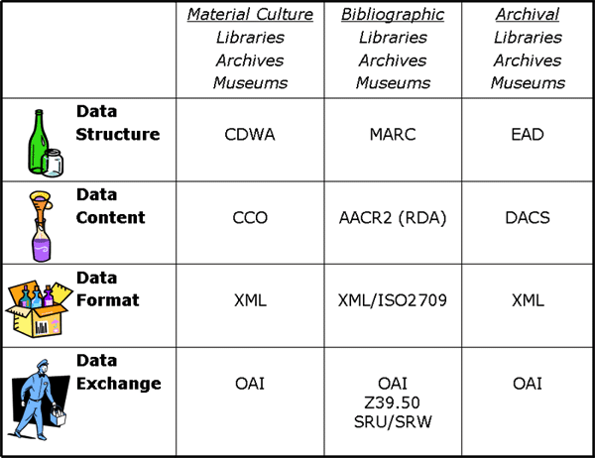
And you also need to know about…
Chart by Elings & Waibel, “Metadata for All” <http://firstmonday.org/htbin/cgiwrap/bin/ojs/index.php/fm/article/view/1628/1543>

Slide 12
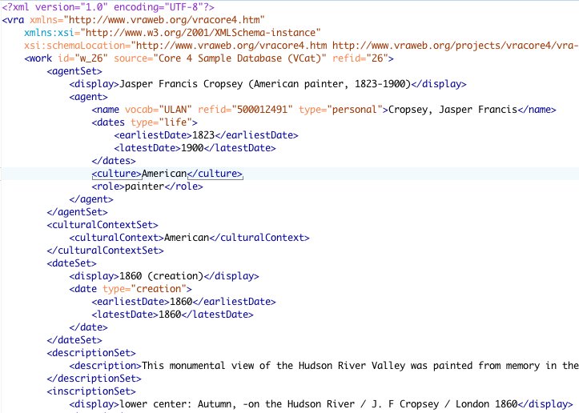
2 minutes on XML

Slide 13
General principles to apply
Tie your choice of standards to your purpose
Art images vs. documentary images
Pedagogical vs. museum object management vs. archival
Look to the community for best practices
Know why you’re doing something a certain way
Display, search, browse
Current and reasonable future discovery needs
If it’s not immediately justifiable, ask the hard questions
Avoid the temptation to over-describe
Document your decisions
Consider uses of your metadata beyond your local system

Slide 14
So now what?
Let’s look at some options.

Slide 15
Some metadata standards of use to VR professionals
Data structure (descriptive)
VRA Core
CDWA
CDWA Lite
LIDO
MARC
MODS
Dublin Core
Data structure (technical)
MIX
EXIF (mostly)
Data content
CCO
RDA/AACR2
DACS

Slide 16
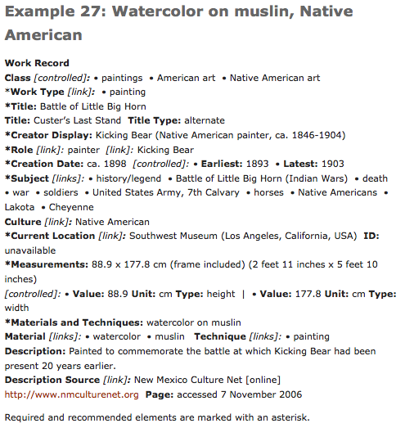
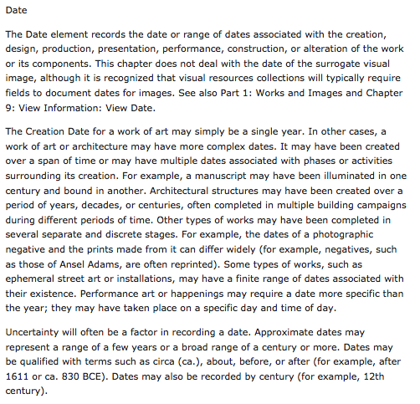
CCO content standard
From http://cco.vrafoundation.org/
Also see CCO Ten Key Concepts

Slide 17
Using a content standard
In some situations, it’s OK to pick and choose when to apply it
It’s just a set of rules (that humans wrote) and therefore is wide open to interpretation
Try to constrain the full standard for your local implementation
Don’t fret too much if your case isn’t covered or you find it ambiguous
Provided examples are useful, but they’re not the rules
Alternatives to CCO
AACR2/RDA if you want a more “bibliographic” approach
DACS if you want a more archival approach, focusing on the description of whole collections rather than individual items

Slide 18
Visual Resources Association Core Categories (VRA Core)
THIS is the metadata structure standard that you really need to know
Designed by visual resources specialists
Currently hosted online by LC, maintained by an advisory group
Focus on creation, style, culture
Best used on collections of reproductions of works of art & architecture

Slide 19
Important features of VRA Core
Distinguishes between collection, work, and image
Provides for values for both display and indexing
Schemas for unrestricted and restricted versions

Slide 20
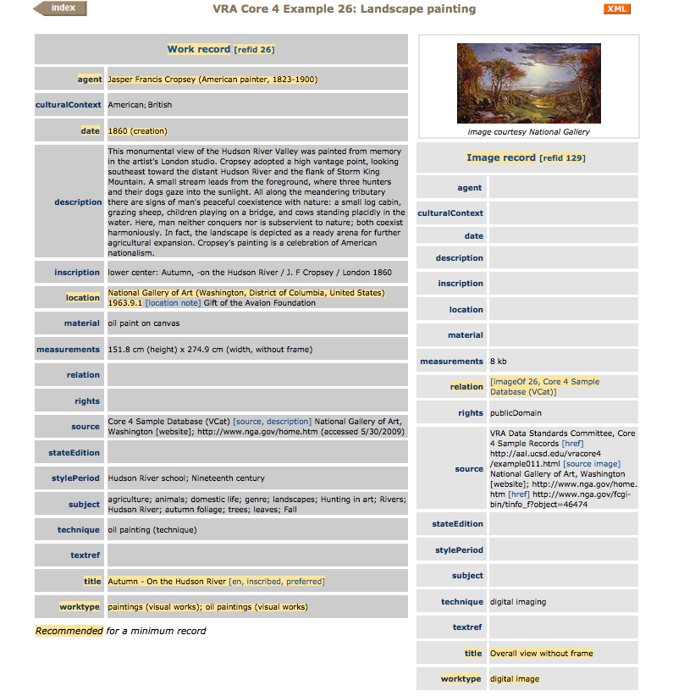
This record in XML
Notes:
Things to point out:
* Work and image in separate records
*Separate elements for display and indexing values
*Use of controlled vocabularies
*Connections to research relevant to the work

Slide 21
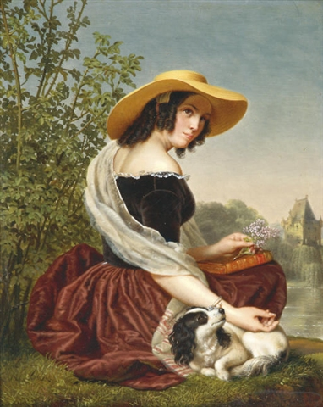
Let’s create some VRA!
Good memories by Ange Francois, Belgian painter (1800-1867)
oil on panel
23.5 x 18.5 cm
Date: Unknown but not later than 1867
Look at data values guidelines for each element.
http://commons.wikimedia.org/wiki/File:MemoriesAngeFrancois.jpeg

Slide 22
Categories for the Description of Works of Art (CDWA)
Strong museum, curatorial focus
Strong on culture, physical location
Meant to describe original works, not surrogates or reproductions
Best used for unique materials owned and managed by your institution
Base metadata format for many museum collection management systems
No formally specified encoding, but recommends storing data in a relational structure
Guidelines are nearly as prescriptive as a content standard

Slide 23
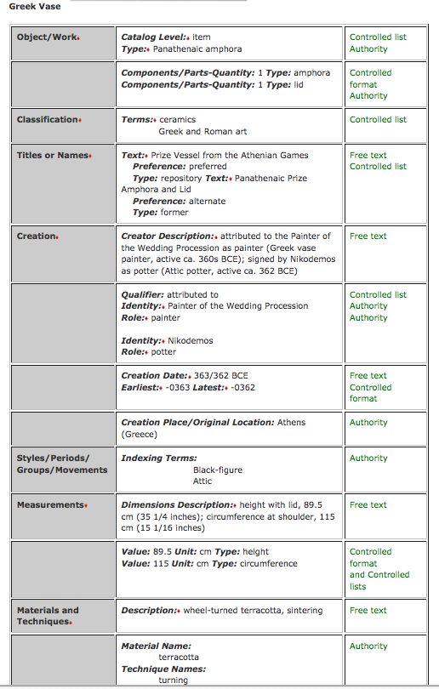
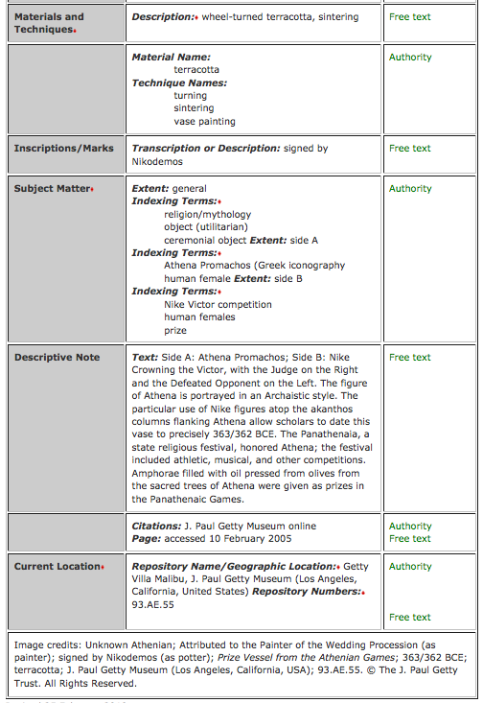
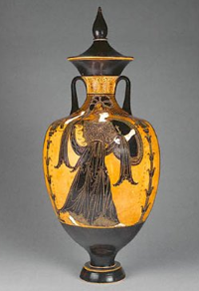

Slide 24
And again, in CDWA…
Good memories by Ange Francois, Belgian painter (1800-1867)
oil on panel
23.5 x 18.5 cm
Date: Unknown but not later than 1867
Look at data values guidelines for each element.
http://commons.wikimedia.org/wiki/File:MemoriesAngeFrancois.jpeg

Slide 25
CDWA Derivatives
CDWA Lite = Simplified version of the full CDWA
In XML
For data sharing
LIDO = Lightweight Information Describing Objects
Expansion of CDWA Lite
Combined with museumdat
Also intended for use in data harvesting, between institutions
Intended to supersede both CDWA Lite and museumdat

Slide 26
MARC
Used in library catalogs
Might use if
You wanted discovery through the library catalog
Your unit is an integral part of an academic library system and does not invest in an image database for teaching
You can do it, but it’s not a great fit
MARCXML sometimes used when MARC exists but an XML form is needed
BIBFRAME is in planning phase as successor
I won’t suggest that we do a MARC exercise here. (Woohoo!)

Slide 27
Metadata Object Description Schema (MODS)
“Bibliographic” in nature
No natural places for some data elements crucial for visual resources, such as cultural origin of an object
Doesn’t make work vs. image distinction
Might use if:
You’re integrating your VR material material into a wider digital library context
You are describing documentary images rather than art images
You already have a system that can handle it

Slide 28
And again, this time in MODS…
Good memories by Ange Francois, Belgian painter (1800-1867)
oil on panel
23.5 x 18.5 cm
Date: Unknown but not later than 1867
Don’t worry about the “right” data values.
http://commons.wikimedia.org/wiki/File:MemoriesAngeFrancois.jpeg

Slide 29
Simple Dublin Core
An extremely basic metadata structure standard, originally developed for documents on the web
Intended to be core across all resource domains
This is the format used for the OAI-PMH metadata sharing protocol
Rarely if ever used as a native metadata format in the cultural heritage sector

Slide 30
Qualified Dublin Core
A more robust version of simple Dublin Core
Additional elements
Element qualifiers
Syntax encoding schemes
Native format in some digital library systems
DSpace
CONTENTdm
Might use if:
You’re integrating your VR material material into a wider digital library context
You are describing documentary images rather than art images
You already have a system that can handle it

Slide 31
And now in Qualified Dublin Core…
Good memories by Ange Francois, Belgian painter (1800-1867)
oil on panel
23.5 x 18.5 cm
Date: Unknown but not later than 1867
Don’t worry about the “right” data values.
http://commons.wikimedia.org/wiki/File:MemoriesAngeFrancois.jpeg

Slide 32
But this is only the first step.
Let’s think more carefully about what goes in those fields.
Content standards + vocabulary control

Slide 33
Vocabulary control
Also known as:
Controlled vocabularies
Authority control
Use it for fields where:
You want browseability
Many different resources will have the same value in a field
One thing might be known by different names and it would be useful to discover those things together

Slide 34
Which fields in VRA core would benefit from vocabulary control?

Slide 35
Controlled vocabularies are highly specialized – other communities may have some that are useful for you
Most have a mechanism for new terms to be proposed
Let’s look at some controlled vocabularies useful for VR collections

Slide 36
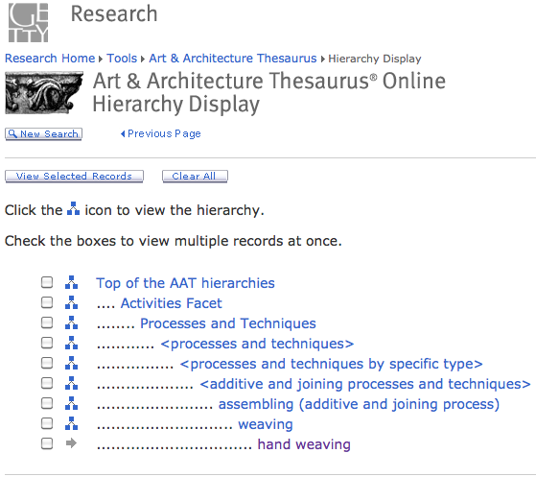
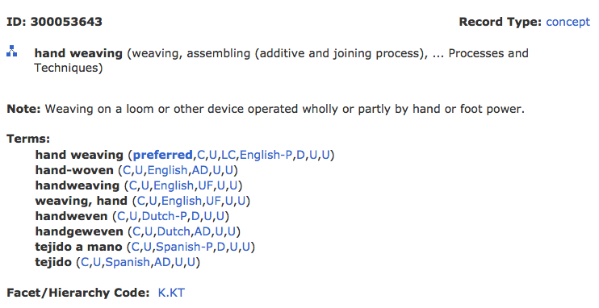
Art & Architecture Thesaurus (AAT)
Notes:
Facets:
Associated concepts
Physical attributes
Styles and periods
Agents
Activities
Materials
Objects
Brand names

Slide 37
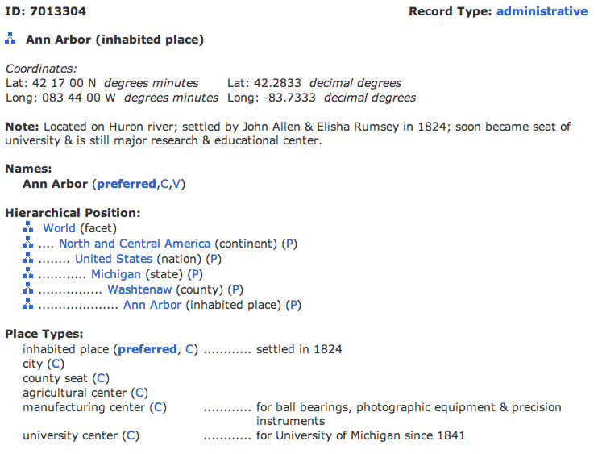
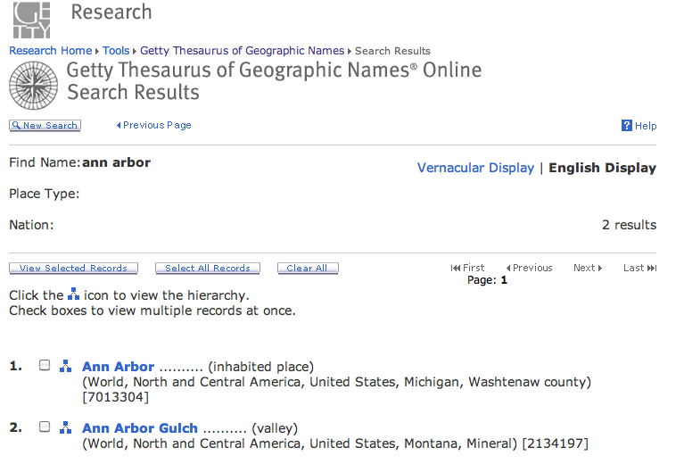
Thesaurus for Geographic Names (TGN)

Slide 38
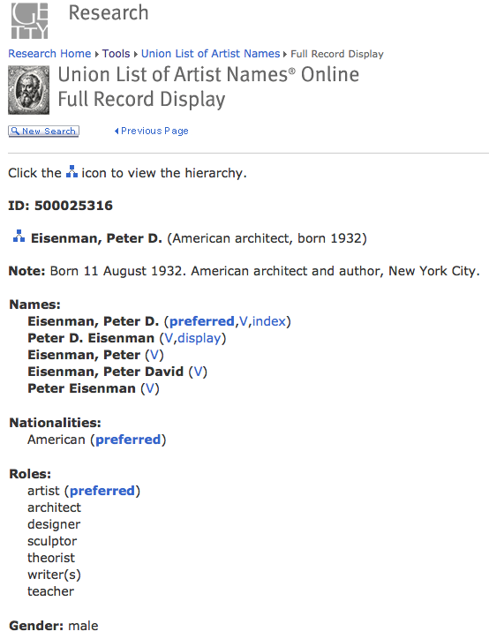
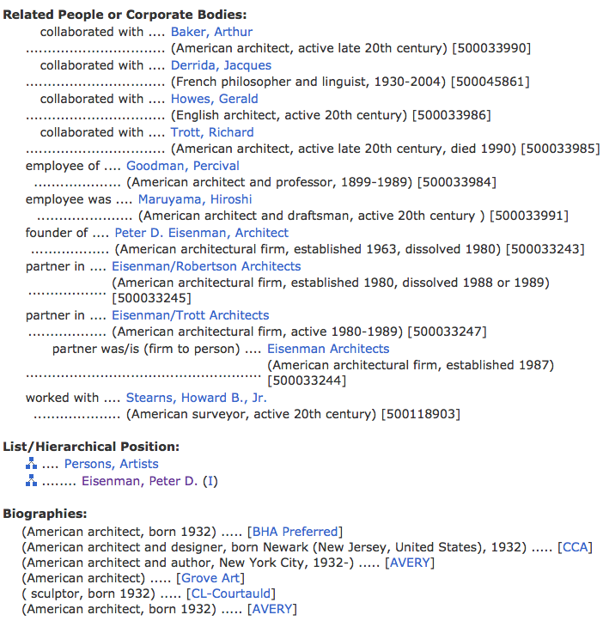
Union List of Artists’ Names (ULAN)

Slide 39
Cultural Objects Name Authority (CONA)
A work authority file
In a pilot phase from Getty vocabularies
Records conform to CDWA and CCO
Contributions accepted in their own XML format, CDWA Lite, and LIDO in the future
Records include:
Creator
Creation date
Measurements
Materials
Current location
Etc.

Slide 40
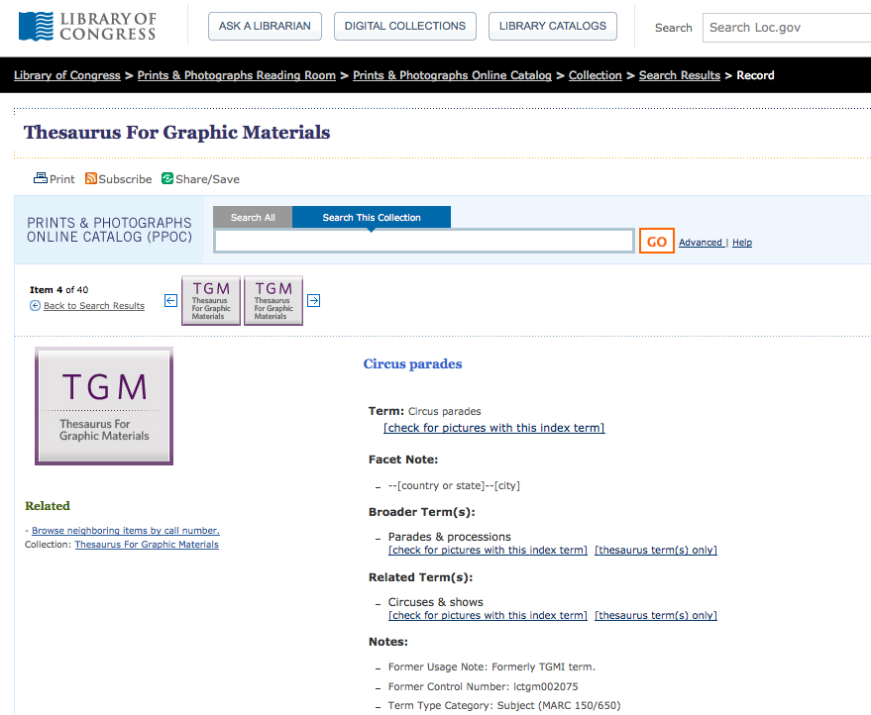
Thesaurus for Graphic Materials (TGM) I & II

Slide 41
Getting from one format to another; aka, metadata mapping
Surprise! You’ve done some of this already today.
VRA Work Title ≈ CDWA Title Text ≈ MODS <titleInfo><title>
A documented crosswalk lays the groundwork for automatically transforming metadata from one structure standard into another.
Notes:
Mappings performed via XSLT, or a full programming language.

Slide 42
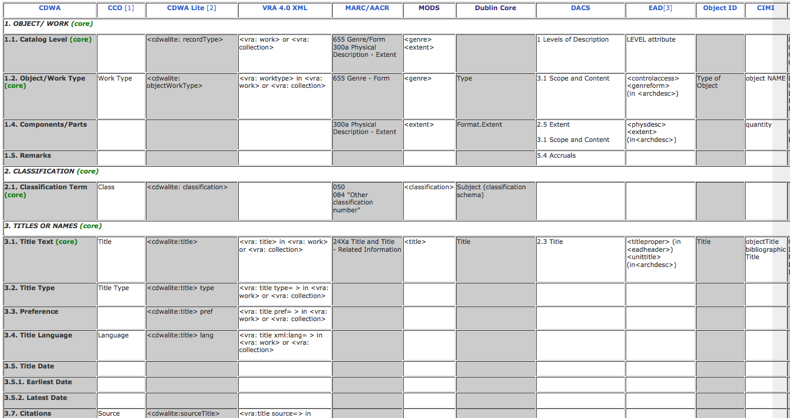
Much mapping work pre-exists for you
http://www.getty.edu/research/publications/electronic_publications/intrometadata/crosswalks.html

Slide 43
There will be many implementation issues
Store metadata internal to an image file or externally?
Store natively in XML or in a relational database or some other way?
How widely can/will you share your metadata?
What will your workflow look like?
Description vs. authority control
Digitize first or describe first?
Is there any pre-existing metadata you can reuse?
What can you to in today’s implementation to make migration to future systems easier?
Notes:
Have a group discussion about these issues.

Slide 44
Your interaction with the system
All discovery and digital asset management systems have limitations
Be informed so you can push where reasonable, and contribute effectively to system selection and implementation process
Be careful about hacking your data to accommodate a local system quirk

Slide 45
A word about Linked (Open) Data
A semantic web strategy, allowing systems to interact with a big web of shared data
Tim Berners Lee’s Linked Data Design Principles*
Use URIs as names for things
Use HTTP URIs so that people can look up those names.
When someone looks up a URI, provide useful information, using the standards (RDF, SPARQL)
Include links to other URIs. so that they can discover more things.
Getty vocabularies planned release as LOD soon
Library school thesis by Jeff Mixter exposed VRA Core as LOD: http://jmixter.s3-website-us-east-1.amazonaws.com/thesis/
* http://www.w3.org/DesignIssues/LinkedData.html

Slide 46
What’s next?
There’s an active metadata community to talk with
Increasingly catalogers are working closely with technical staff
Practice, practice, practice
The metadata landscape is rapidly changing; get involved!
I’d be happy to talk further: jennriley@unc.edu
This work by Jenn Riley is licensed under a Creative Commons Attribution-NonCommercial-ShareAlike 3.0 Unported License.

