Slide 1
How much to semanticize? Looking at the future of library data and the Semantic Web
Jenn Riley
Metadata Librarian
Indiana University
Digital Library Program

Slide 2
“The Semantic Web is not a separate Web but an extension of the current one, in which information is given well-defined meaning, better enabling computers and people to work in cooperation.”
Berners-Lee, Tim, James Hendler and Ora Lassila. (May 2001). “The Semantic Web.” Scientific American 284(5).

Slide 3
RDF model
URI reference
Subject
Predicate
URI reference
URI reference
Object
literal
RDF Primer http://www.w3.org/TR/rdf-primer/

Slide 4
Inferencing
Let’s say you have these statements, all from different sources:
Dewey the dog is owned by Leslie the librarian
Leslie the librarian lives at 1234 Cutter Lane
Dogs typically live in the same home as their owners
An inferencing engine can decide it’s likely that:
Dewy the dog lives at 1234 Cutter Lane
Leap of faith:
If you have access to enough data, inferencing systems will work

Slide 5
Linked data
Use URIs as names for things
Use HTTP URIs so that people can look up those names.
When someone looks up a URI, provide useful information, using the standards (RDF, SPARQL)
Include links to other URIs, so that they can discover more things.
Berners-Lee, Tim. (2006). “Linked Data Design Issues.” http://www.w3.org/DesignIssues/LinkedData.html

Slide 6
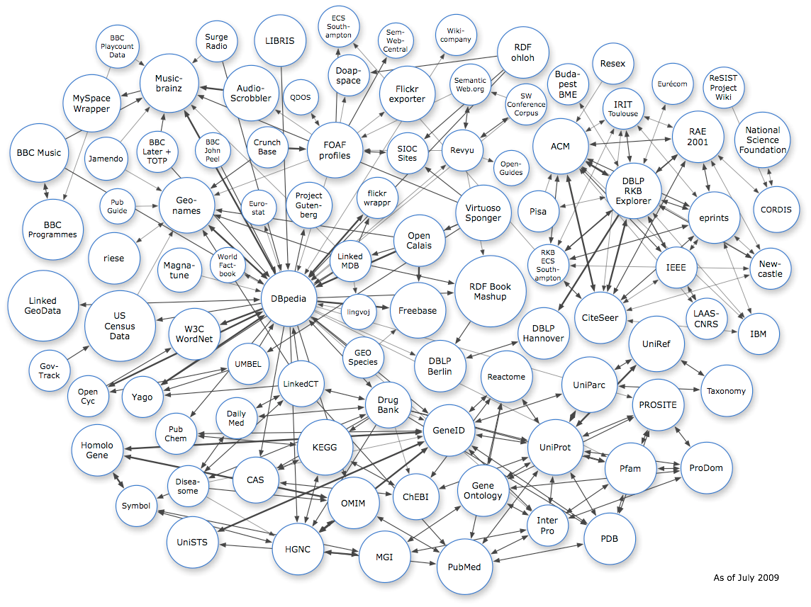
http://richard.cyganiak.de/2007/10/lod/

Slide 7
Linked Data in libraries
id.loc.gov
VIAF
Hungarian National Library
German National Library
Royal Library of Sweden
(at least)
RDA???

Slide 8
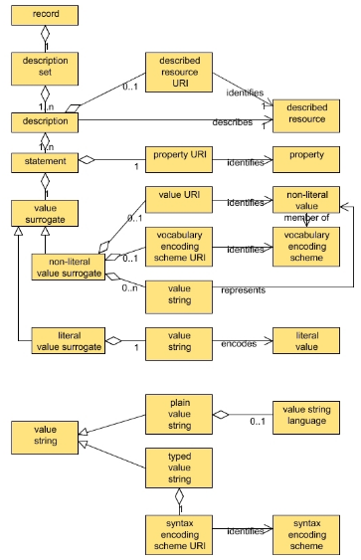
Dublin Core Abstract Model
DC gone off the deep end
RDF-inspired
Basic premise is that conformance to the same underlying models is a fundamental requirement for metadata interoperability
New generation of DCMI standards and resources built on this core
Encodings
Interoperability levels
Application profile guidelines and syntax

Slide 9
Why is it so hard for library-types to wrap our brains around all of this?
The underlying model of DCAM, RDF, and the Semantic Web has some significant differences from the models we’re used to.
It’s all very, well, meta.

Slide 10
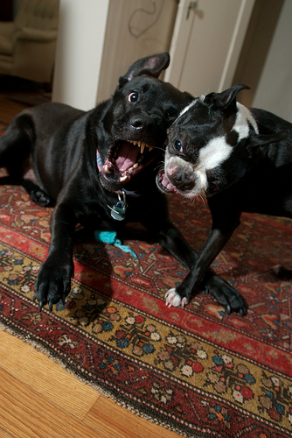
We’re basically doing this right now.
http://www.flickr.com/ photos/blogjamdotorg/ / CC BY-NC 2.0

Slide 11
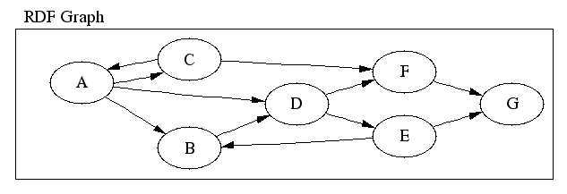
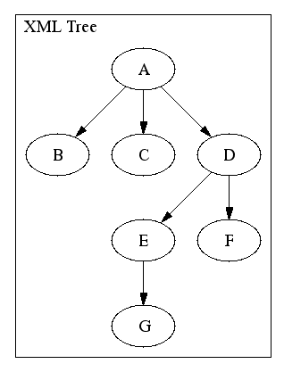
Walsh, Norman. (2003). “RDF Twig: Accessing RDF Graphs in XSLT.” Extreme Markup Languages Conference, 4 - 8 August, 2003, Montreal, Quebec, Canada.
http://nwalsh.com/docs/articles/extreme2003/

Slide 12
An example from V/FRBR at IU

Slide 13
XML – top down
RDF – bottom up

Slide 14
RDF Schema ≠ XML Schema
RDF Subject ≠ Library Subject

Slide 15
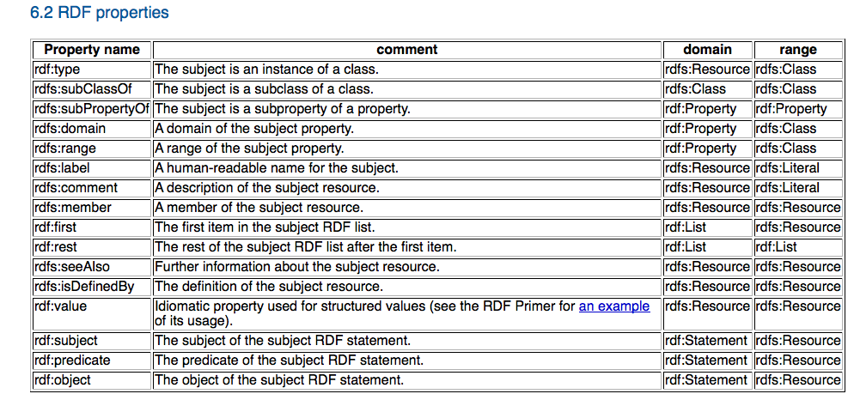
RDF Vocabulary Description Language 1.0: RDF Schema. http://www.w3.org/TR/rdf-schema/

Slide 16
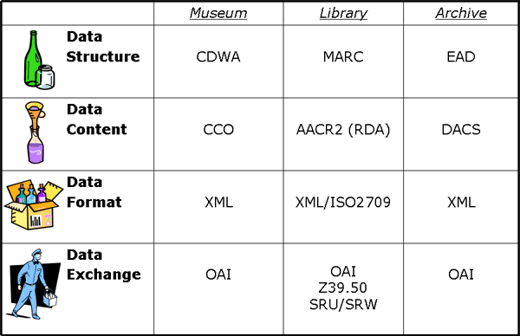
But we’re used to thinking this way
Elings, Mary W., and Günter Waibel. (March 2007). “Metadata for All: Descriptive Standards and Metadata Sharing Across Libraries, Archives, and Museums.” First Monday 12(3). http://firstmonday.org/article/view/1628/1543

Slide 17
Some key realizations
XML elements aren’t RDF properties
XML model speaks to our comfort with authority and “following the rules”
RDF talks about element sets as vocabularies
RDF model is intentionally additive
But is potentially fragile from missing linkages
RDF pushes humans further back in the process; it doesn’t remove them entirely

Slide 18
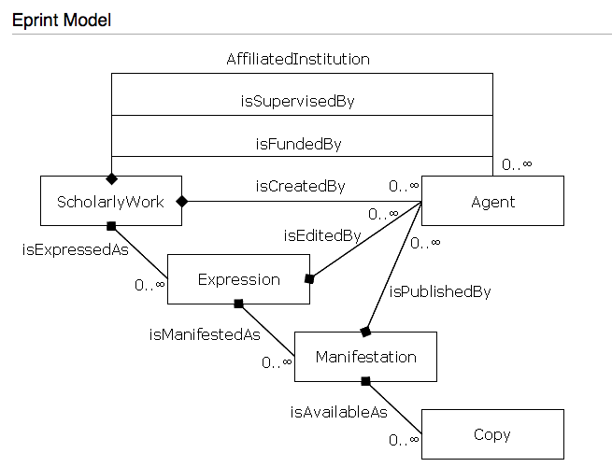
Scholarly Works Dublin Core Application Profile. http://www.ukoln.ac.uk/repositories/digirep/index/Model

Slide 19
Who’s here?

Slide 20
“…accustomed patterns of operation and existing standards do not serve us well in a Web environment.”
Library of Congress Working Group on the Future of Bibliographic Control. On the Record. http://www.loc.gov/bibliographic-future/news/lcwg-ontherecord-jan08-final.pdf

Slide 21
Potential ≠ Success

Slide 22
Potential ≠ Success

Slide 23
Potential ≠ Success

Slide 24
So what do we do now?
(Do we even need to do anything?)
(Or are new and revised XML formats going to be enough?)

Slide 25
Balance building infrastructure with facilitating production

Slide 26
Here’s what we know
Libraries have to move data to the Web
URIs are good
Relegating information to notes comes back to bite you
Libraries are already making tentative investments in these technologies
But…
We have trouble accepting things “not invented here”
DC 1:1 principle ran into problems in practice
Systems never evolved to handle the more functional metadata structures we planned

Slide 27
“Over the course of time we have largely let go of our Aristotelian belief that there is only one right and true tree of knowledge, but we have behaved as if the rule was still in effect because we have had to use atoms—usually paper—to preserve and transmit information.”
Weinberger, David. (2007). Everything is Miscellaneous: The Power of the New Digital Disorder. New York: Times Books, p. 82.
I believe we can apply this thinking to system design as well.

Slide 28
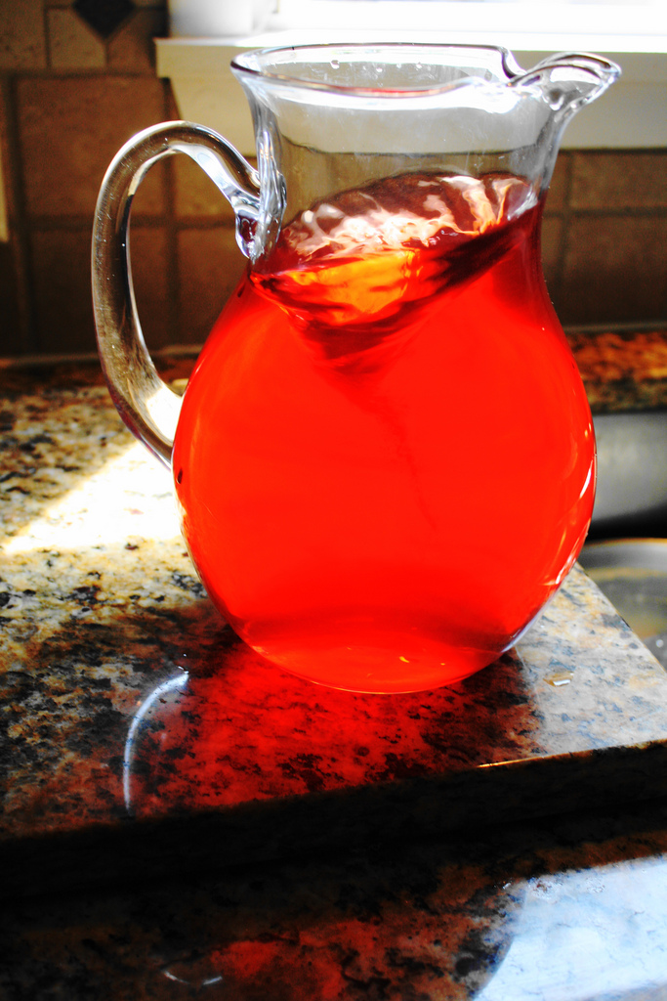
I’m about to drink it…
http://www.flickr.com/ photos/lawcrow911/ / CC BY-NC-SA 2.0

Slide 29
Take these opportunities (1)
Blacklight/VuFind/etc.
We have more control over these discovery systems than we’ve had, well, ever
They’re getting a lot of press, support, and funding
They can show off in concrete ways what’s possible if our data is in better shape
Participate in the growing Linked Data community

Slide 30
Take these opportunities (2)
Hide structured metadata behind web pages generated for humans
Participate in a possible DCAM revision
Help push the theory into practice
RDA implementation as RDF properties
This one I’m not so sure of

Slide 31
Can we define our models deeply enough that both graph and tree renderings are possible?
(If so, is it worth it?)

Slide 32
Working incrementally
Semi-formal data dictionaries
Phase 1?
Minting URIs
UML & other formal model representations
Phase 2?
RDF & OWL representations
Phase 3?
DCAM conformance

Slide 33
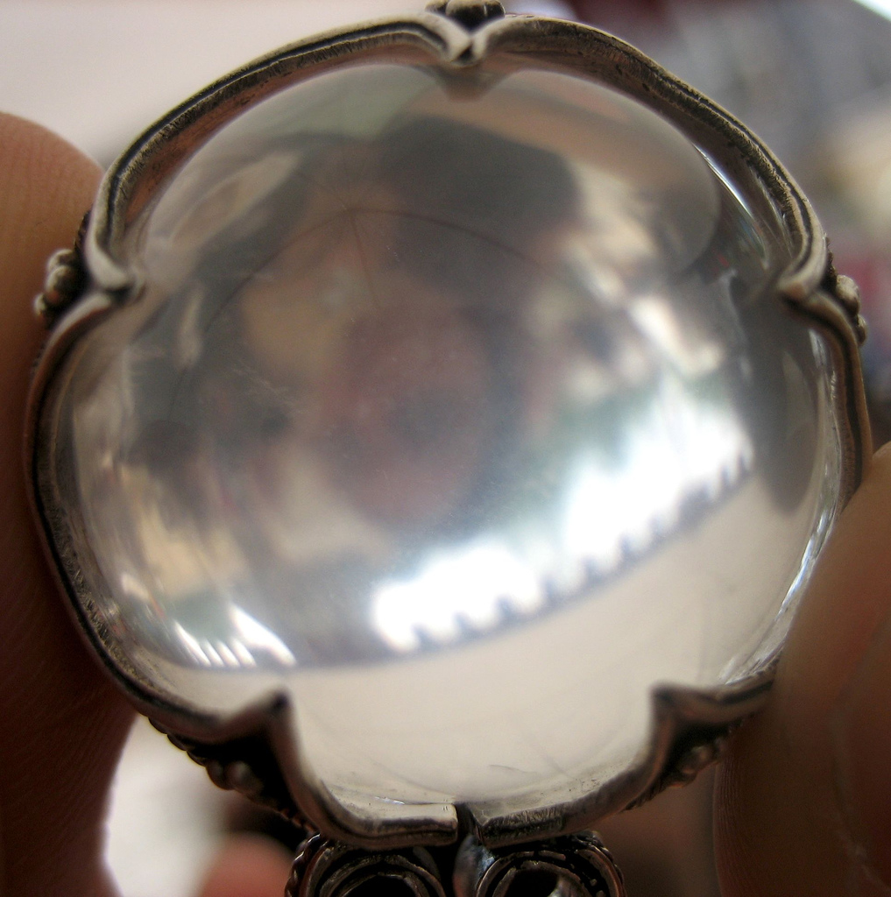
http://www.flickr.com/photos/mararie/ / CC BY-SA 2.0

Slide 34
Thank you!
jenlrile@indiana.edu
These presentation slides: http://www.dlib.indiana.edu/~jenlrile/presentations/uiuc2010/semanticize.pptx

